Slide 1
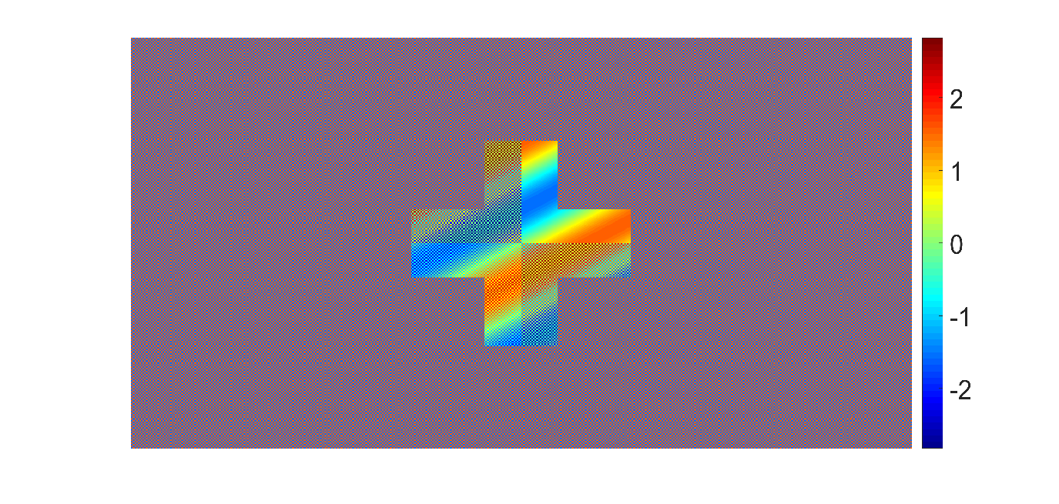
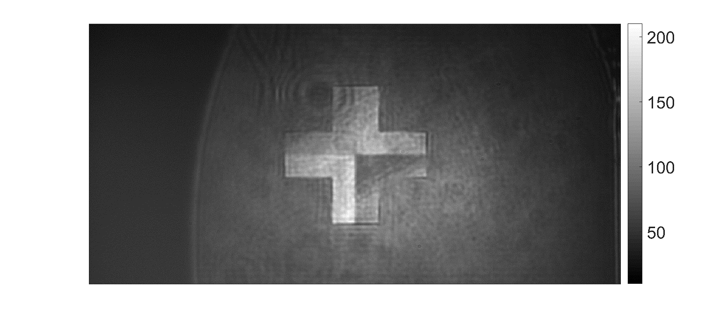
phase element
camera image
pixel cell 1

Slide 2

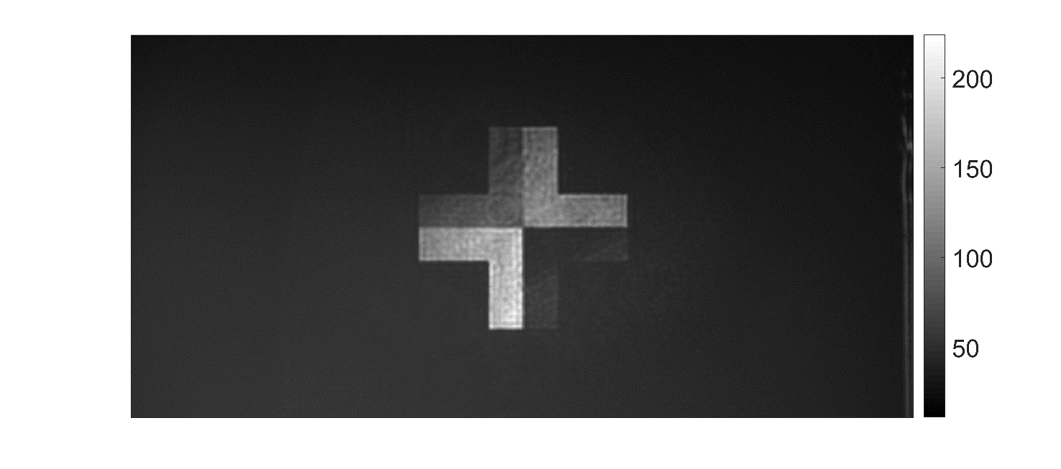
phase element
camera image
pixel cell 4

Slide 3

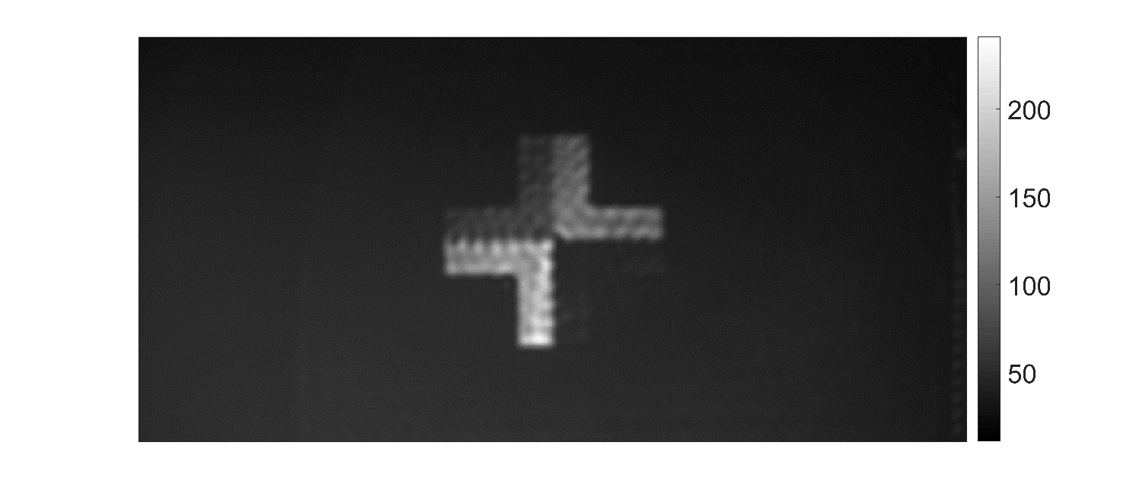
phase element
camera image
pixel cell 20

