Slide 1
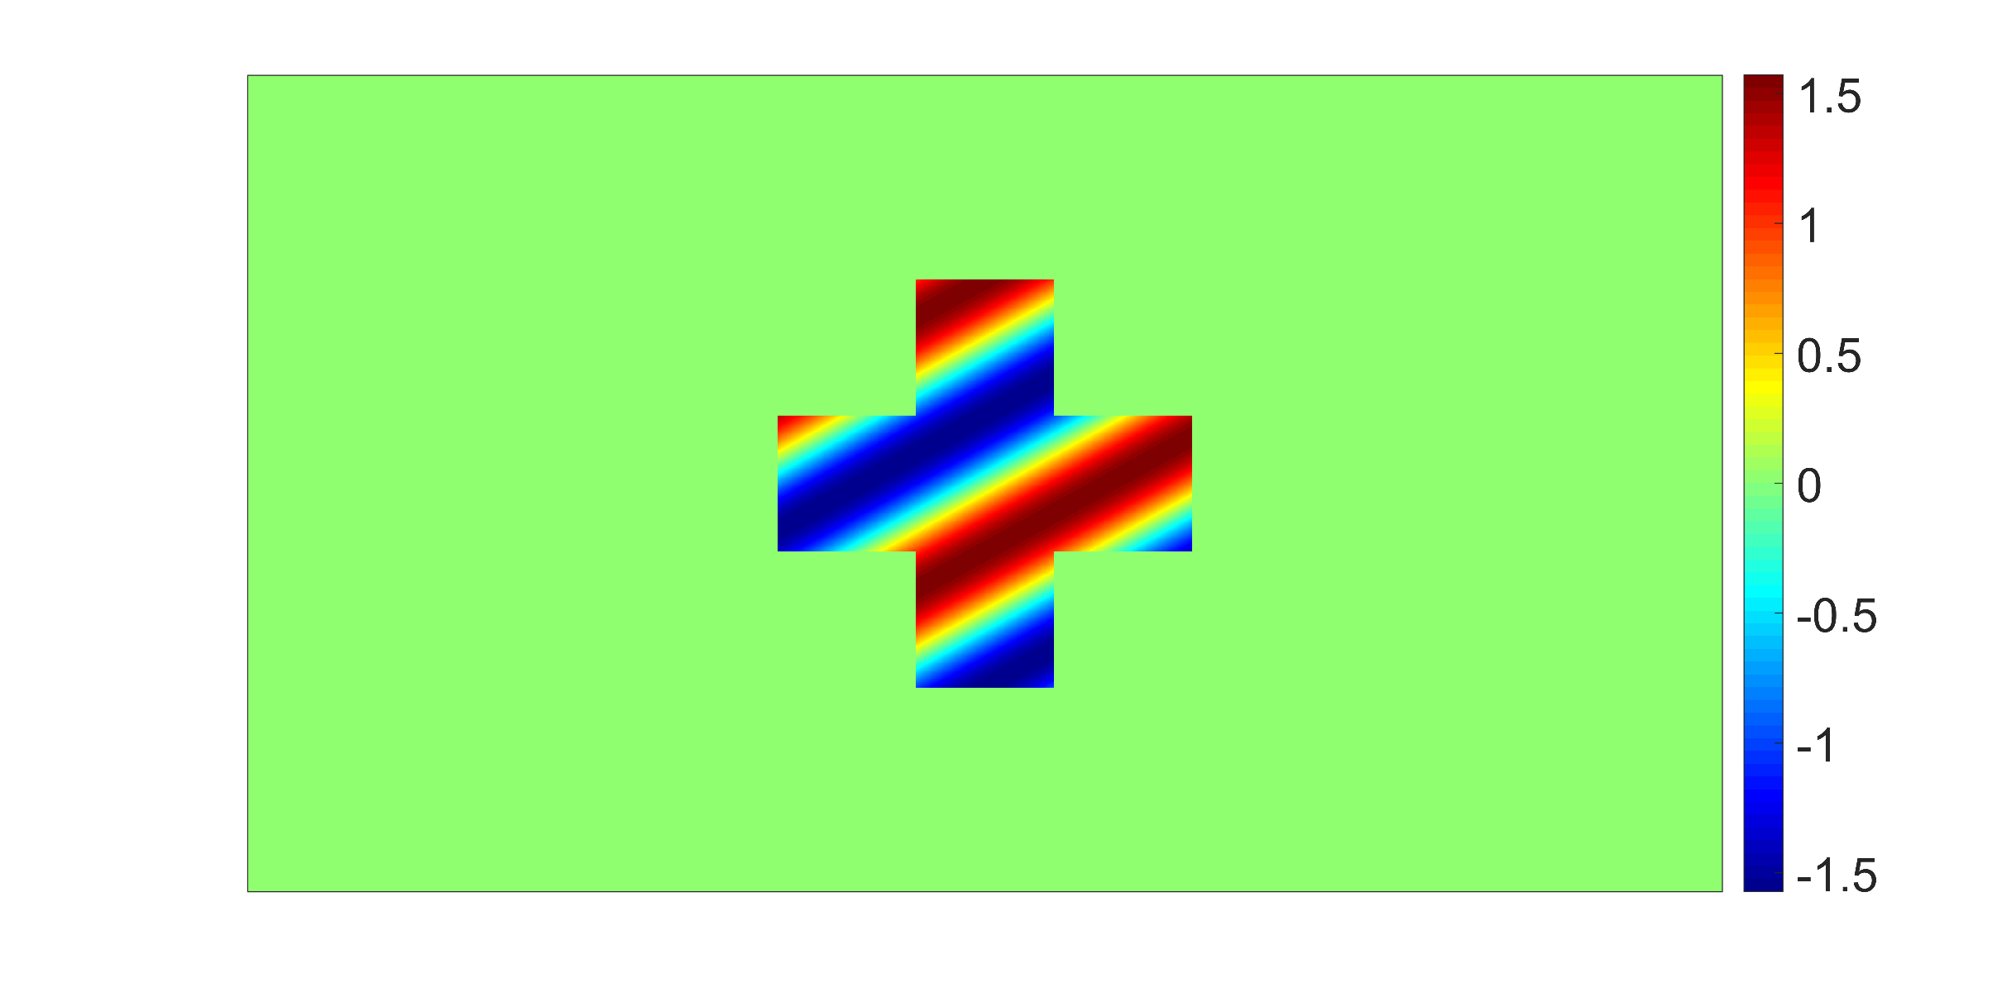
ϕ(x, y)

