Slide 1
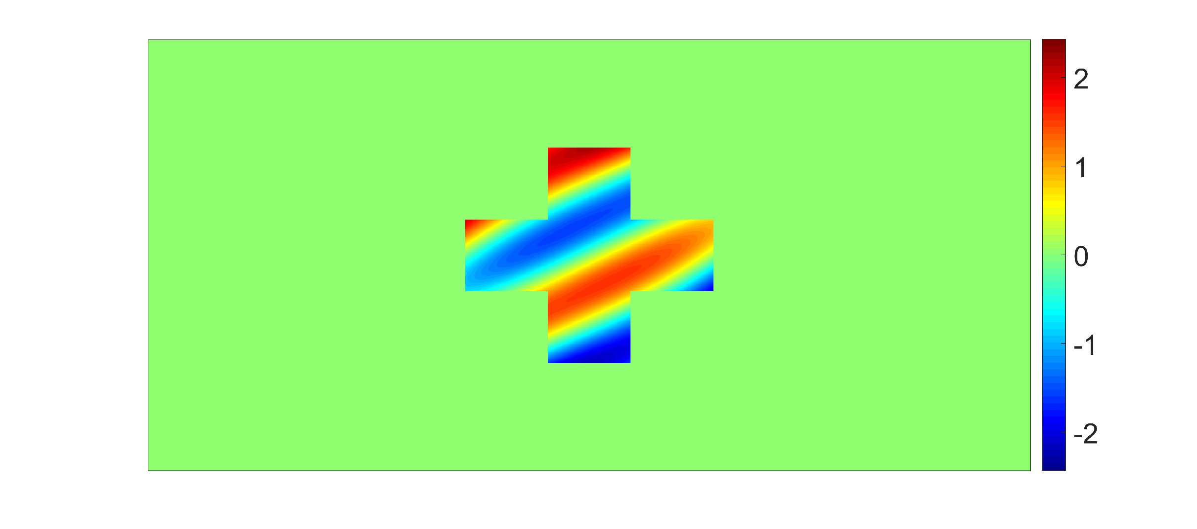
original phase minus laser phase

