Slide 1
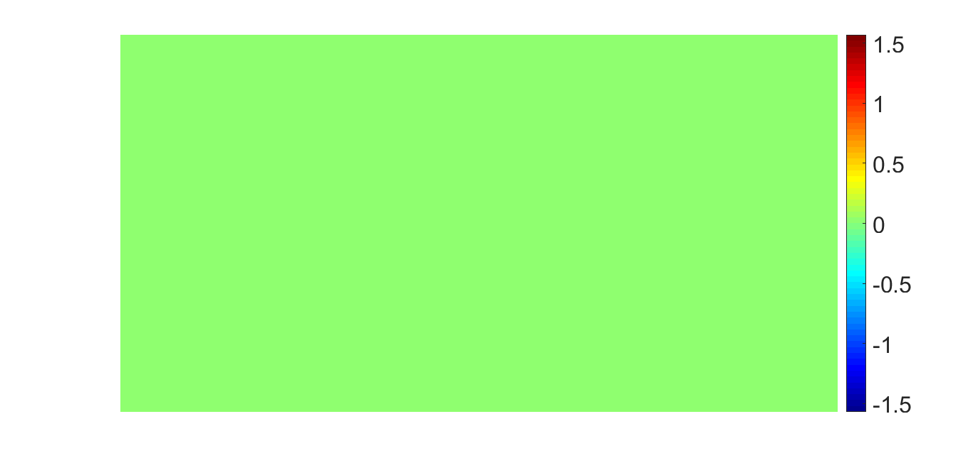
flat phase sent to SLM

