Slide 1
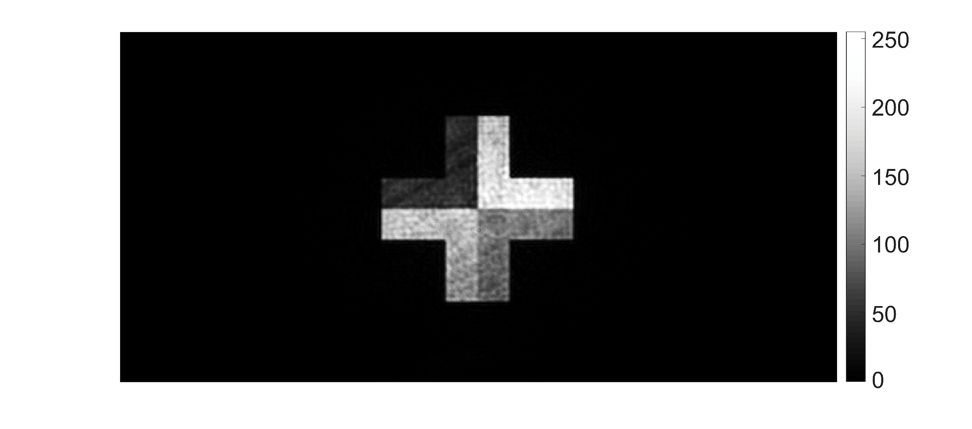
final retrieved amplitude

