Slide 1
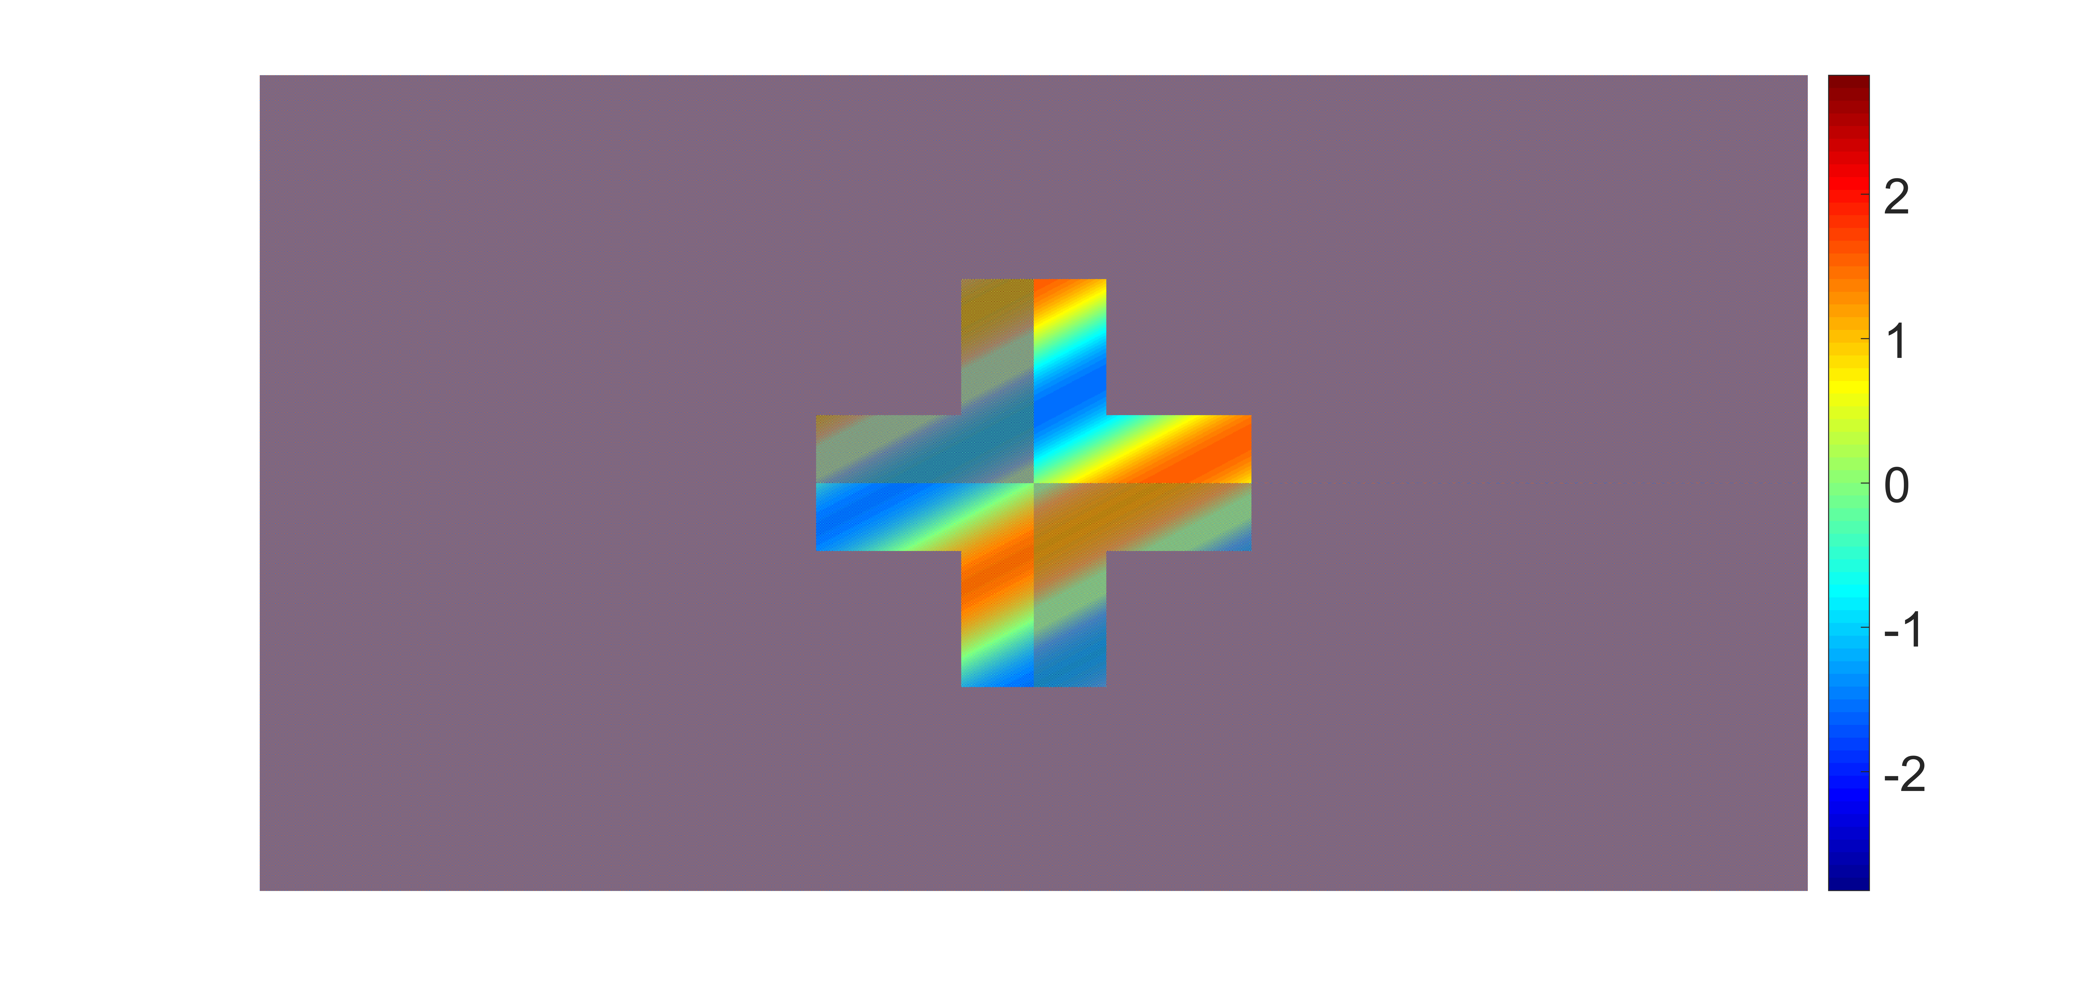
equation 5 with pixel cell 1

Slide 2

equation 5 with pixel cell 12

Slide 3

equation 5 with pixel cell 20

Slide 4

equation 5 with pixel cell 30

