Slide 1
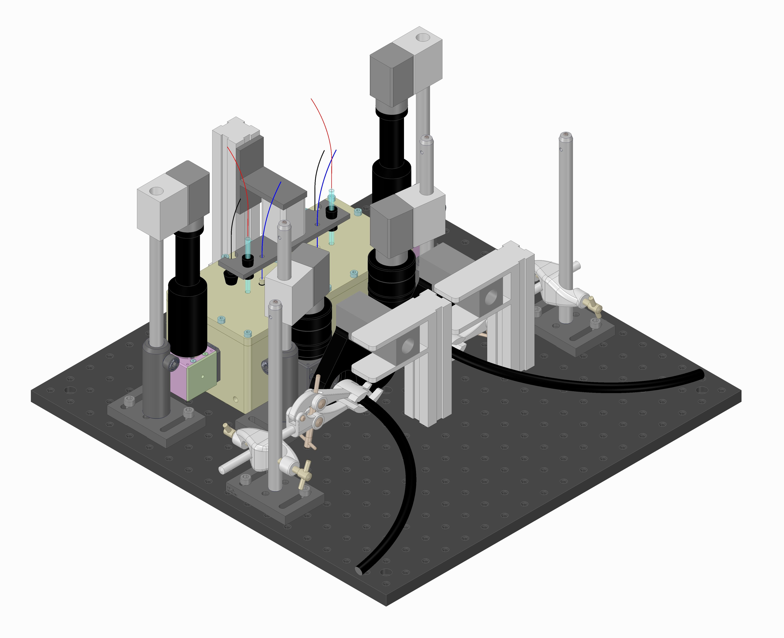
A
Potentiostats and shutter control box
B
cameras
(1)
samples
pneumatic
system
photoelectrochemical cell
Photoelectro-chemical set-up,
cameras
(2)
light shutters
light guides
Illumination source, PC
(3)
mirrors and
beam splitter
optical board
Capsule Control System
(4)
(5)
Photoelectrochemical Set-Up
Batteries
Drop capsule

