Slide 4
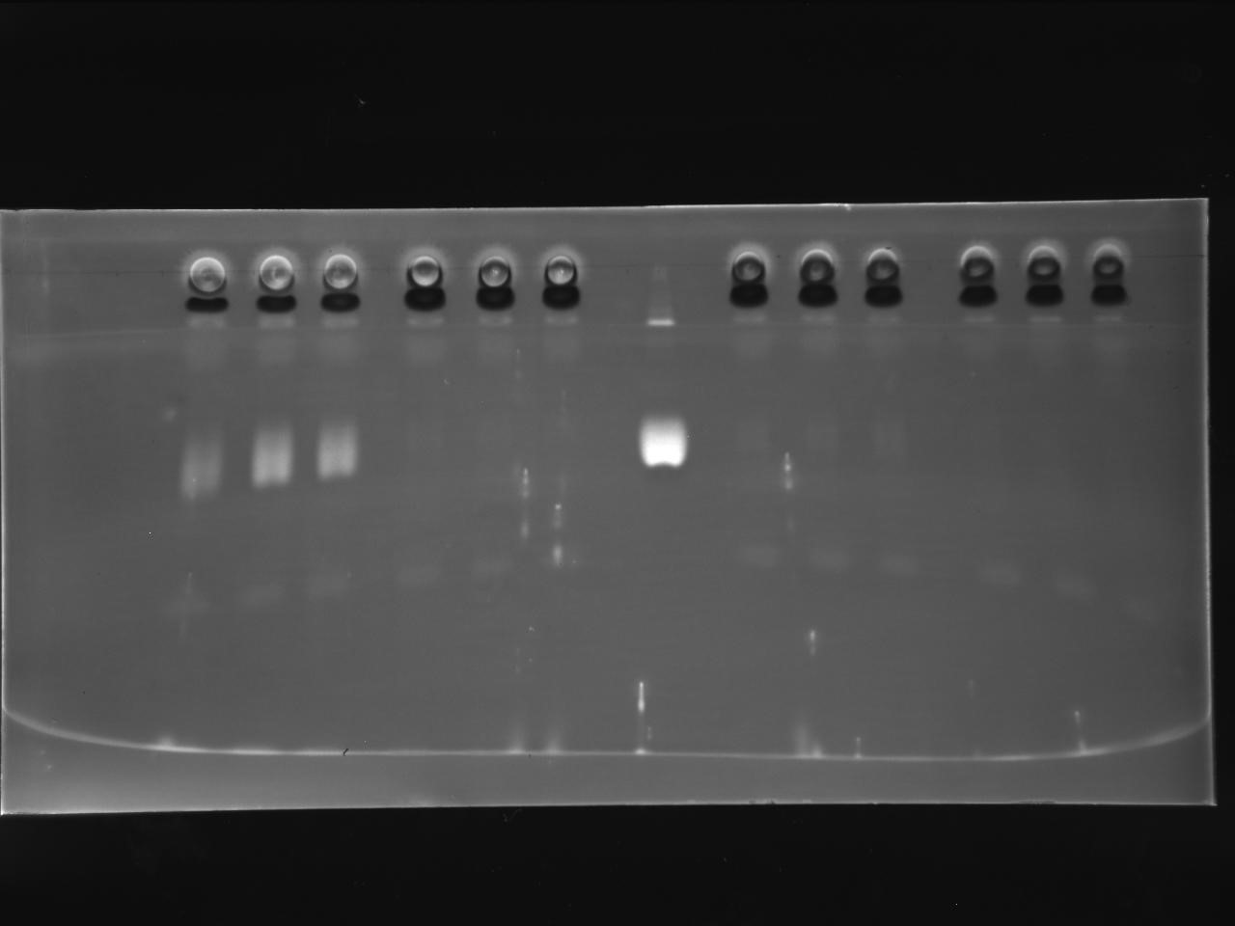
Control Treat1 Treat2 Treat3
TAG
Polar
Control
Treat1
Std
Treat2
Treat3

