Slide 1

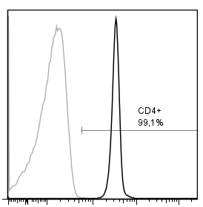

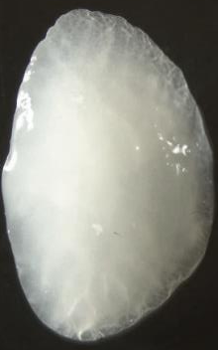
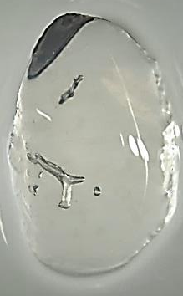
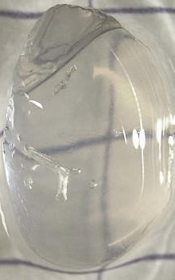
A
human T cells
i.v. transfer
papain
papain
papain
d0
d1
d2
d3
end of experiment
3 hours
papain inhalation
50 µg/ mouse
fluorescently labeled human T cells i.v.
1 x 10⁶ cells/ mouse
sacrifice
perfuse & fixate lung
optional: collect BAL
explant lung
B
purified hu CD4⁺ cells
C
D
before clearing
after clearing
purified hu CD4⁺ cells
99%
100%
Count
Count
FI (CD4)
FI (labeling)
CD4 staining
isotype control
labeled cells
unstained cells
1 mm
Figure 1

