Slide 1
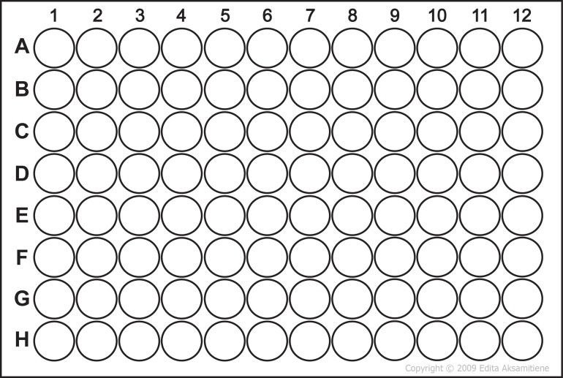
Figure 2: A) multichannel pipet set up with shown tip arrangement reaches every 3rd well across a row in the 96-well treatment plate. B) Map of the locations of ligands in the 96-well daughter treatment plates. The numbers correspond to the “Ligand Tube #” from Table 3. C) 8-well MEMA plate from 8 plate set showing how the multichannel spacing corresponds to the wells in the 8-well plate.
A
Designates destination wells on 8-well plates. I.e. Every ligand in column 1 of the 96-well treatment plate goes into well A01 of one of the 8-well MEMA plates
A01
B01
A02
B02
A03
B03
A04
B04
B
Plate 1
Plate 2
Plate 3
Designates destination plate for 8 plate 8-well MEMA set
Plate 4
Plate 5
Plate 6
Plate 7
Plate 8
C
The same tip spacing used to pick up the ligands from the 96-well treatment plate will reach the 4 wells in one row of the 8-well MEMA plate.
Ligand from A1
of 96-well plate
Ligand from A4
of 96-well plate
Ligand from A7
of 96-well plate
Ligand from A10
of 96-well plate
Ligand from A2
of 96-well plate
Ligand from A5
of 96-well plate
Ligand from A8
of 96-well plate
Ligand from A11
of 96-well plate

