Slide 1
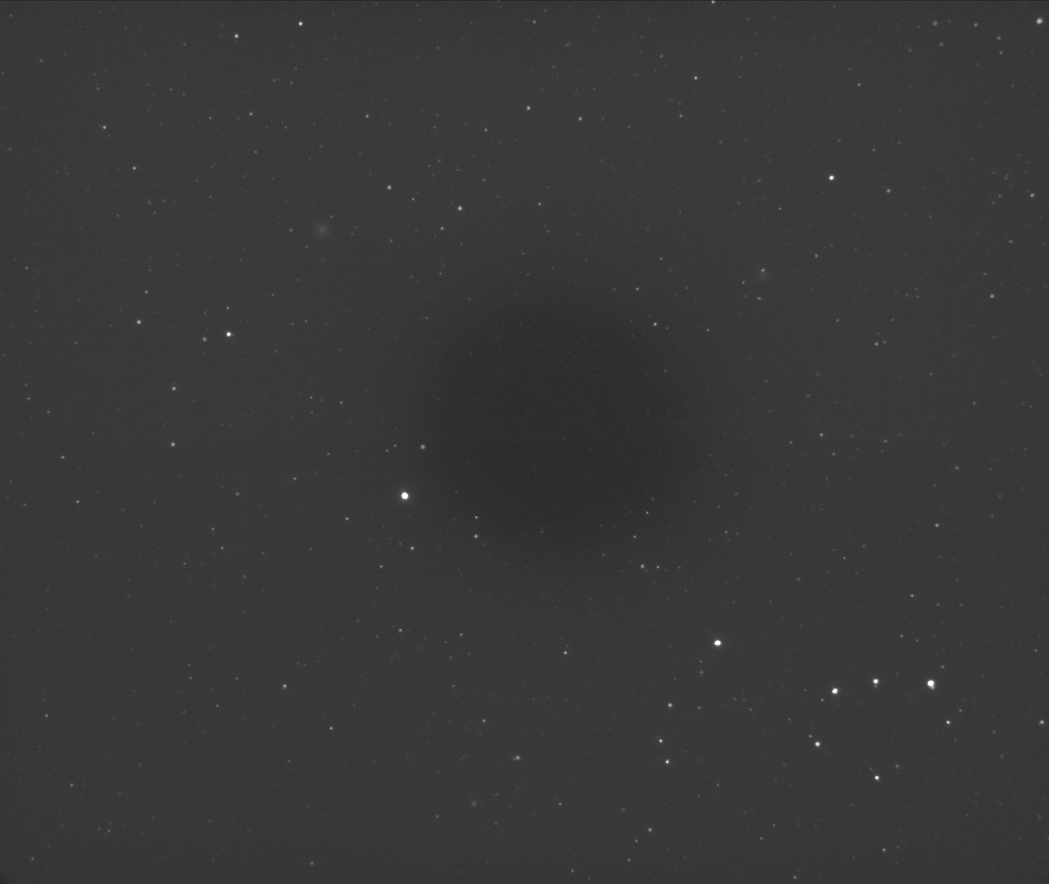
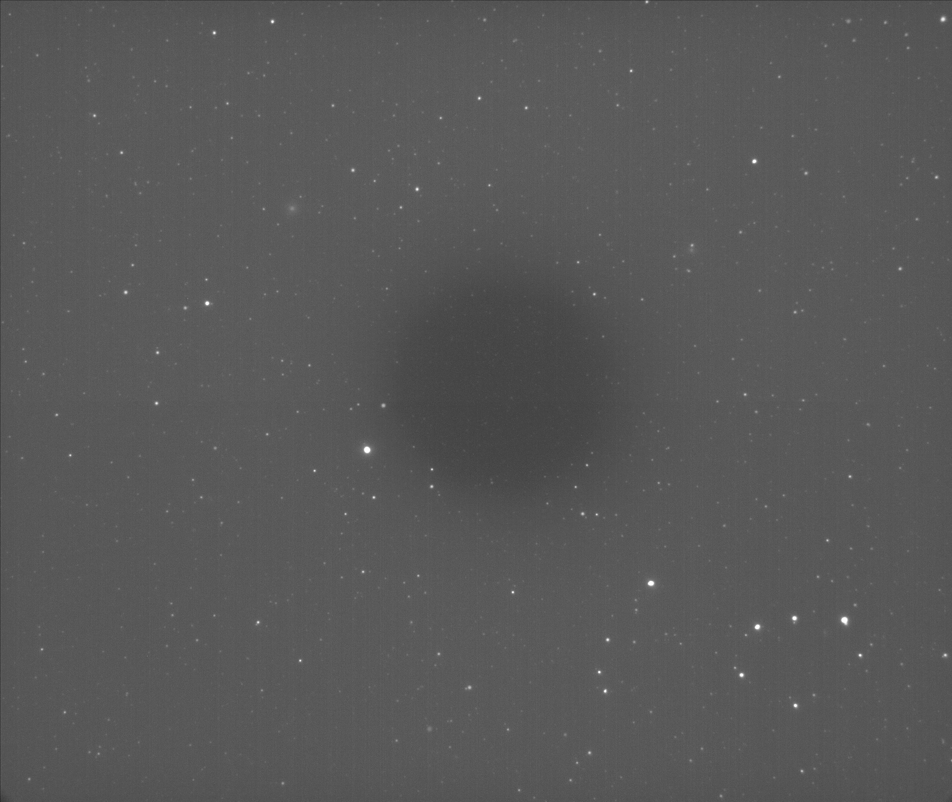
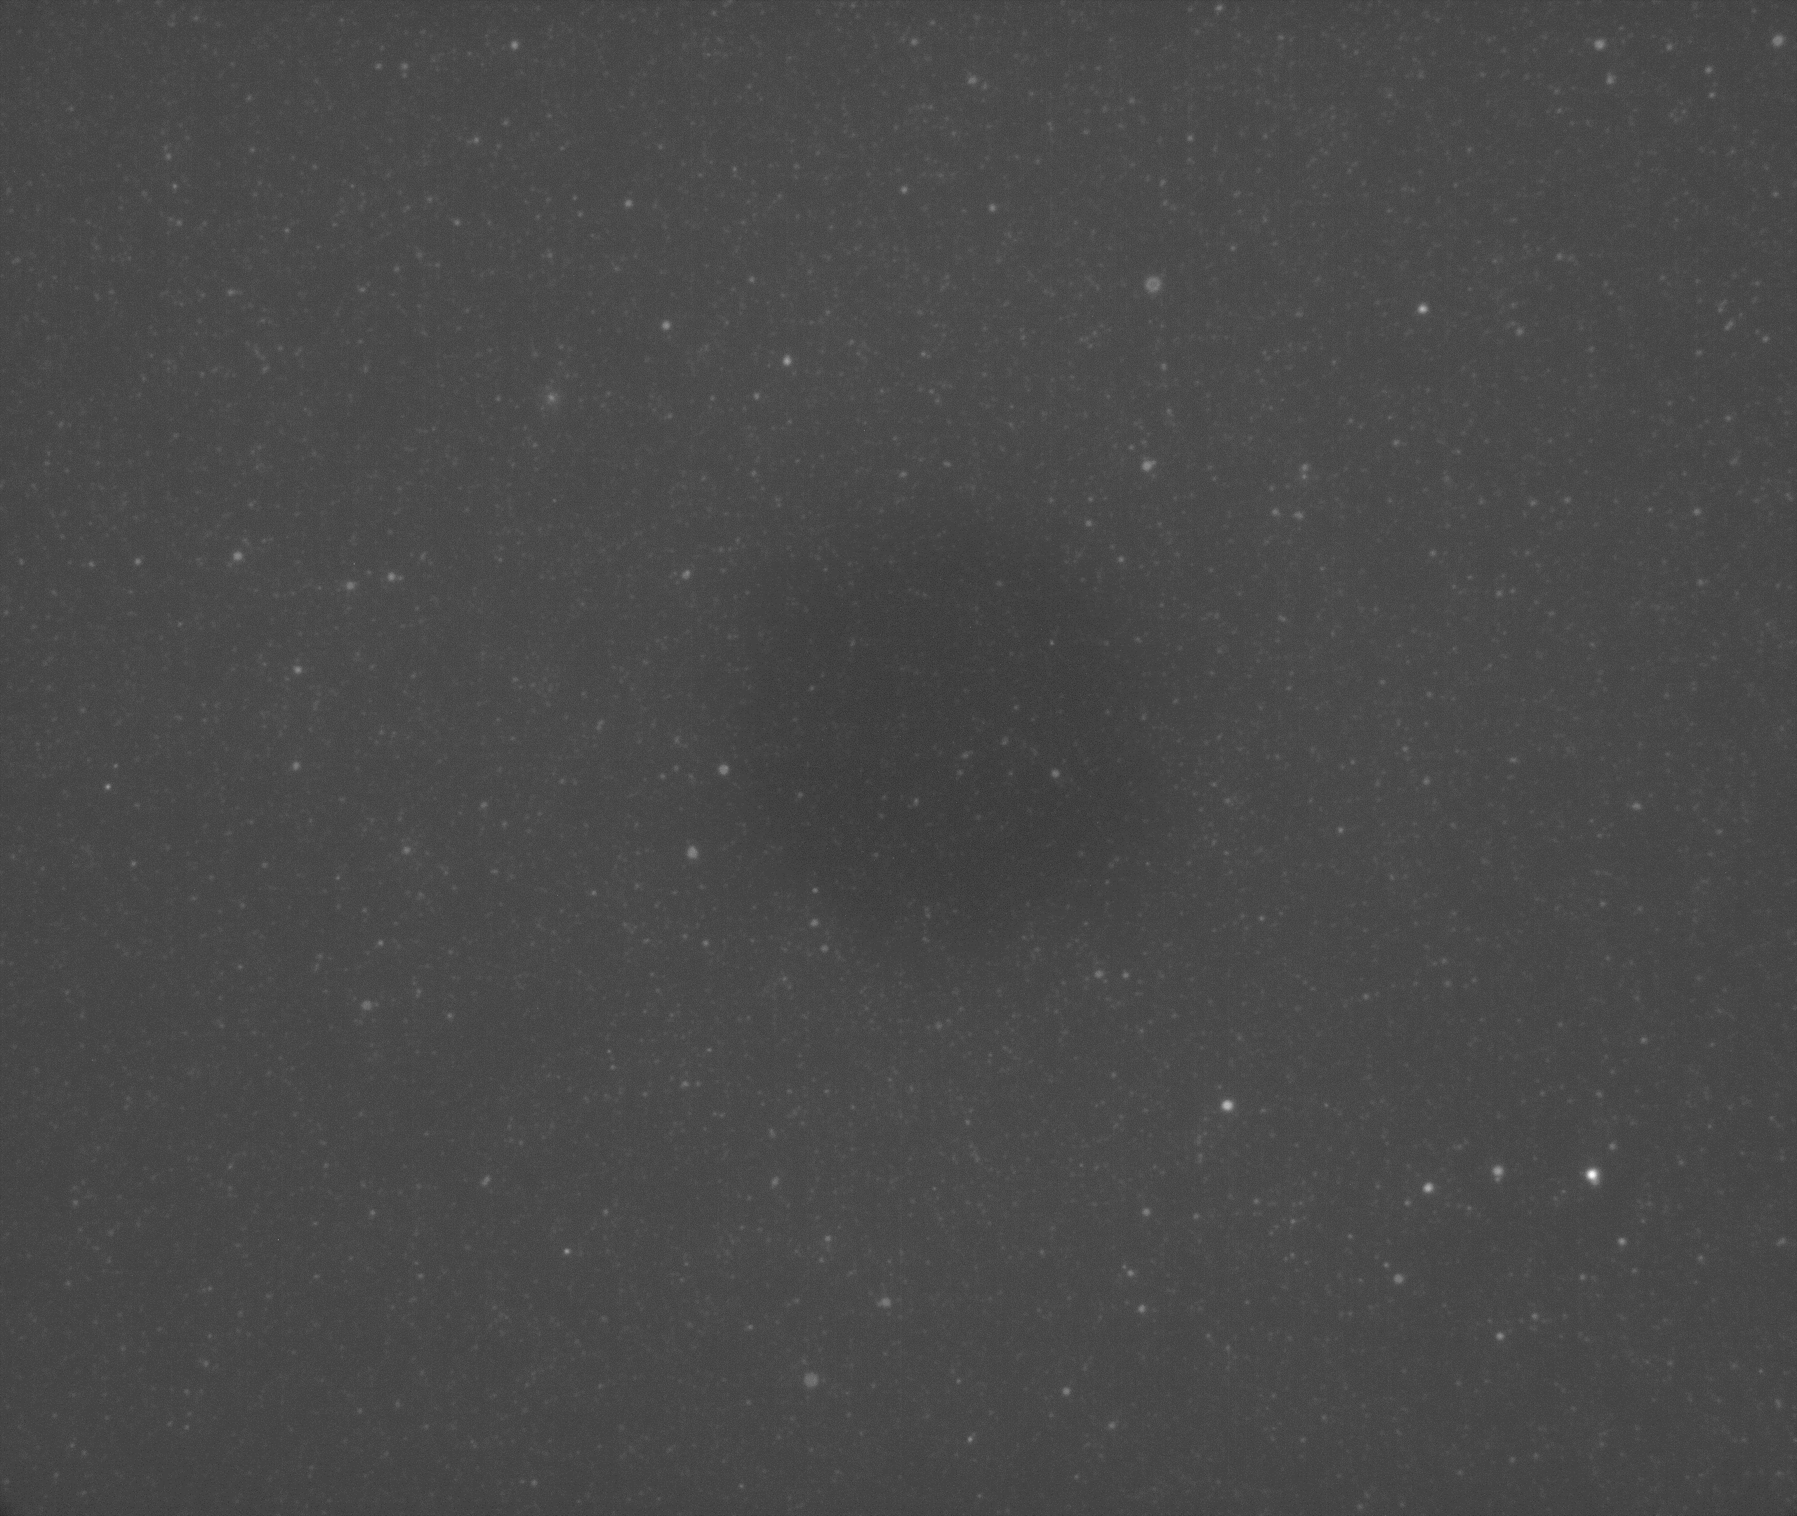
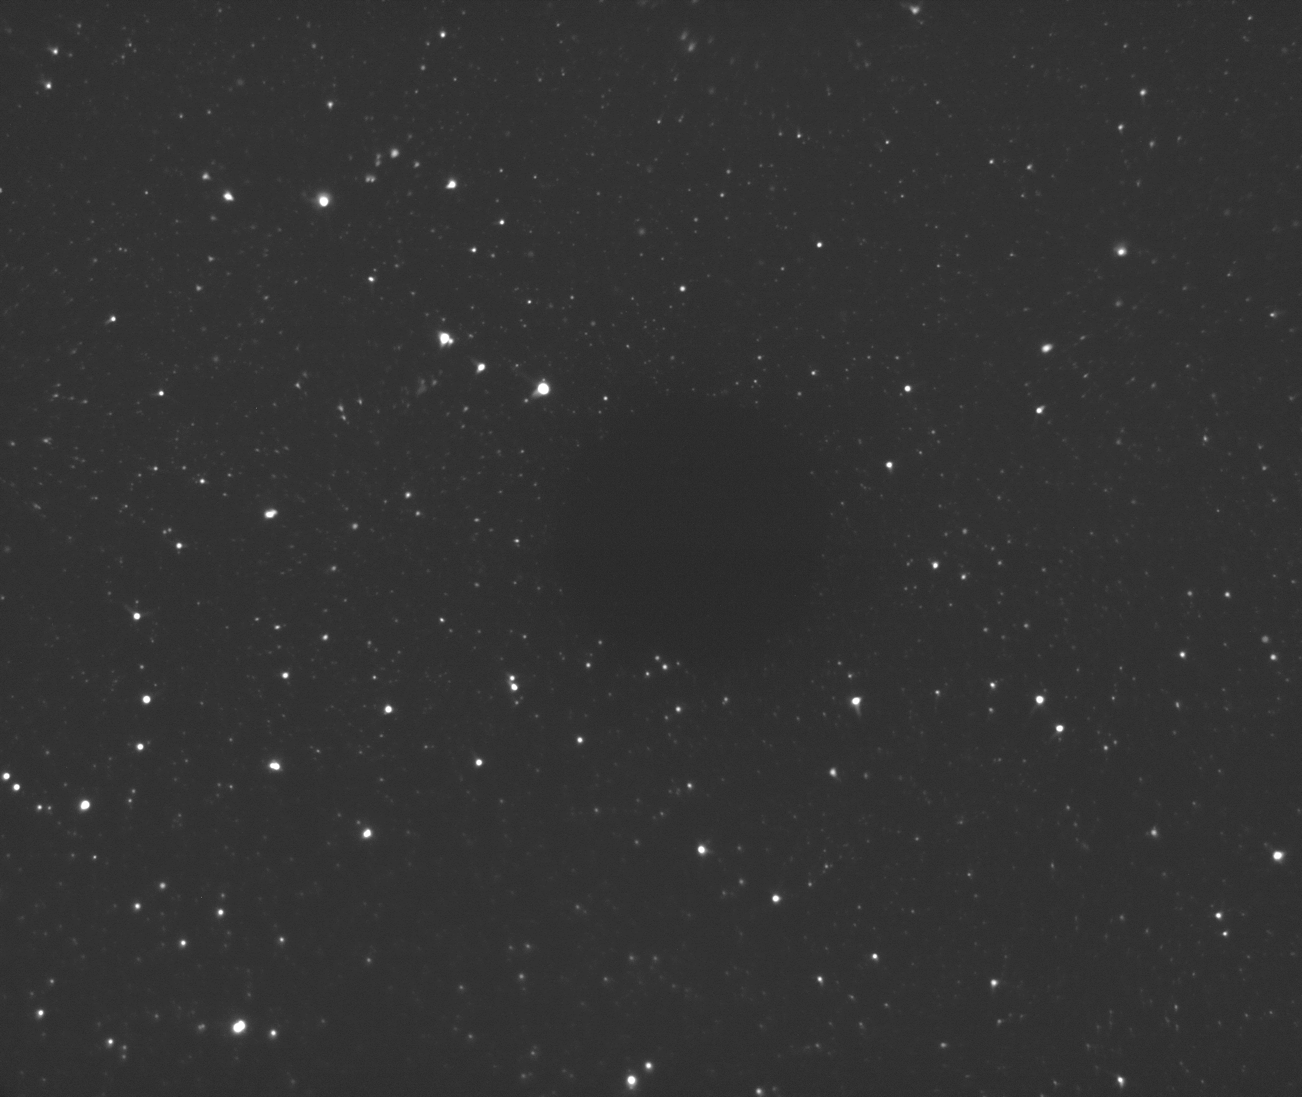
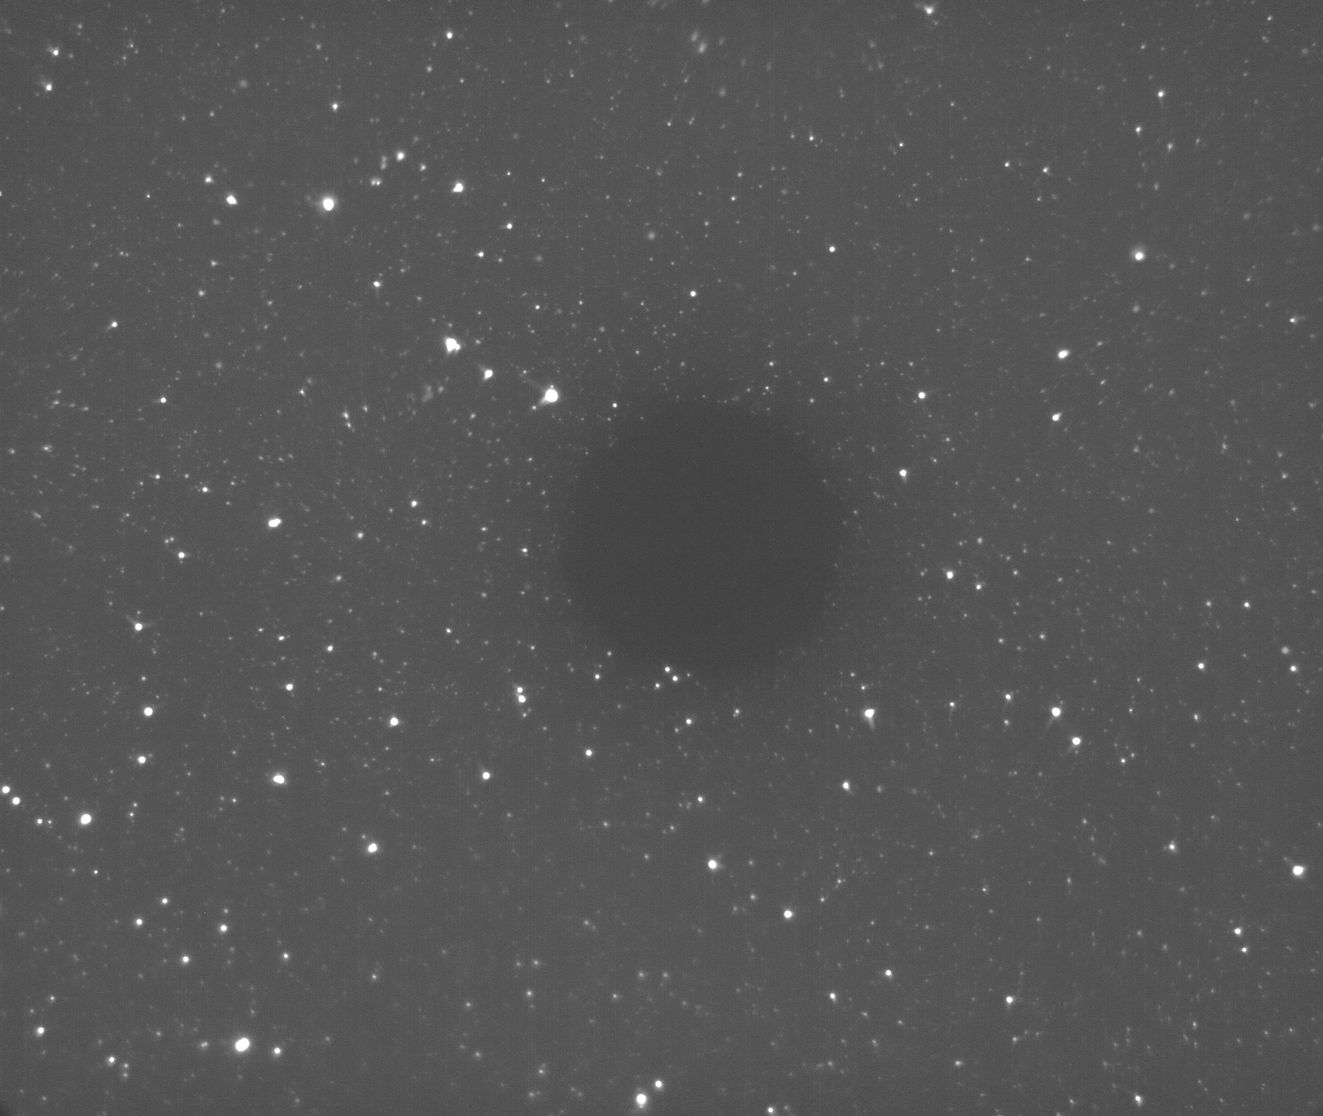
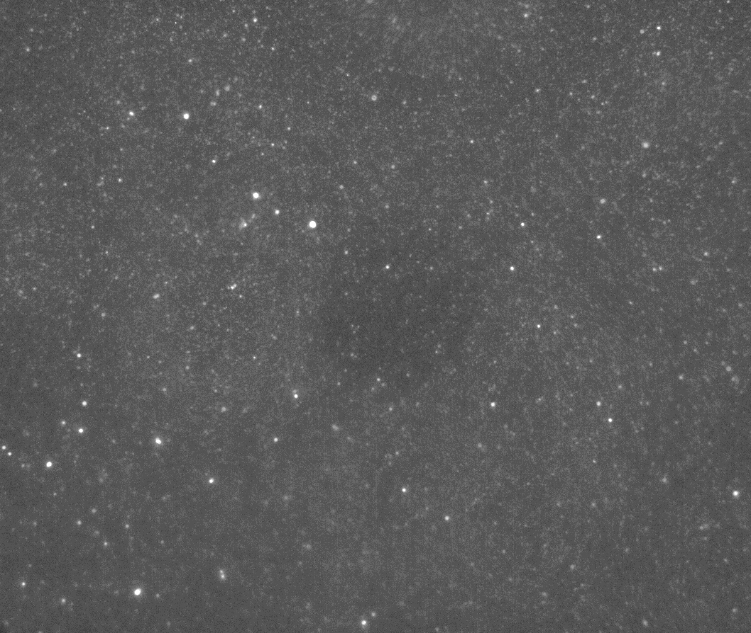
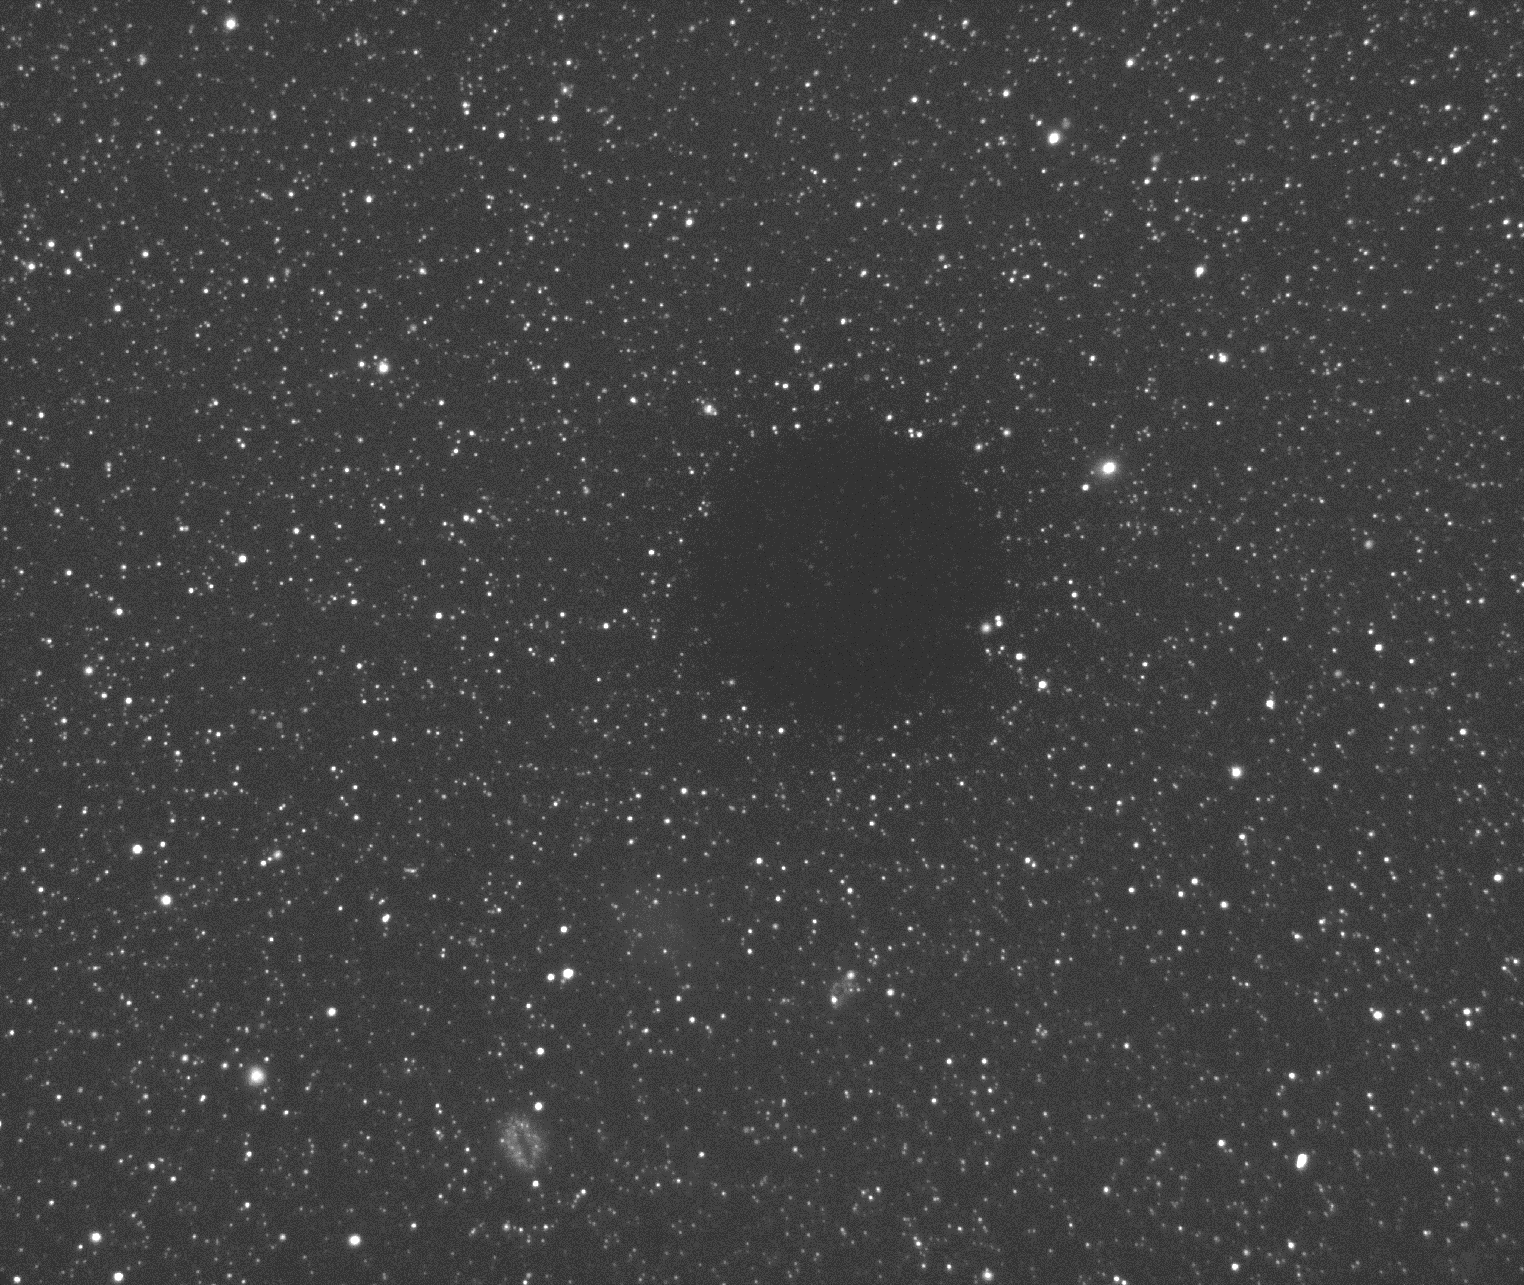
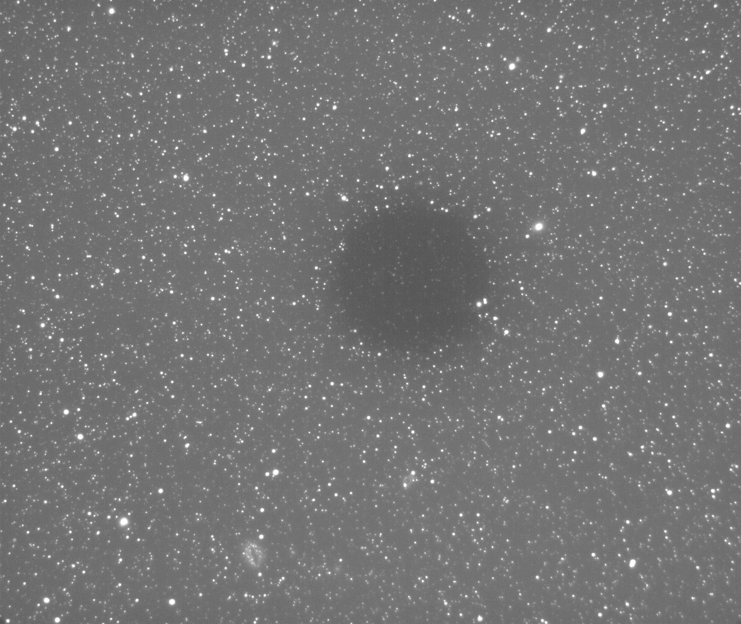
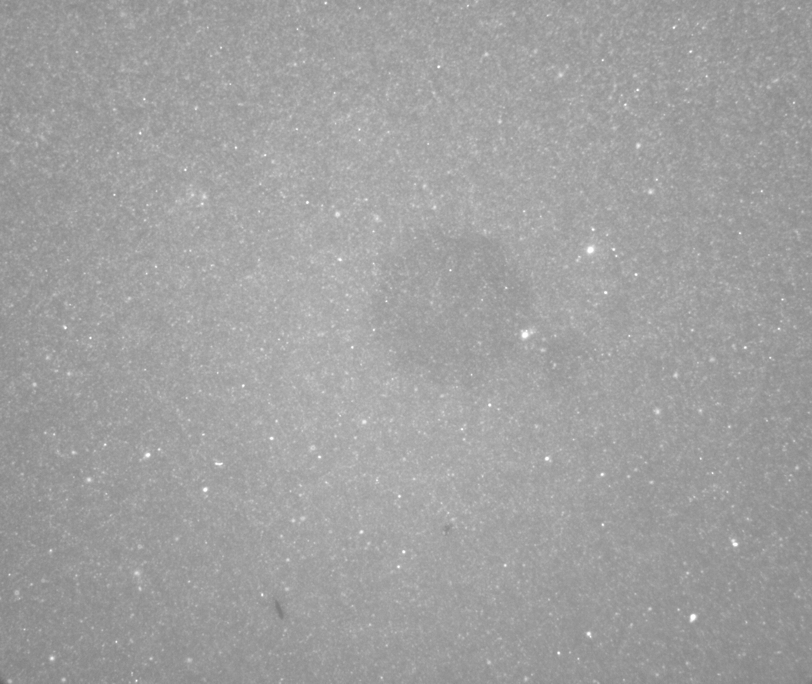
“HPTS_H”, ND1, 1s, 90x, Av8x
“HPTS_L”, ND1, 1s, 90x, Av8x
“Texas Red”, ND1, 1s, 90x, Av8x
Figure 3
470 / 535 nm
“HPTS 1”
410 / 535 nm
“HPTS 2”
560 / 645 nm
“Texas Red”
5 µg/mL
20 µg/mL
500 µg/mL

