Slide 1
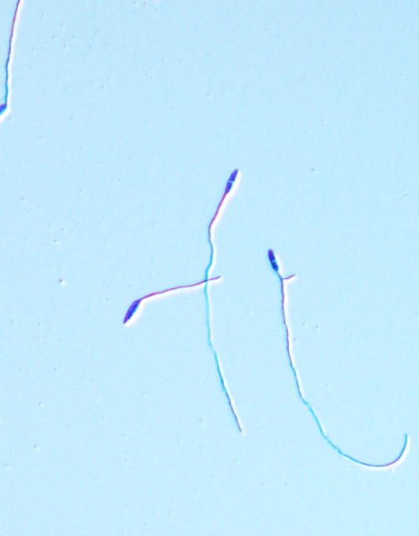
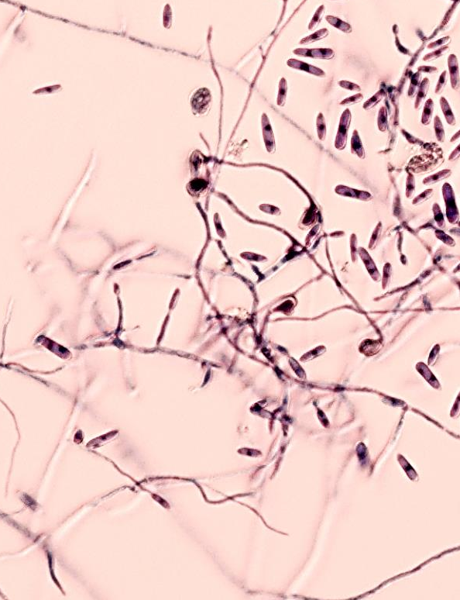
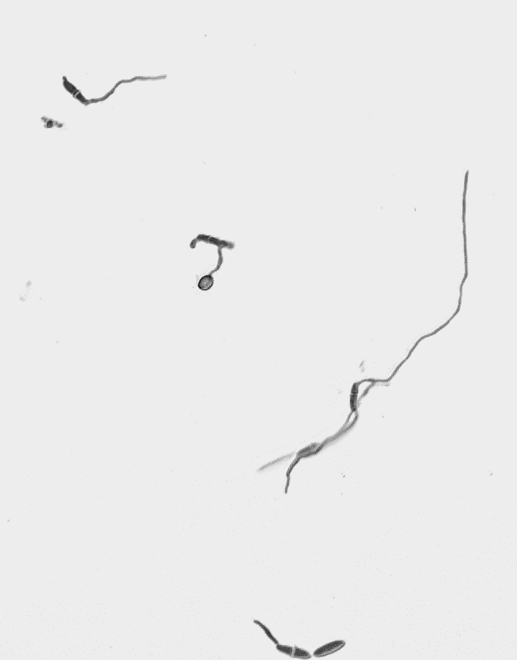
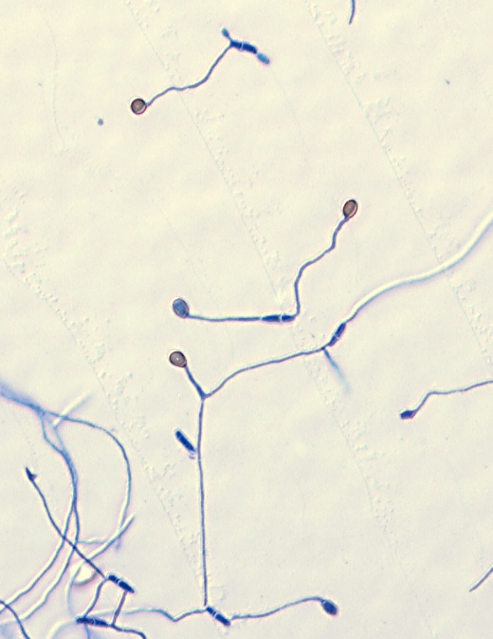
control
active-FE
control
40 µm
ch-FE
No Letters. Circles and Arrows

Slide 2
control
active-FE
control
40 µm
ch-FE
Circles Only

Slide 3
control
active-FE
control
40 µm
ch-FE
Arrows Only

