Slide 1
Setting up the Alice PDX for Home Sleep Testing
Participant Instruction Book

Slide 2
Step 1
Position blue belt with holster around your chest under your armpits with the buckle almost centered.
Holster should be in the center of your chest
Belt should be snug enough that the holster will stay in the center of your chest when you toss and turn during the night.
The arrow on belt buckle should point down.
See picture on next page

Slide 3
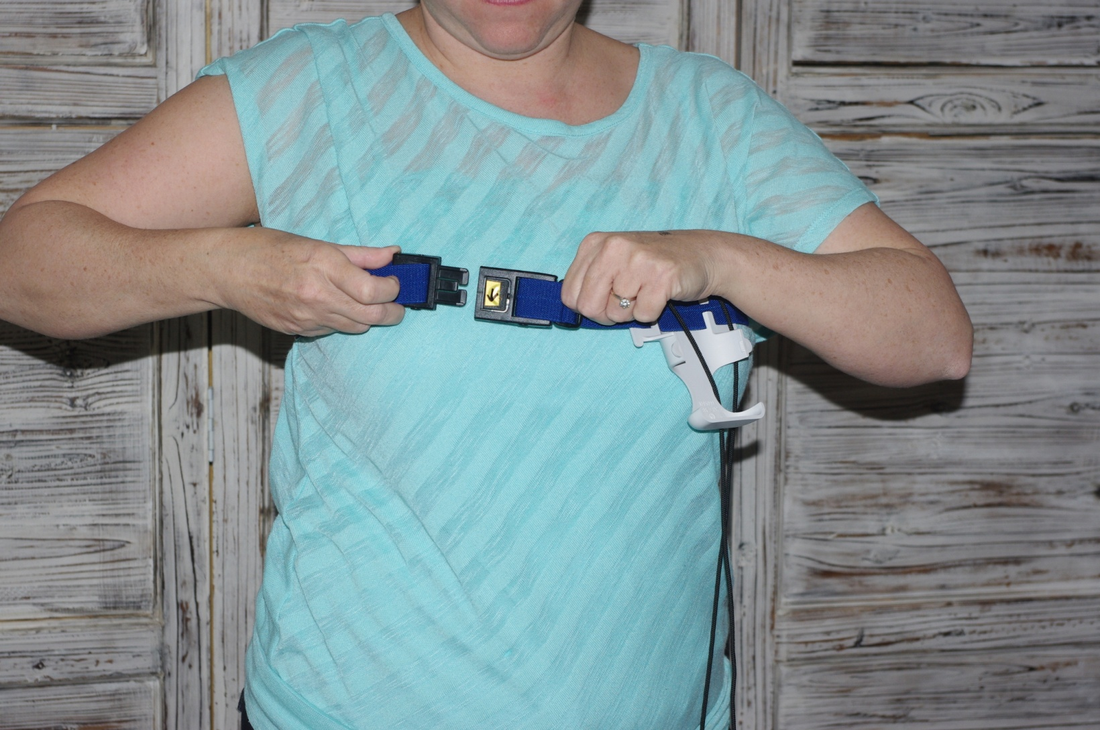
Step 1

Slide 4
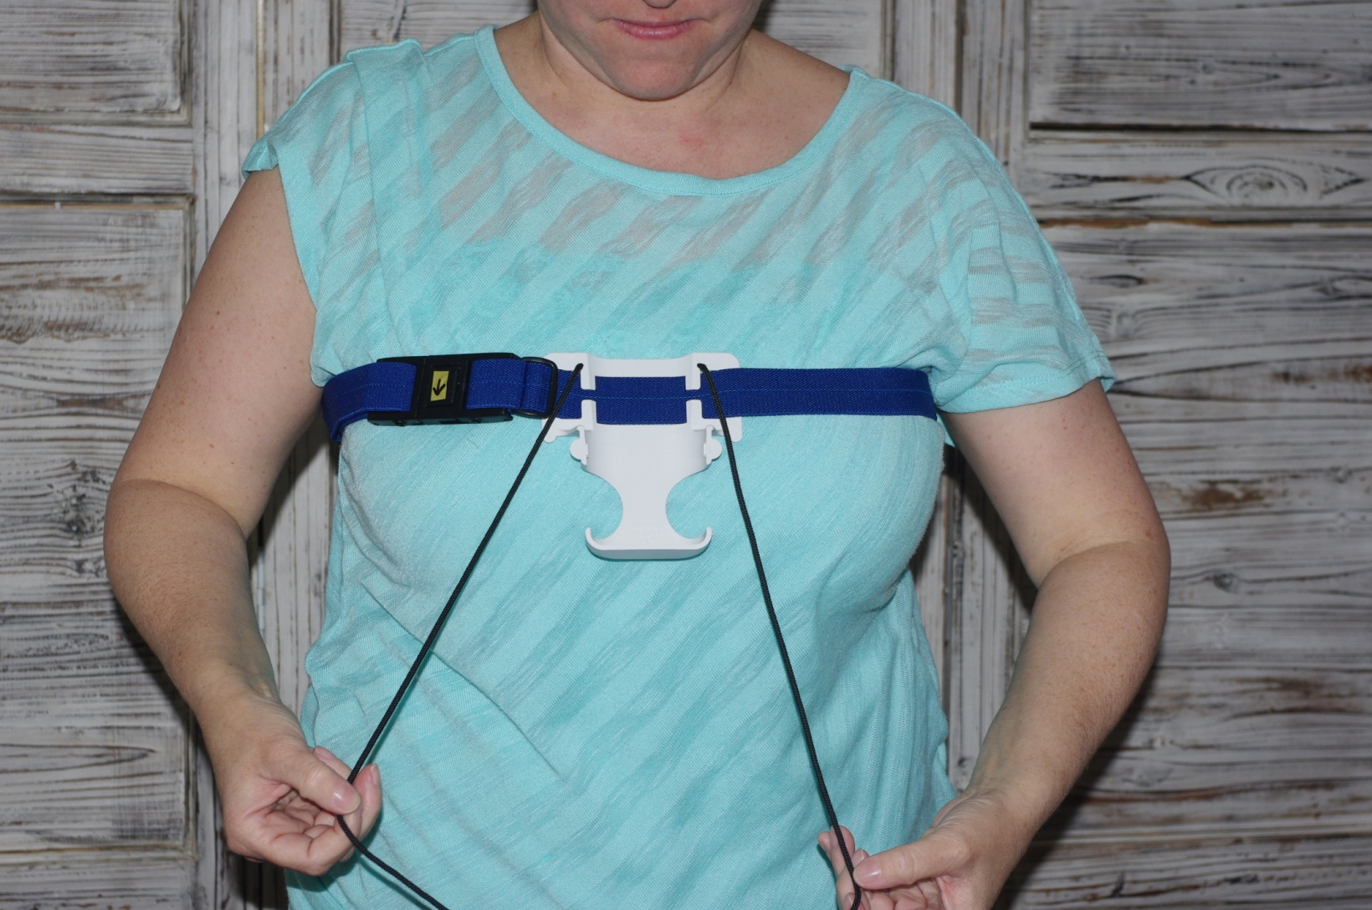
Step 1

Slide 5
Step 2
Place lanyard around your neck and adjust as needed

Slide 6
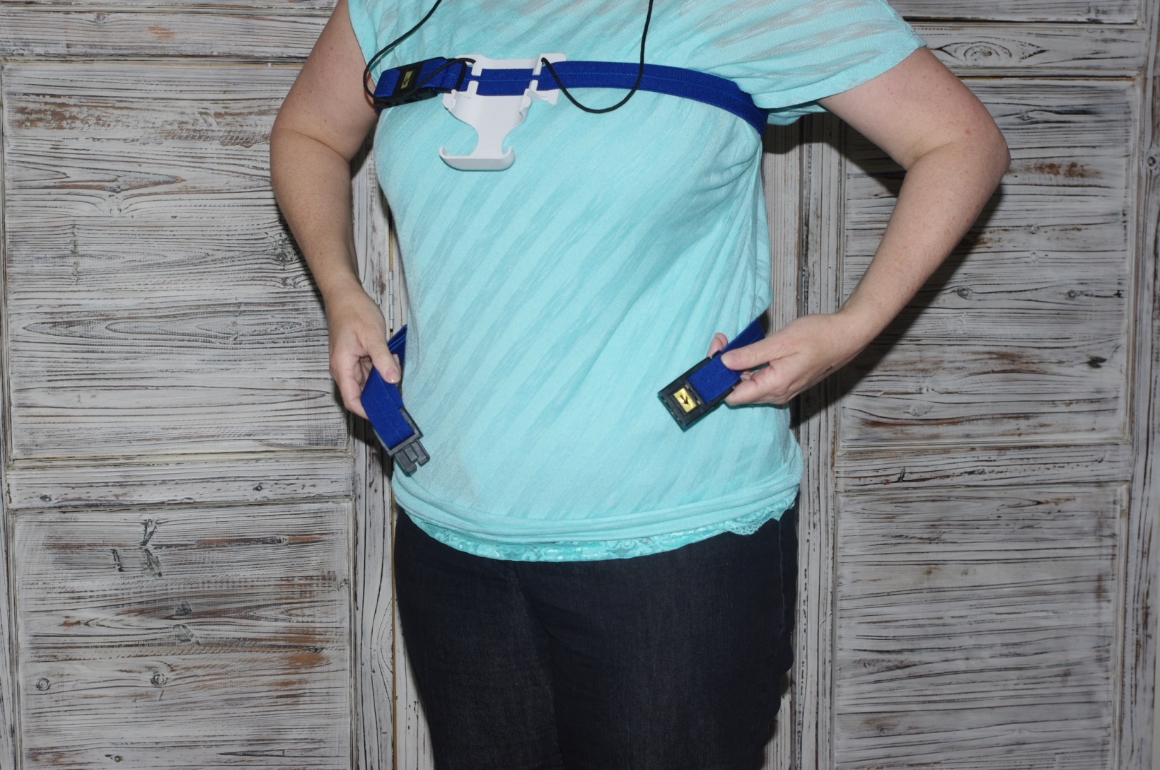
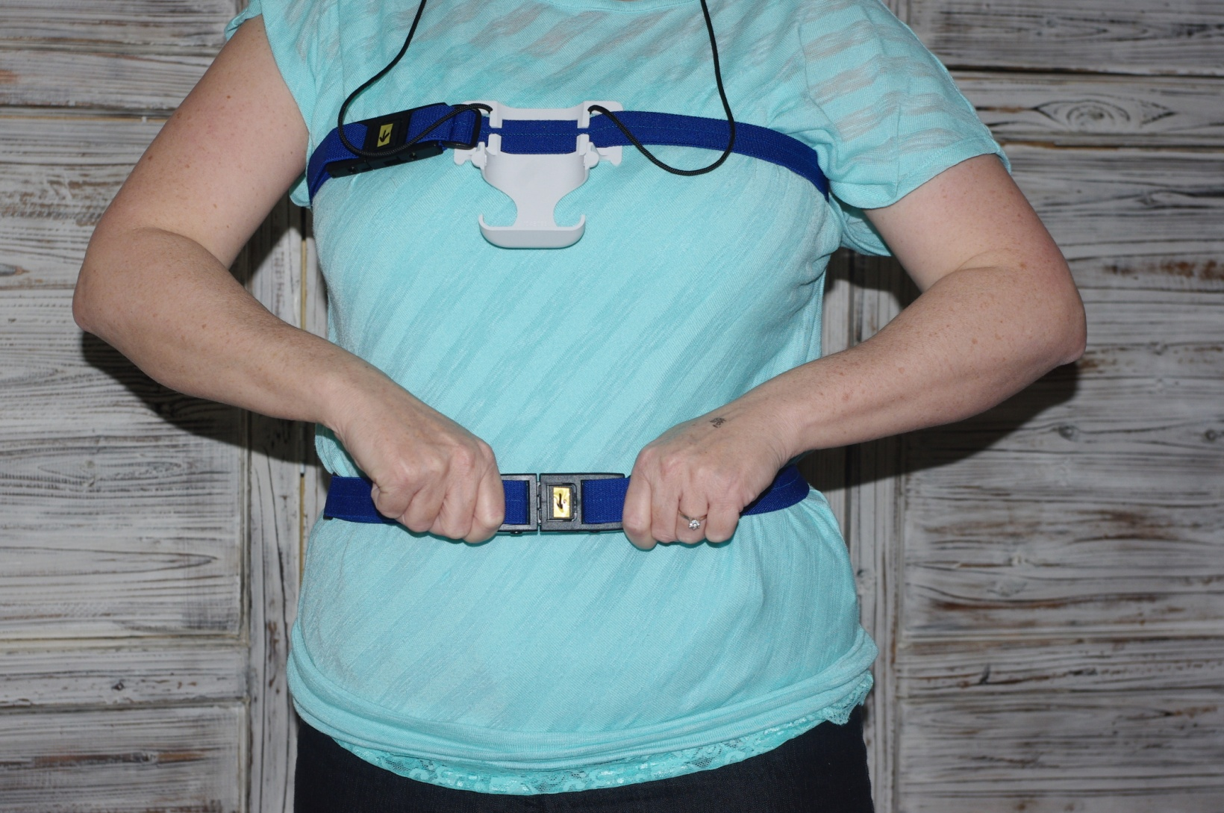
Step 3
Place the other blue belt around your waist. Belt should be snug enough that it does not slide when you toss and turn.
Arrow on belt buckle should point down.

Slide 7
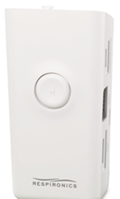
Step 4
Snap white box into the holster on the chest belt. You will hear 2 clicks as the box goes into the holster.
“Respironics” label faces out

Slide 8
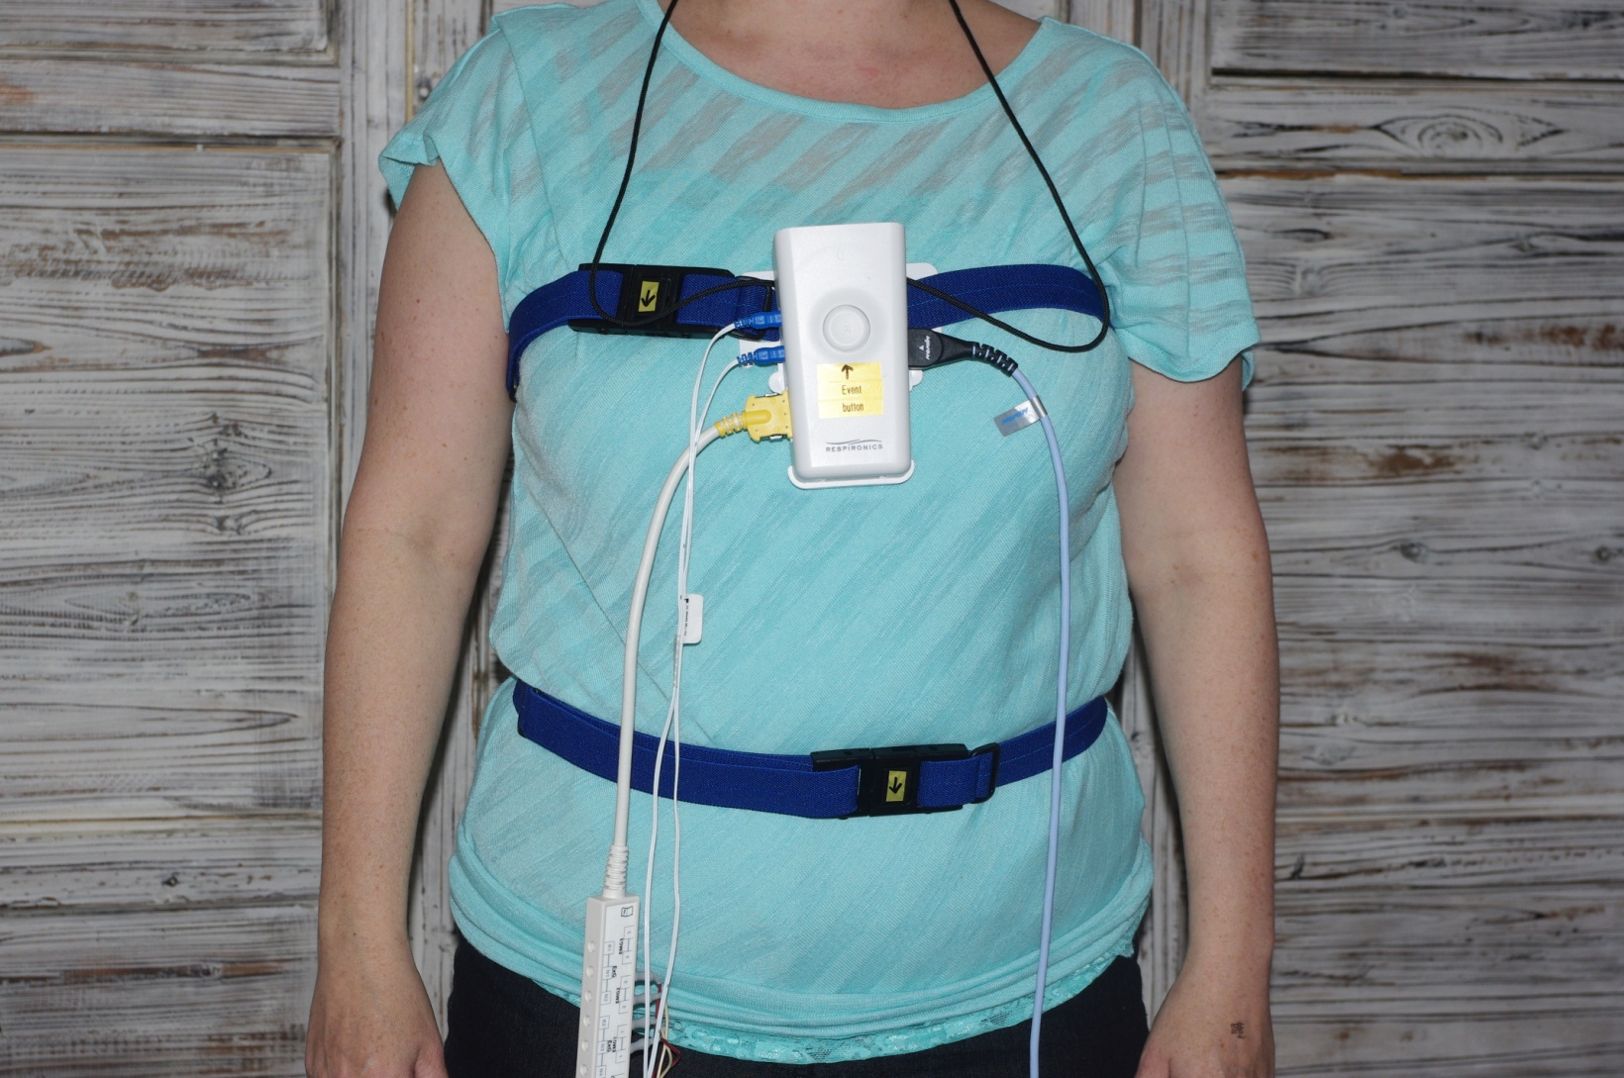
Step 4

Slide 9
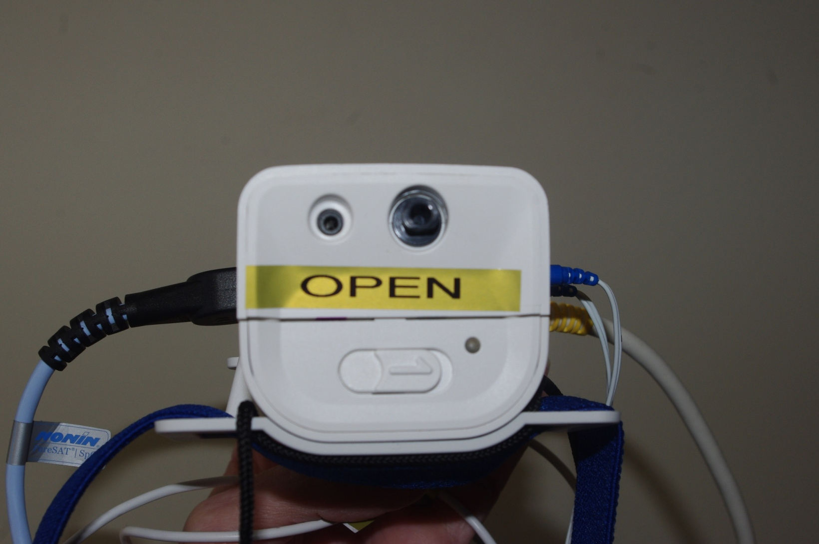
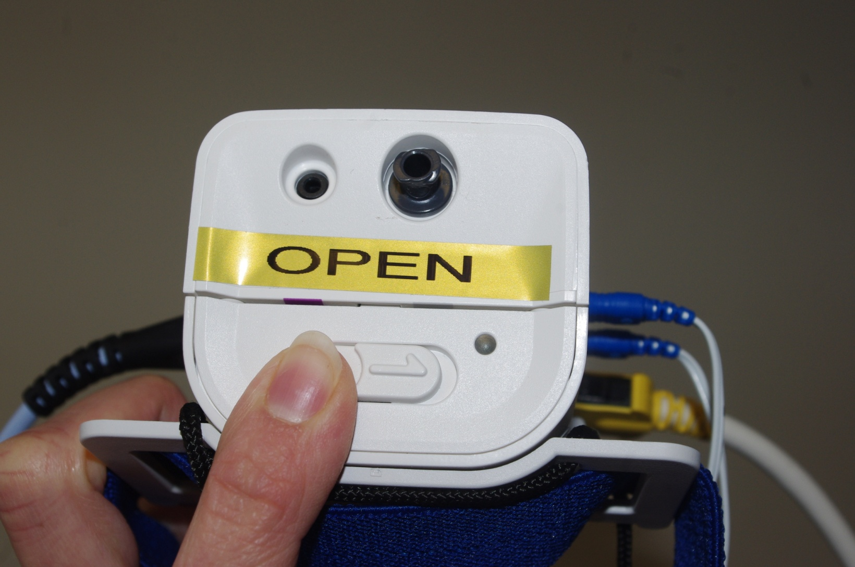
Step 5
Open the device by sliding the button at the top of the device

Slide 10
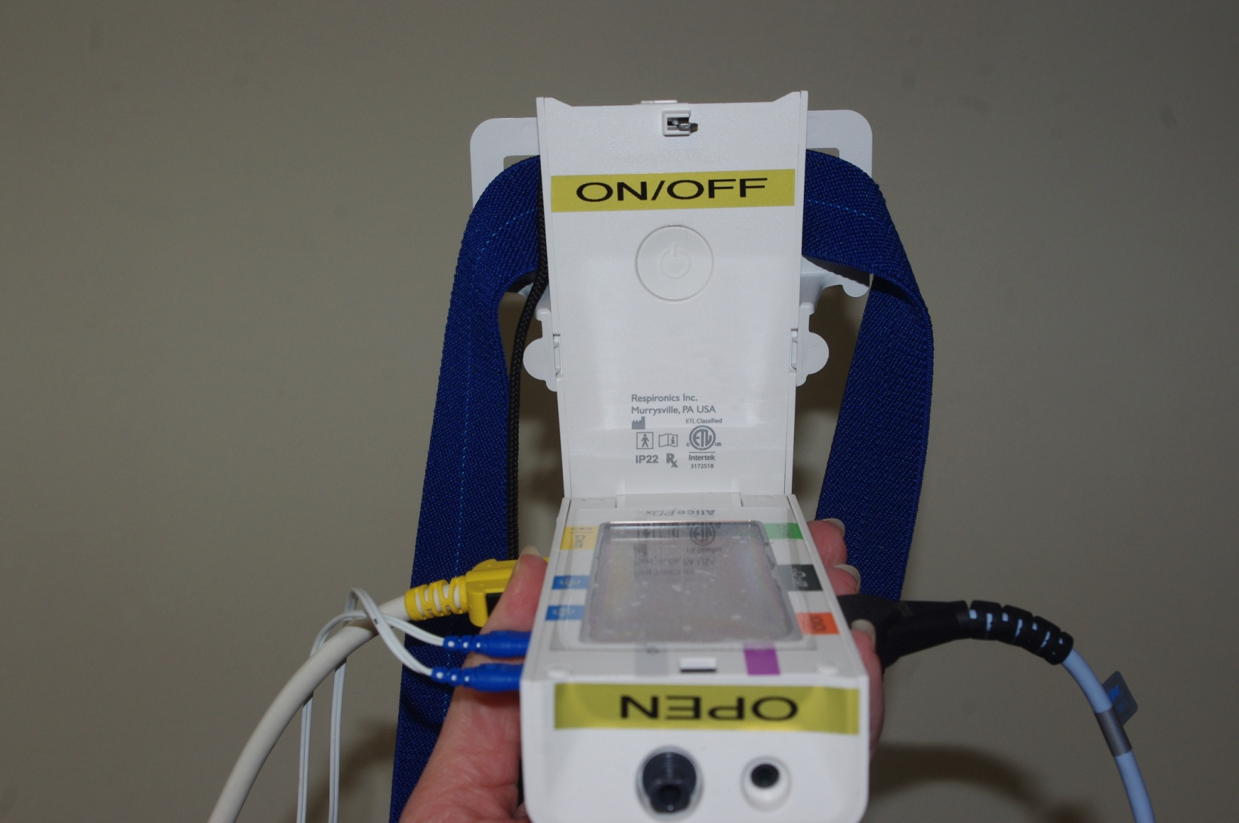
Step 5
The device is already powered on. DO NOT press the power button.

Slide 11
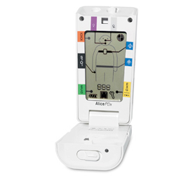
Step 6
You will see a picture of a man in the device window. All of the sensors will stop flashing when they are either plugged into the device or placed on the body.

Slide 12
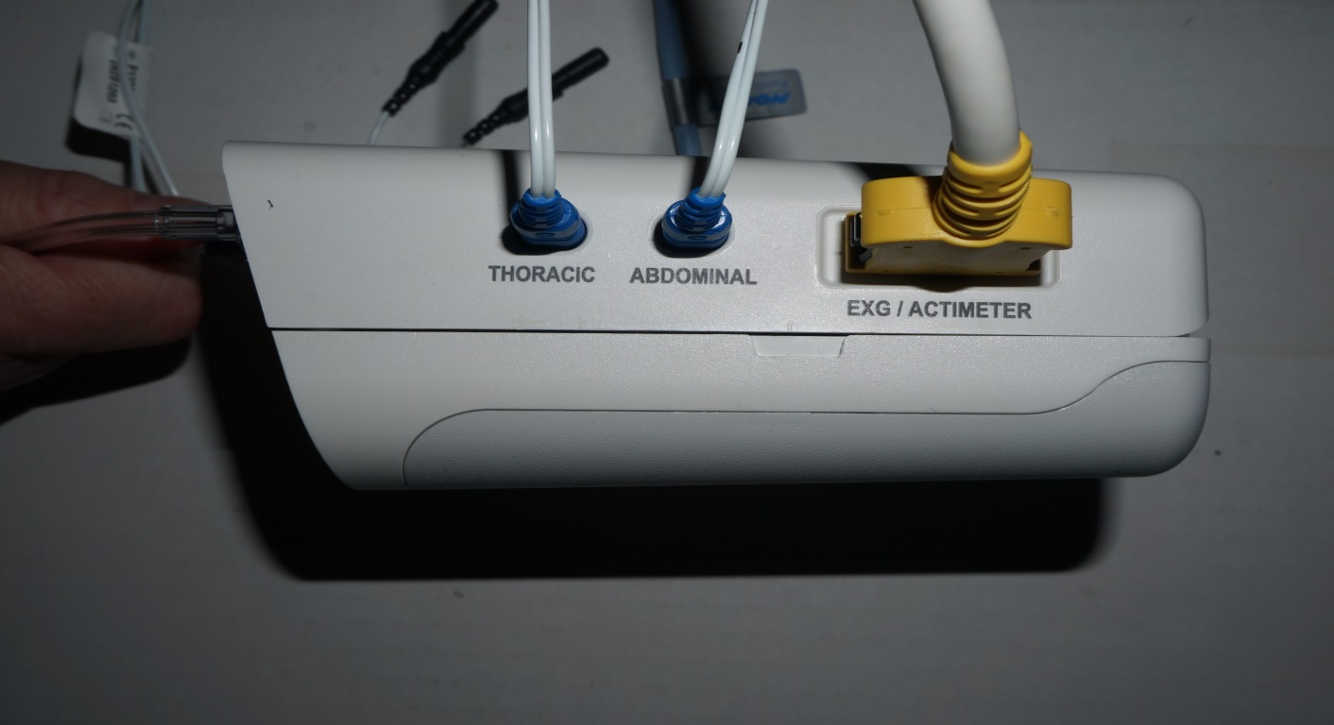
Step 7
Plug chest (thoracic) wires into the ports on the bottom of the belt buckle.

Slide 13
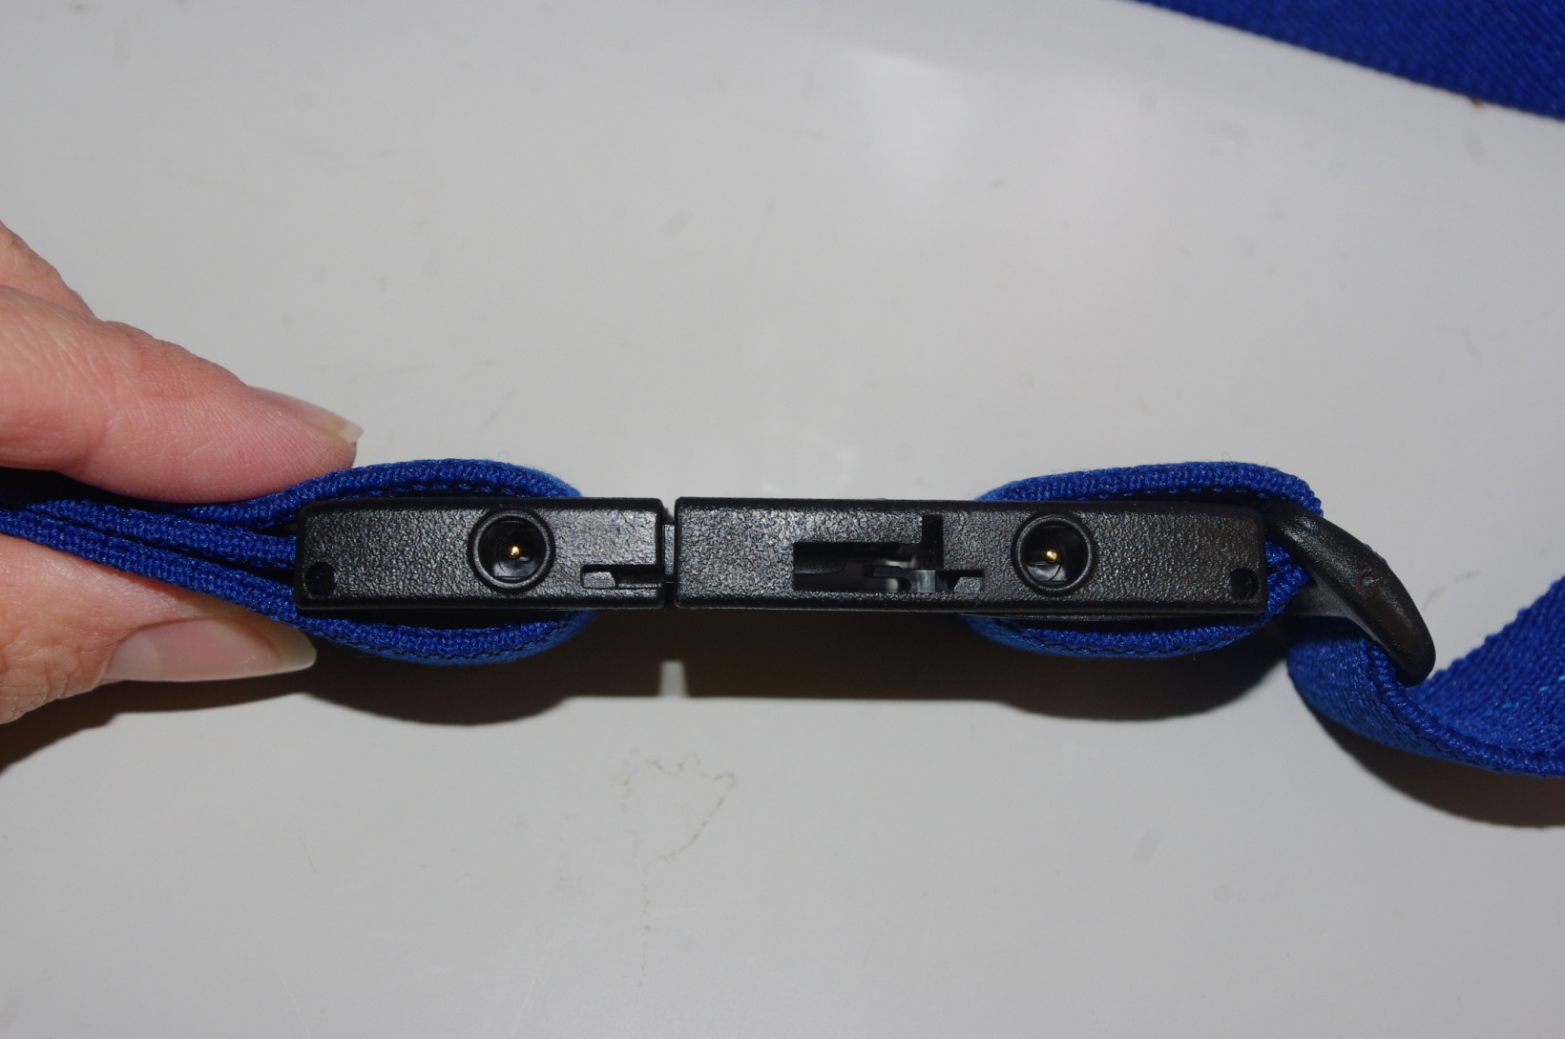
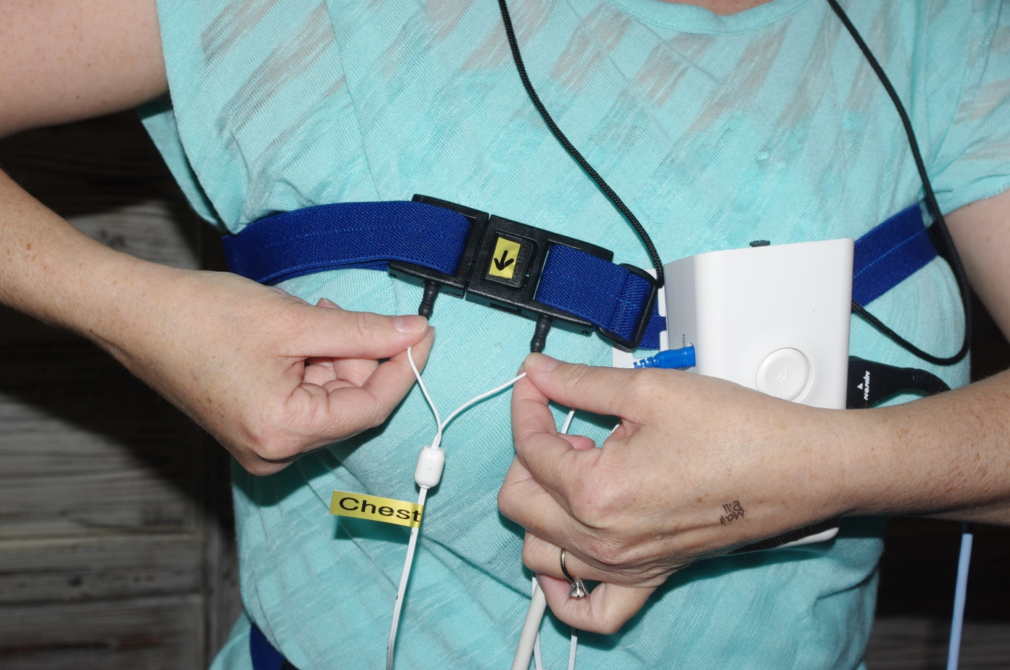
Step 7
View of the bottom of belt buckle
Ports

Slide 14
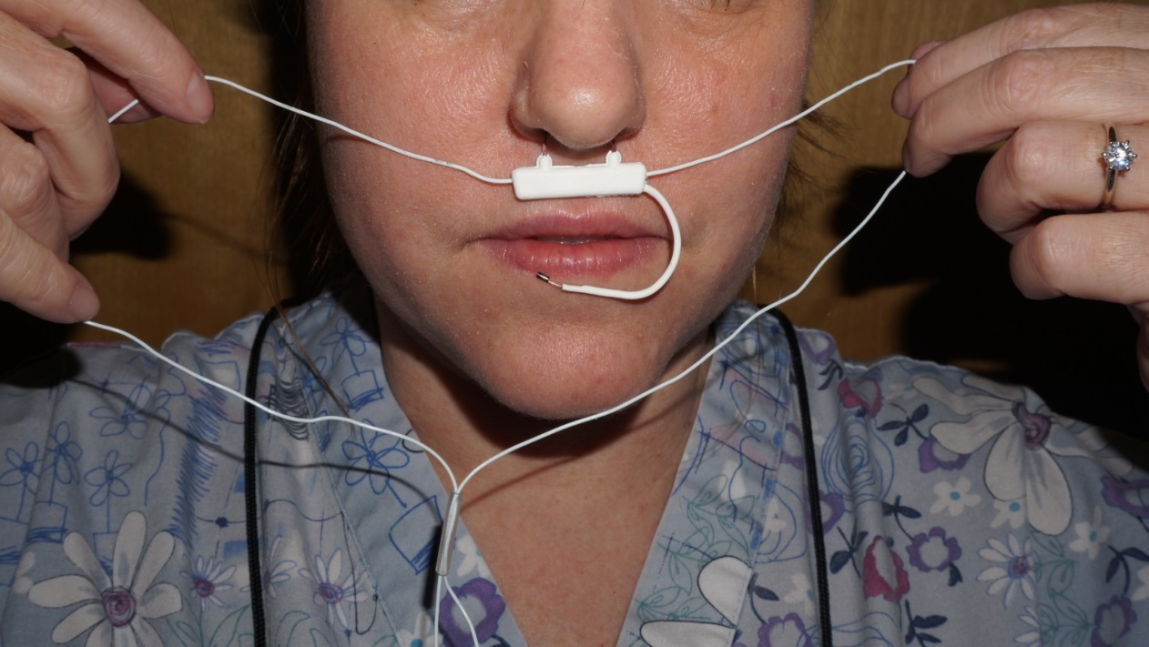
Step 8
A. Place the prongs of the white wire in your nose and wrap wire around your ears.

Slide 15
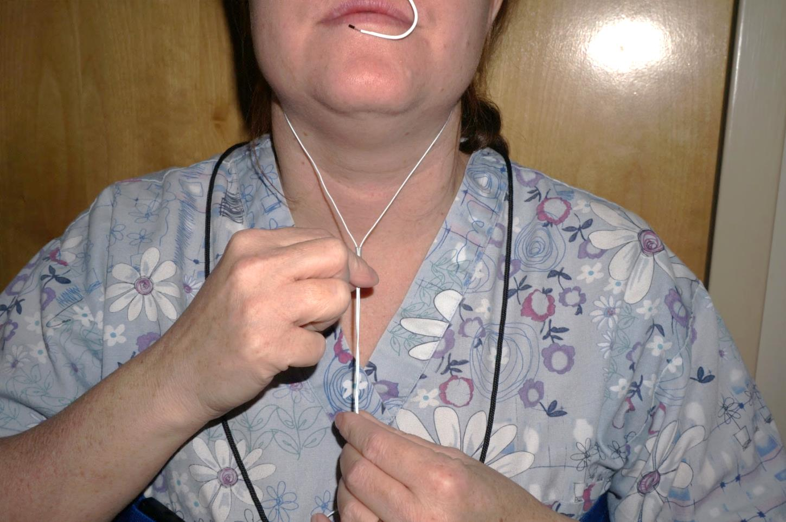
Step 8
B. Pull plastic piece up by neck to secure

Slide 16
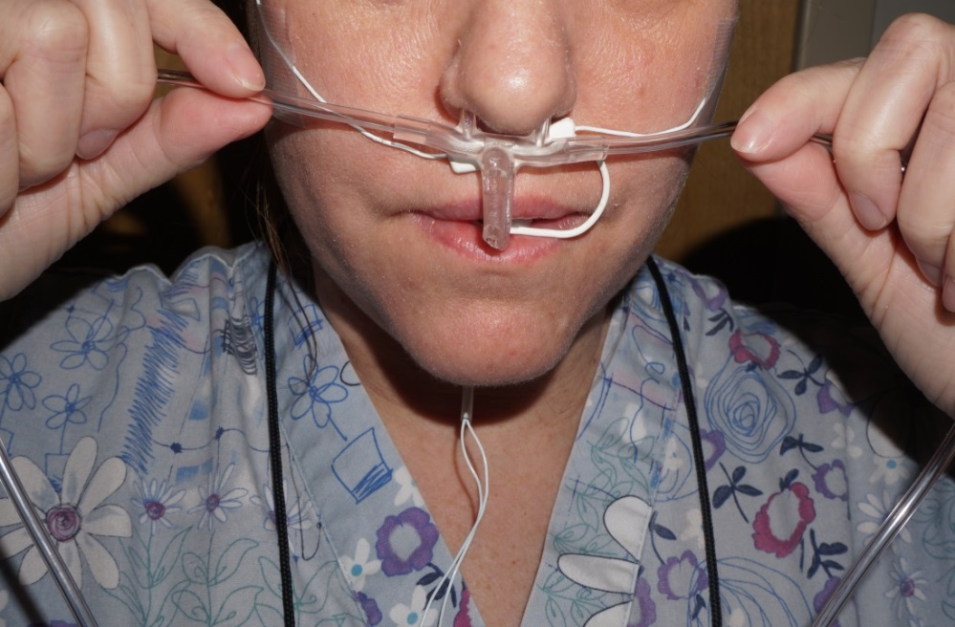
Step 9
A. Position second set of prongs in nostrils and wrap tubing around ears. 2 prongs fit just inside the nose and 1 near the mouth.

Slide 17
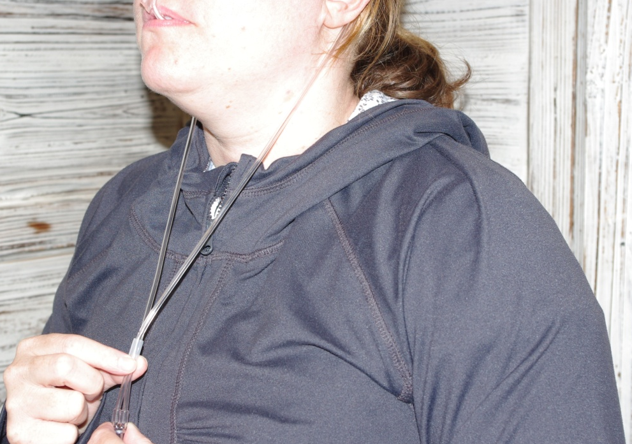
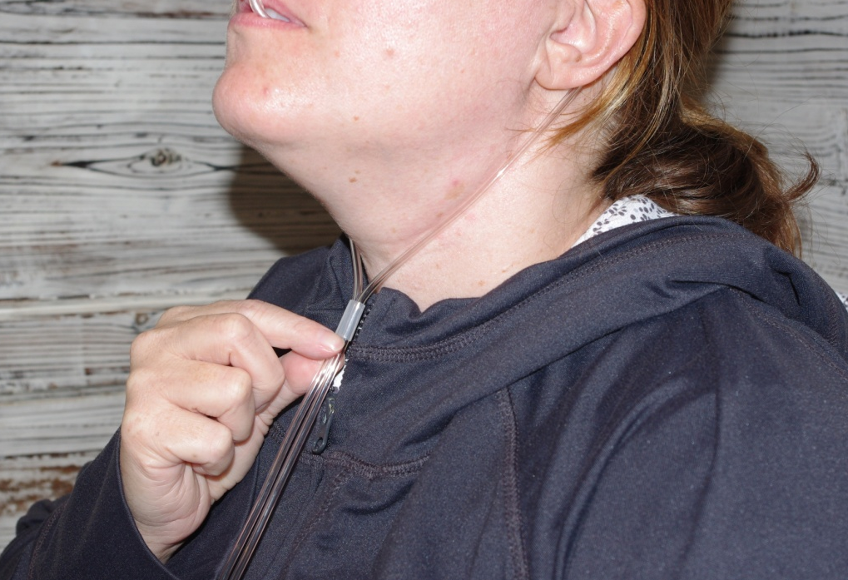
Step 9
B. Slide up plastic piece toward neck to secure

Slide 18
Step 10
Run the long red and white leg wires through each pant leg to avoid getting tangled during the night

Slide 19
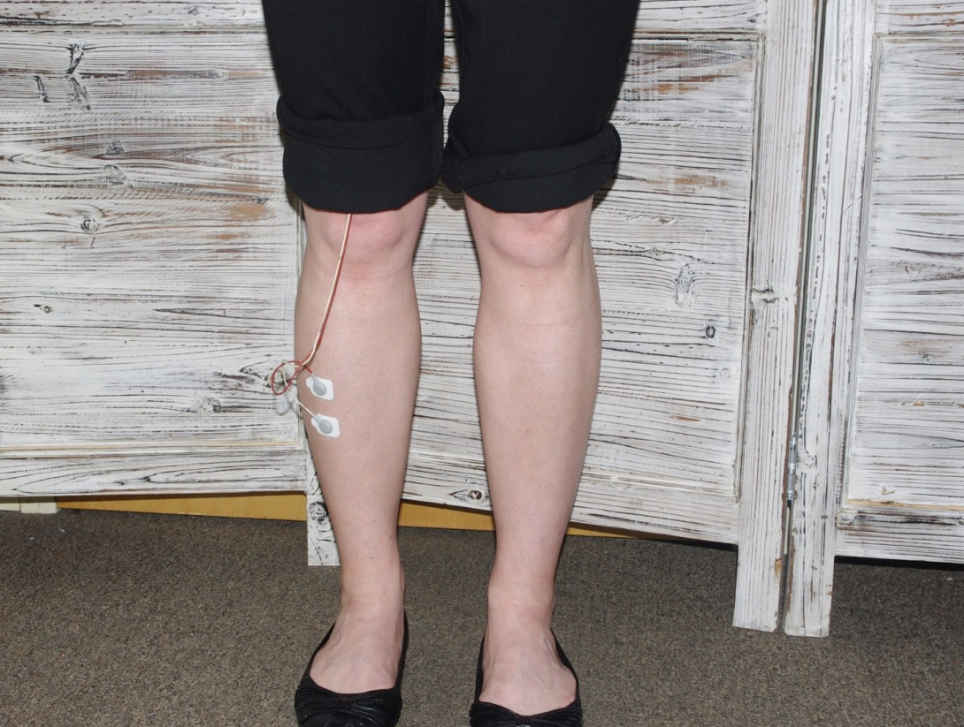
Step 10
B. Use sticky patches to attach a red and white wire to each leg.
C. Flex your leg up and down to locate the muscle on the outside of your lower leg. Place patches directly on muscle. Place one patch directly above the other, at least 2 finger widths apart from one another.

Slide 20
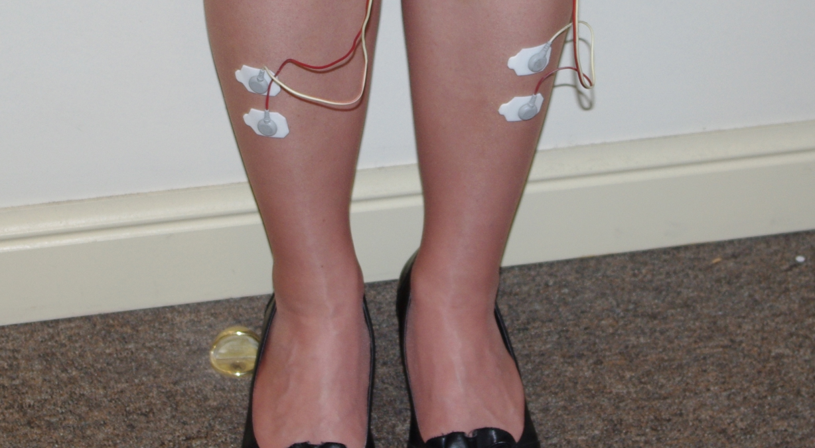
Step 10
When both sets of leg electrodes are attached, it should look like this:

Slide 21
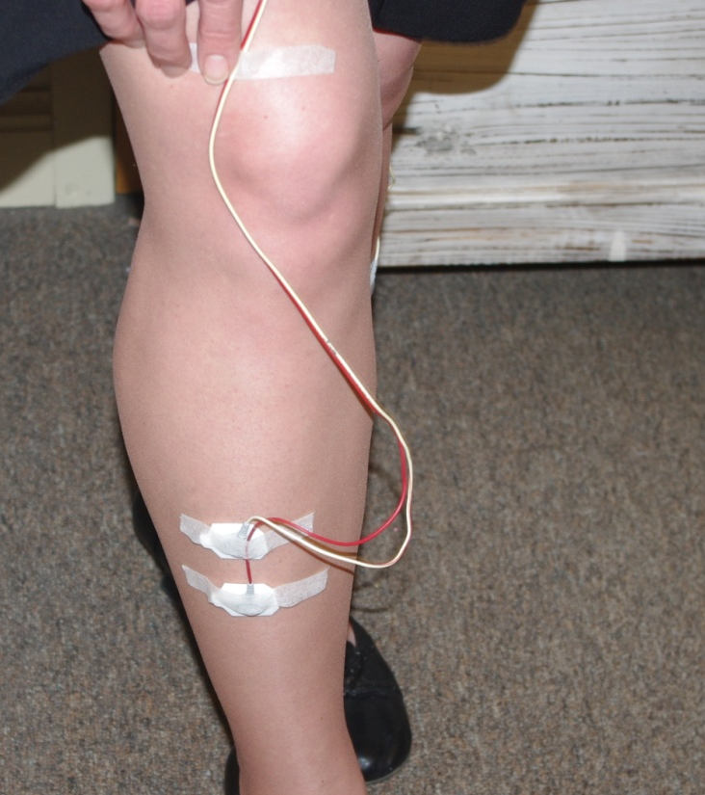
Step 10
Apply tape to each electrode to secure. With your knee bent (to give yourself plenty of slack in the wires) tape wire above each knee to prevent you from getting tangled in the wires.

Slide 22
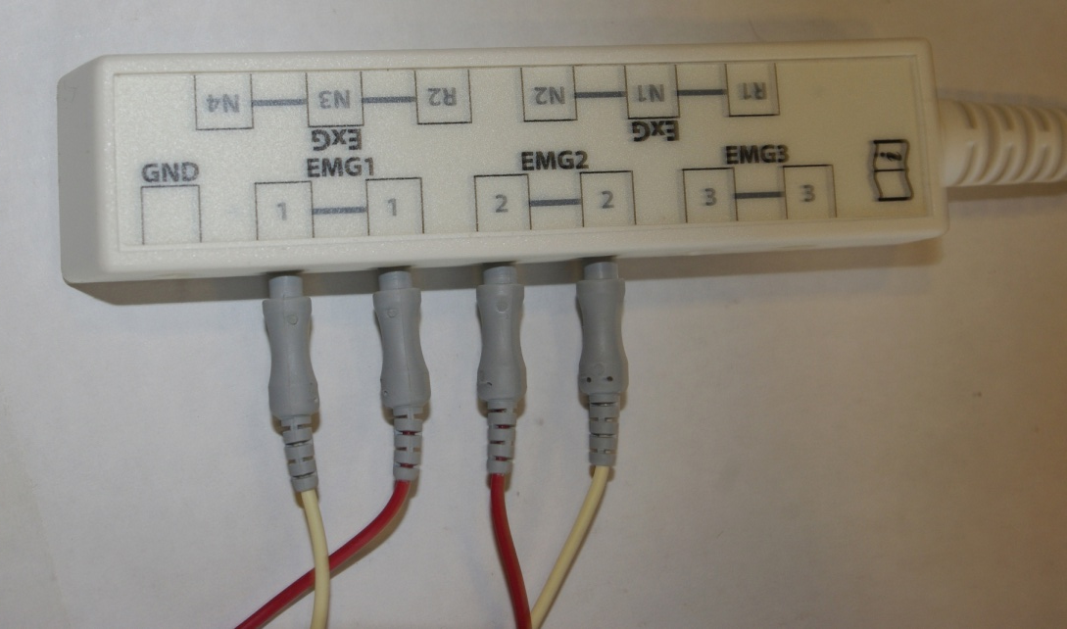
Step 10
The opposite end of the red and white leg wires should already be plugged into the accessory box

Slide 23
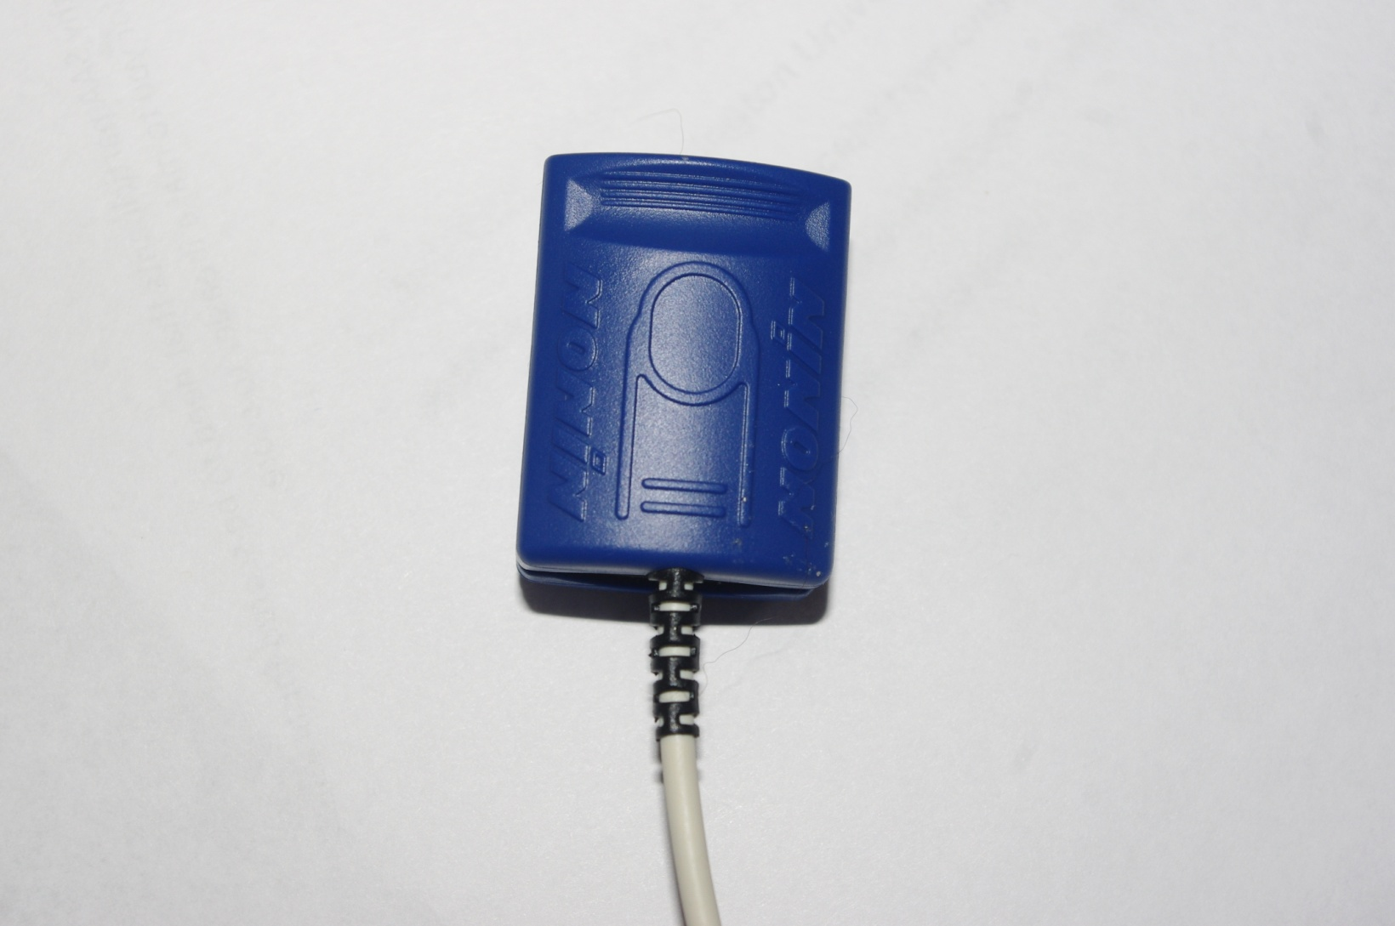
Step 11
A clip style oximeter will be used to measure your oxygen levels throughout the night.

Slide 24
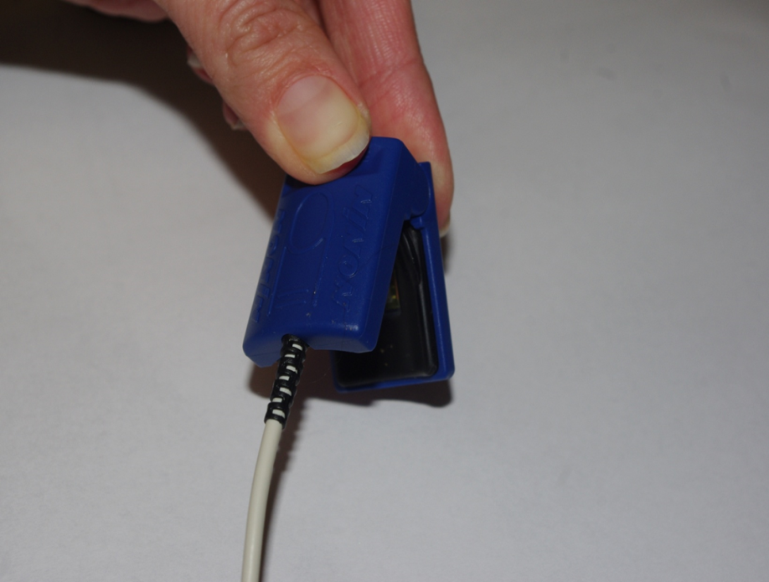
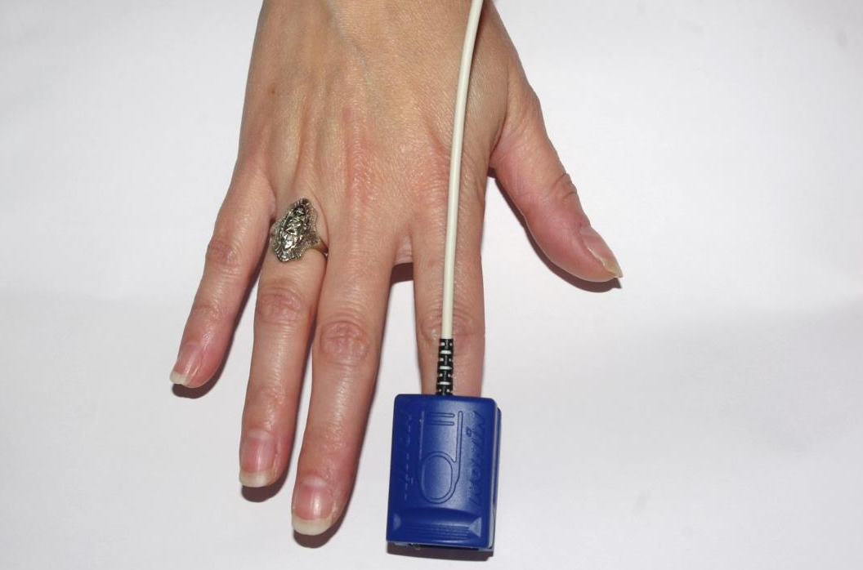
Step 11
A. Pinch the top of the oximeter to open the clip
B. Place the oximeter on index or middle finger
C. Match up the picture of a fingernail on the outside of the clip to your fingernail

Slide 25
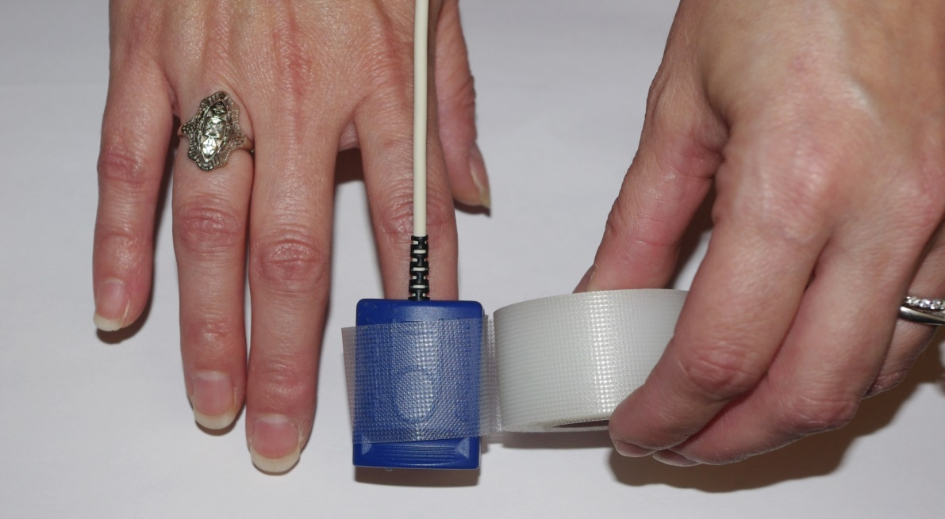
Step 11
Wrap tape around the oximeter clip to secure

Slide 26
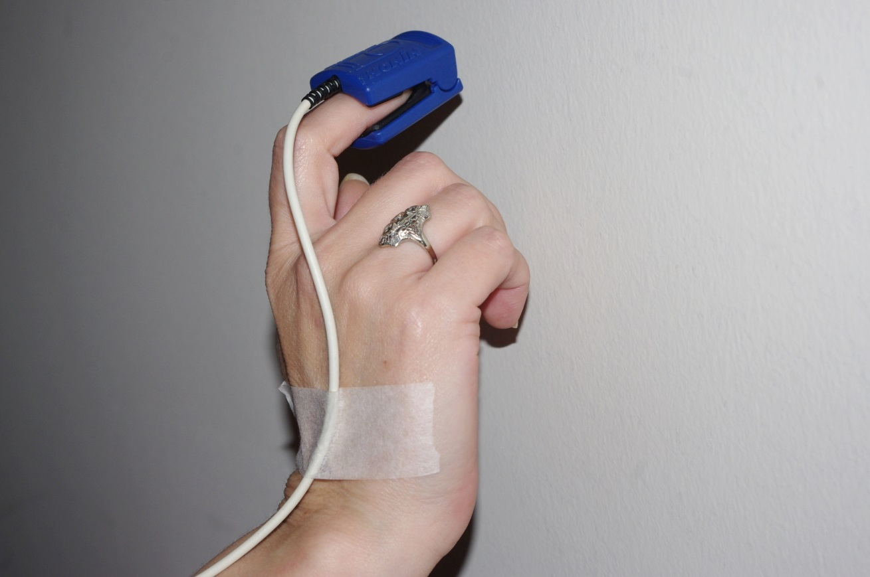
Step 11
You can tape the oximeter wire to your hand and arm. Tuck the cable in the chest belt to avoid getting tangled in the wire.

Slide 27
Step 12
Look at the man on the screen. No signals should be flashing.
If any signals are still flashing, please call the research team for troubleshooting instructions.
Once all sensors are on properly, close the device.

Slide 28
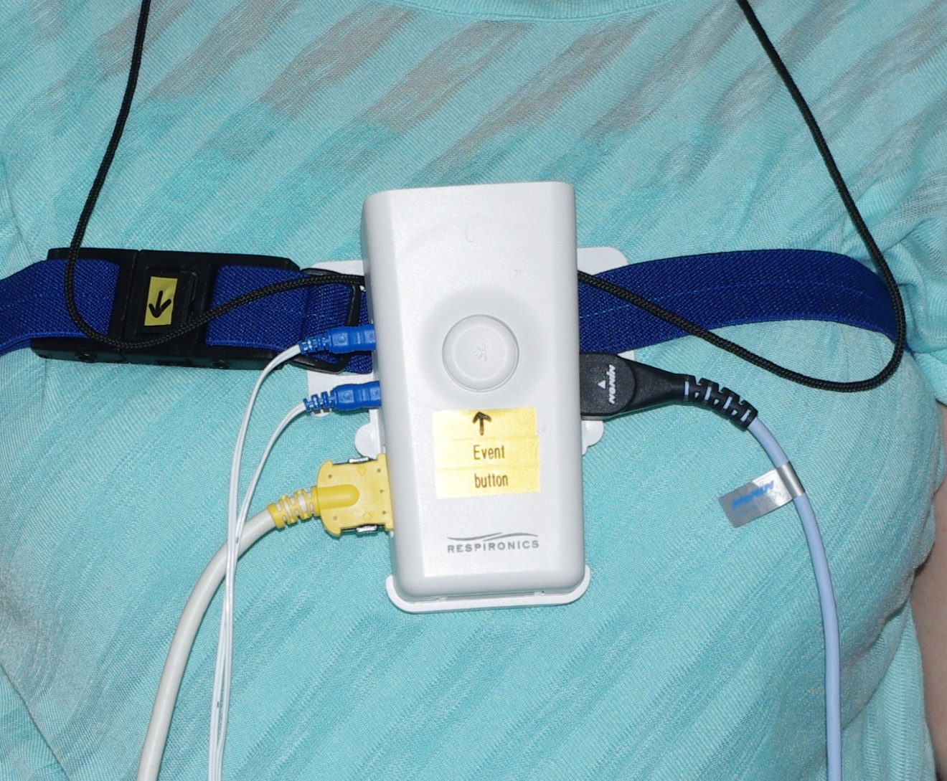
Step 13
Press the event button on the outside of the device at lights out and again in the morning before you remove
the device.

Slide 29
I
The yellow flashing light indicates that either a signal has been lost or that there is a loose connection. Open up the device to check the display. The flashing line will indicate which signal needs to be fixed. The flashing light will turn off after the issue has been fixed.

Slide 30
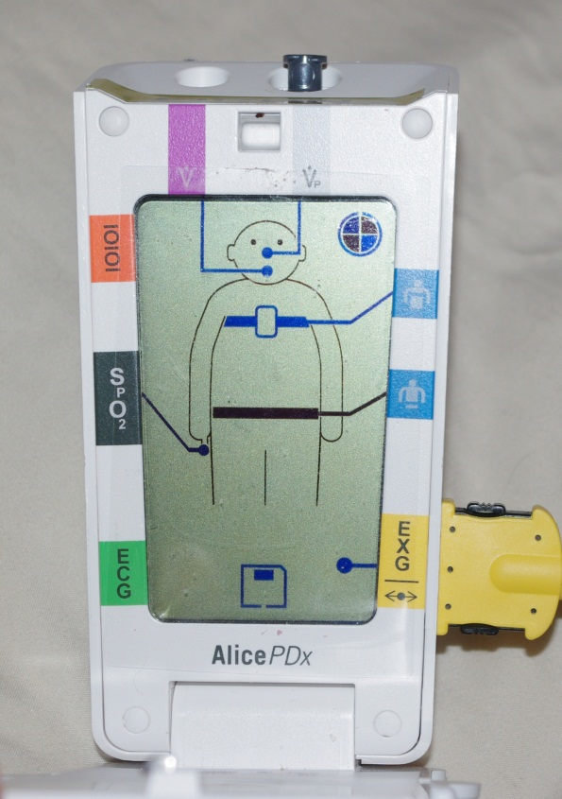
Step 14
Open the device and check the good study indicator circle

Slide 31

All four quadrants will be solid if it was a complete study

Slide 32
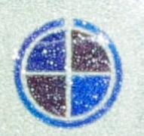
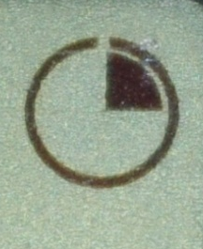
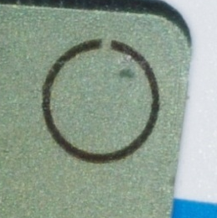
Determine recording quality below
Study recorded the entire night. Good recording! ☺
Study recorded ¼ of the night.
Study was incomplete the entire night.

