Slide 1
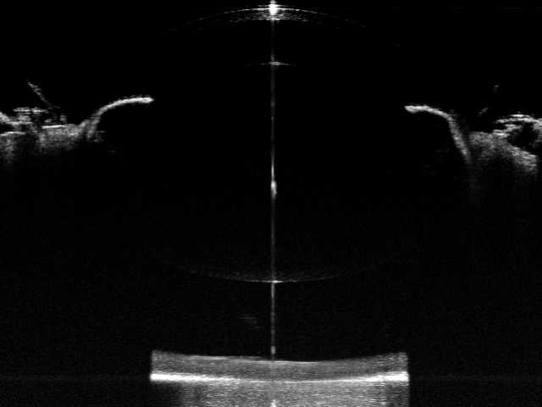
Corneal thickness
Anterior chamber depth
Lens thickness
Axial length
Vitreous chamber depth
+
Retinal thickness

