Slide 1
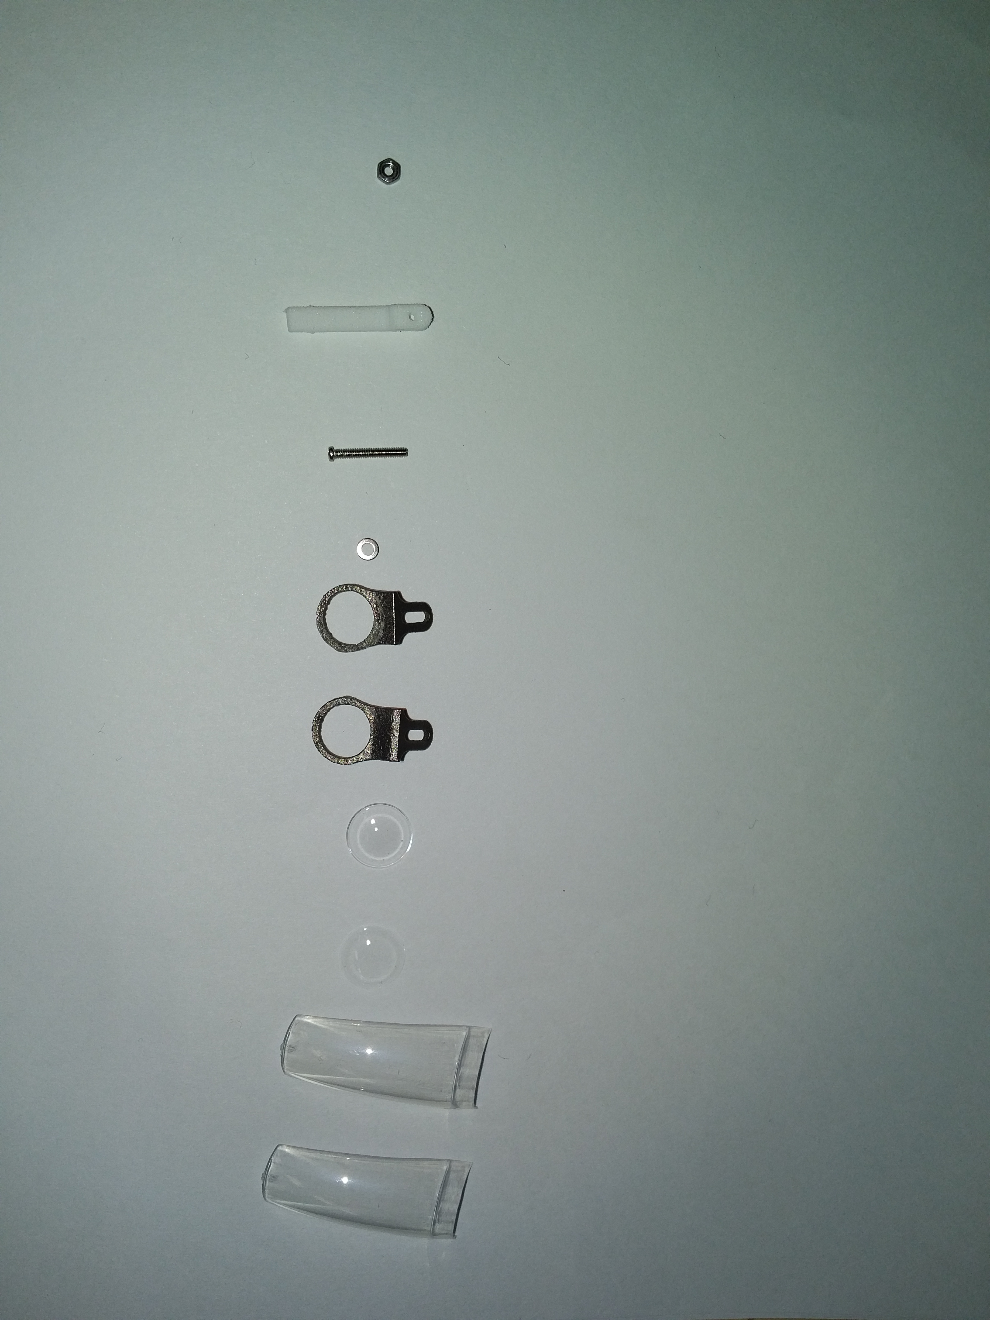
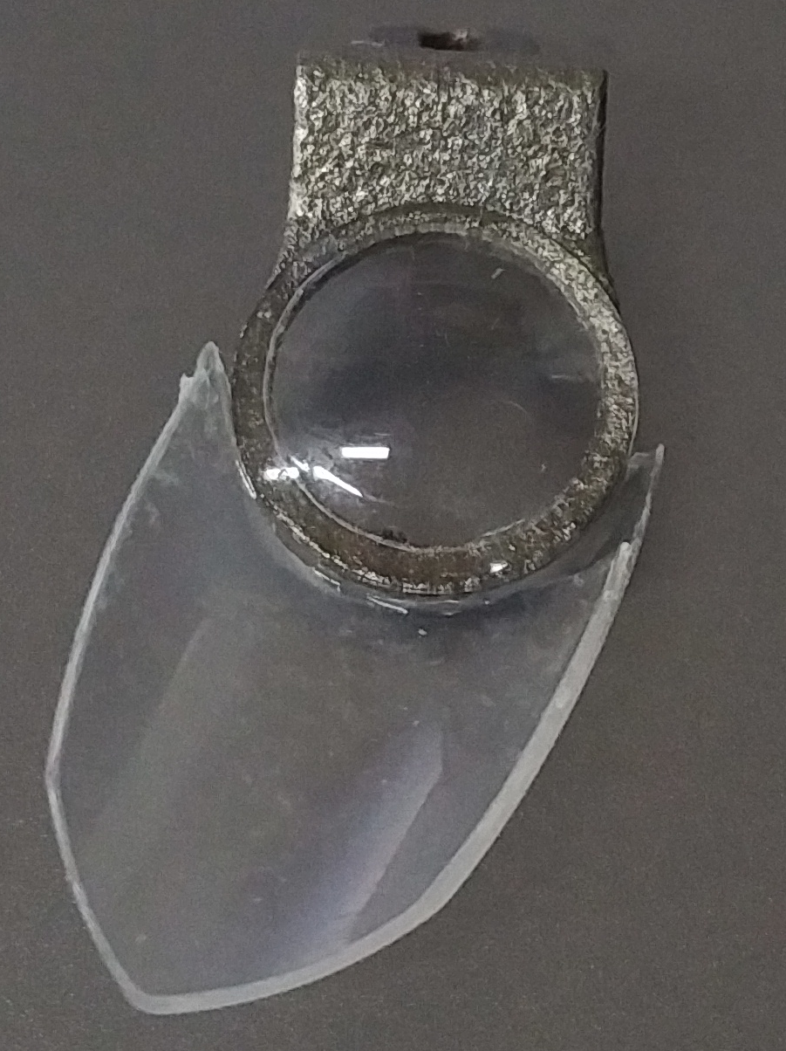
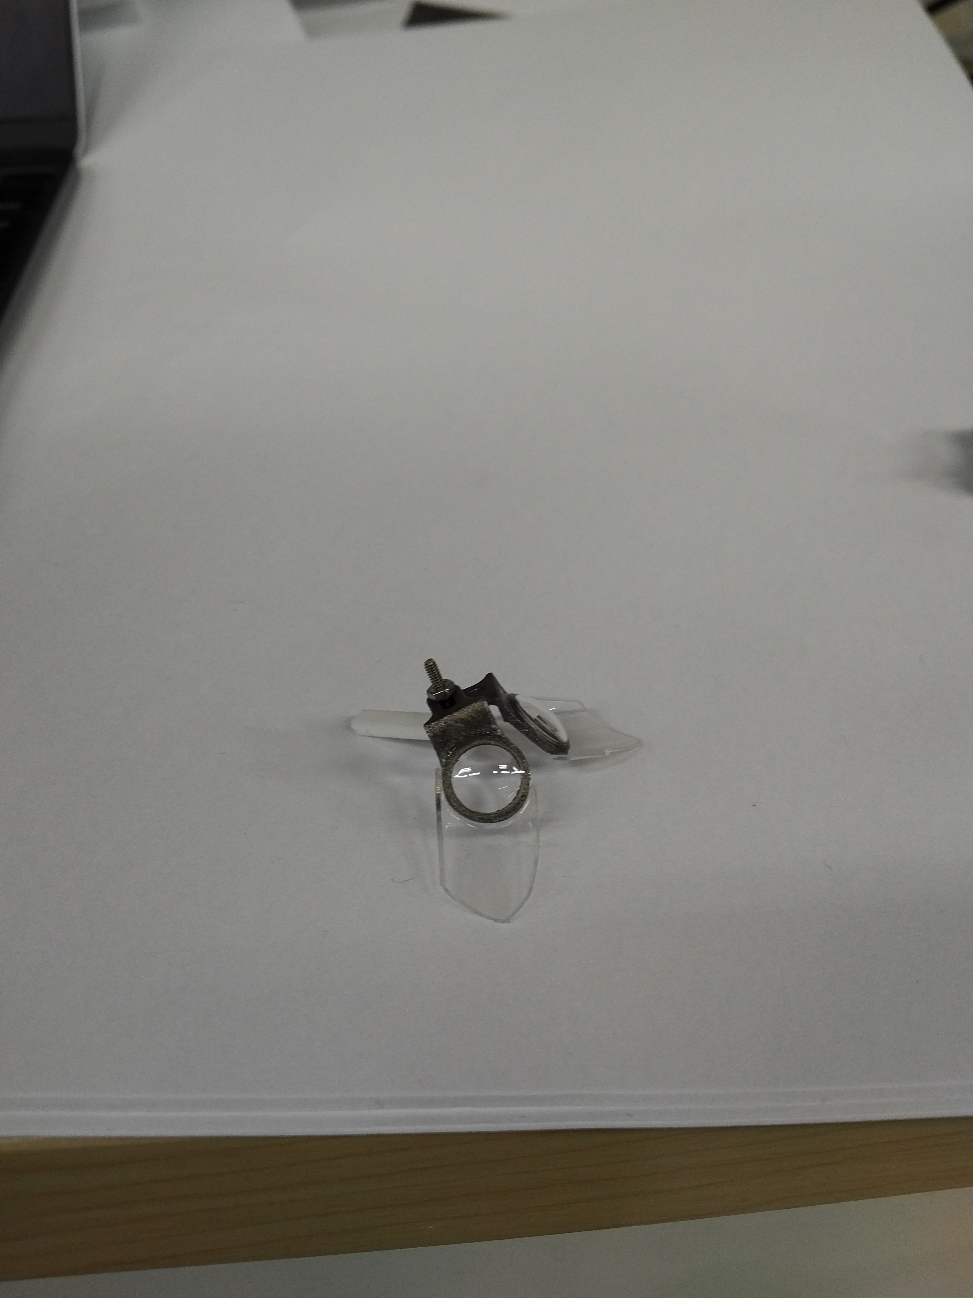
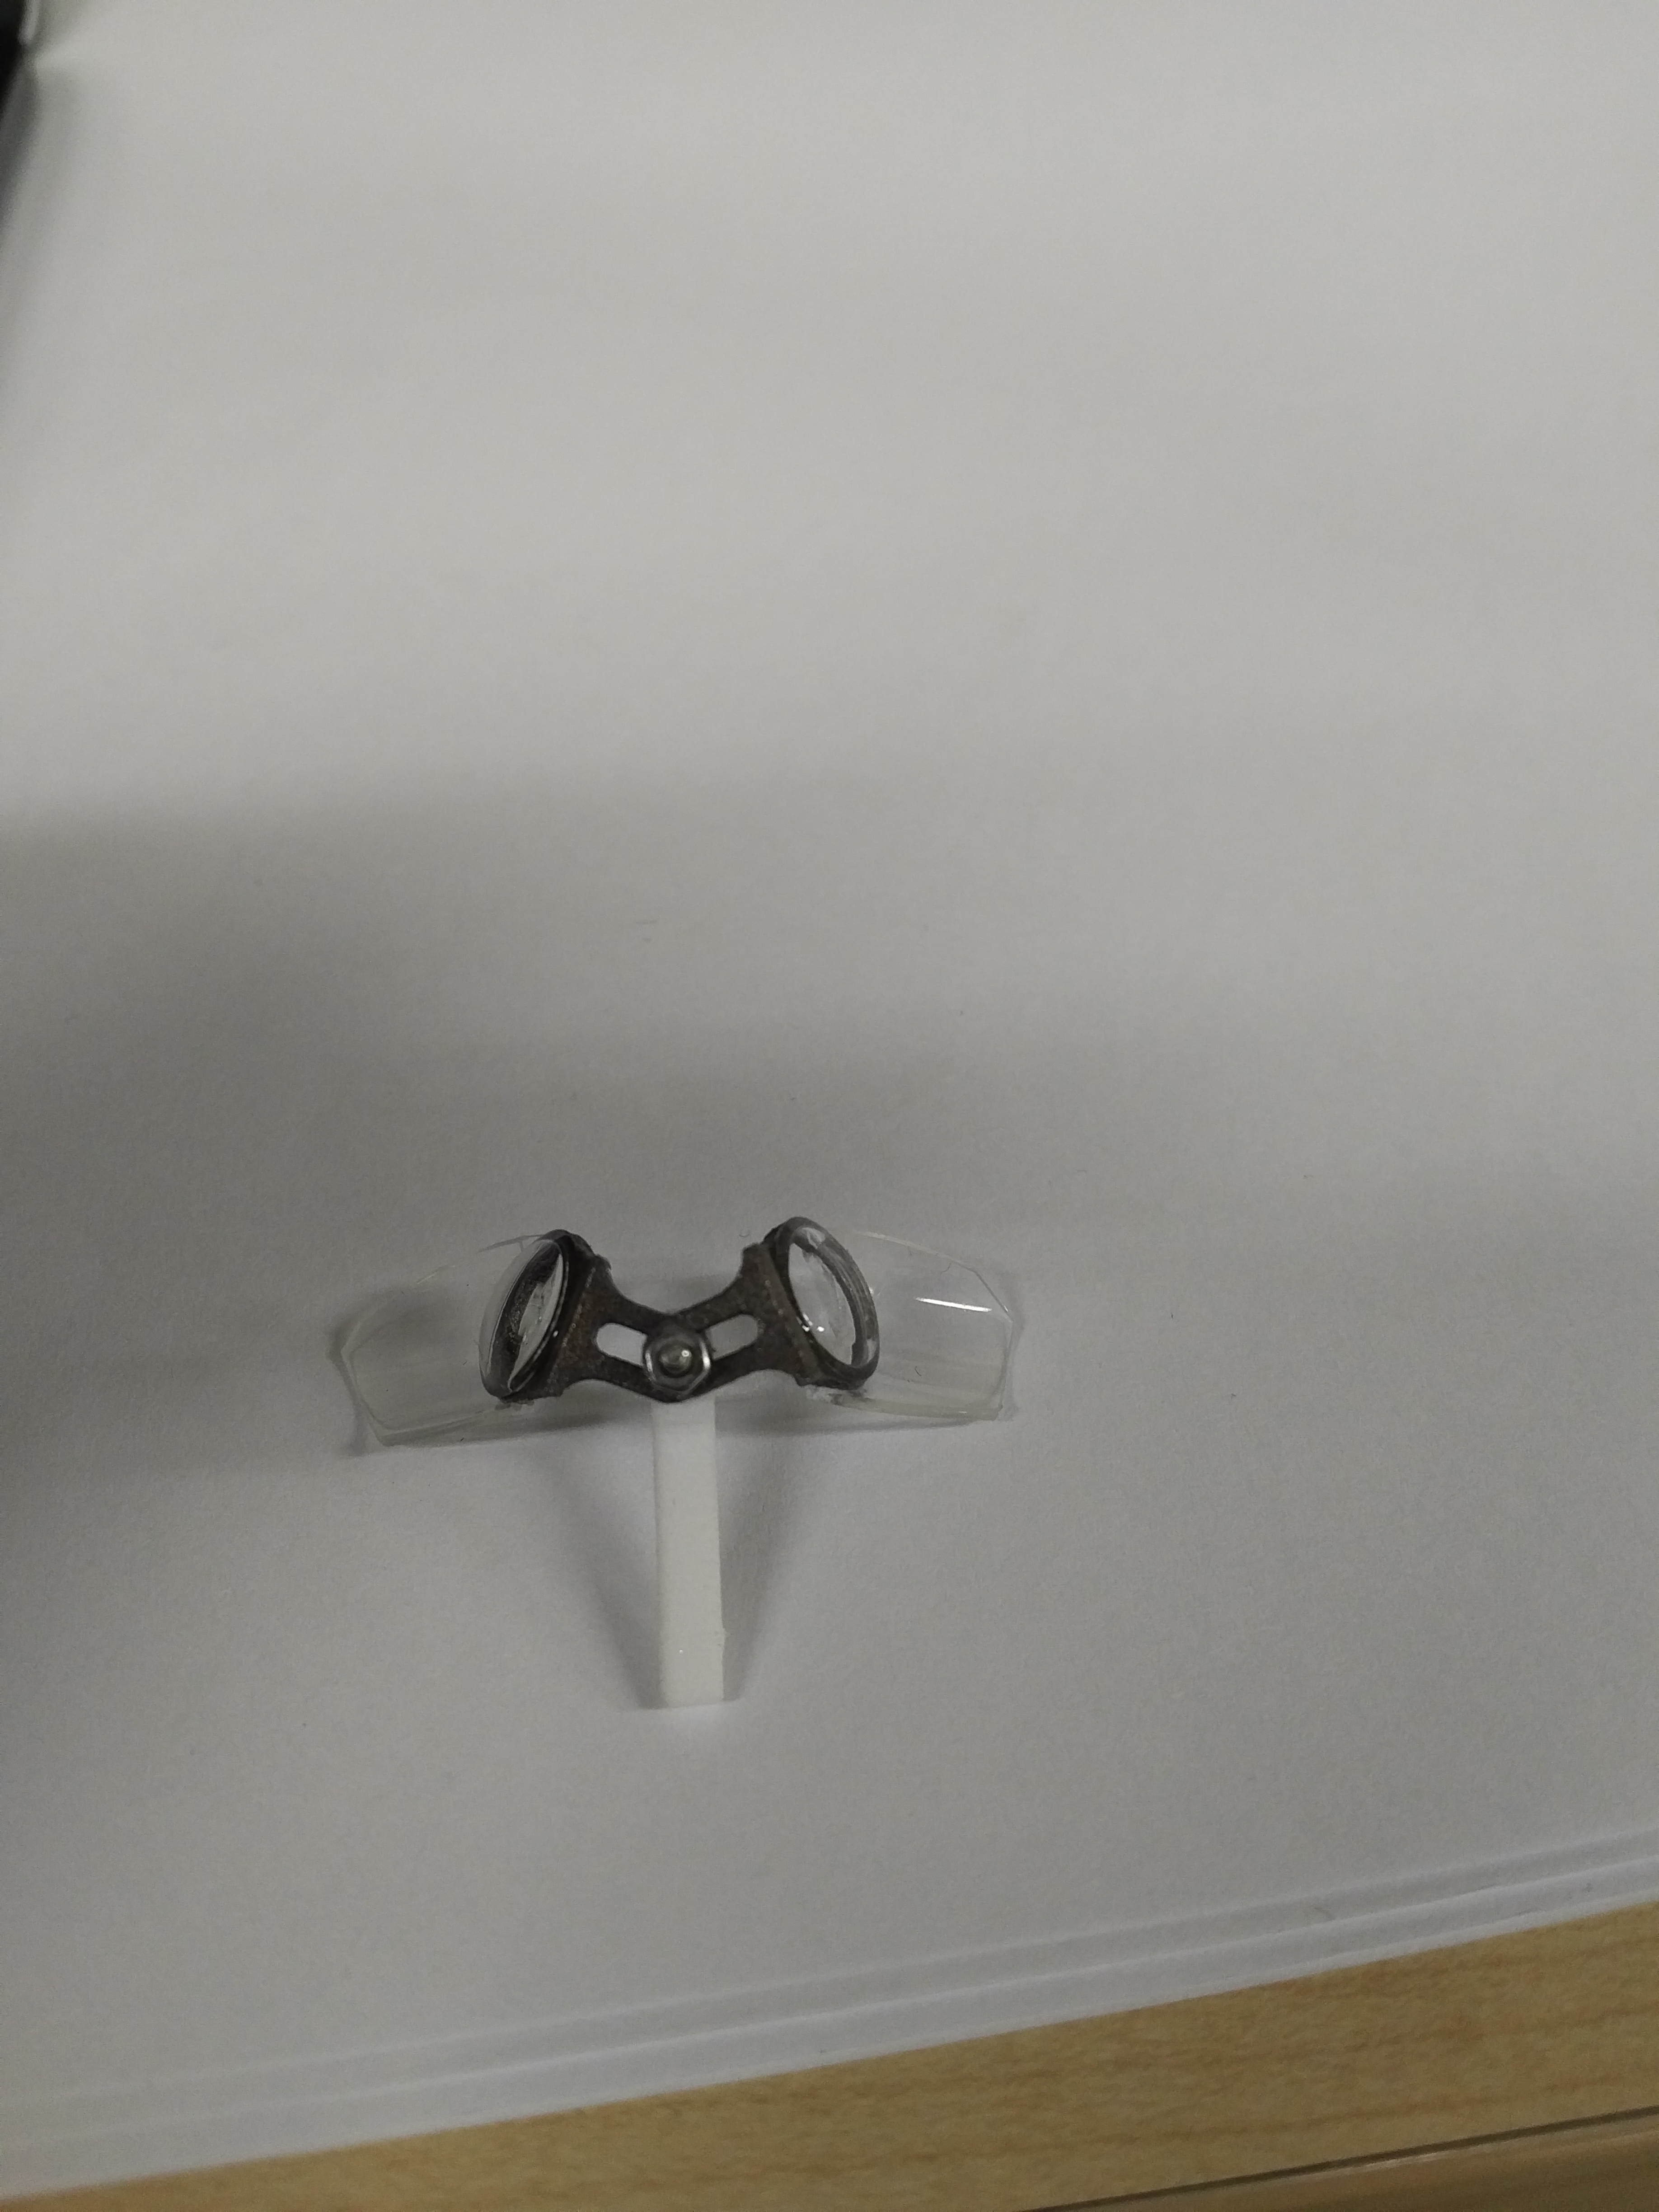
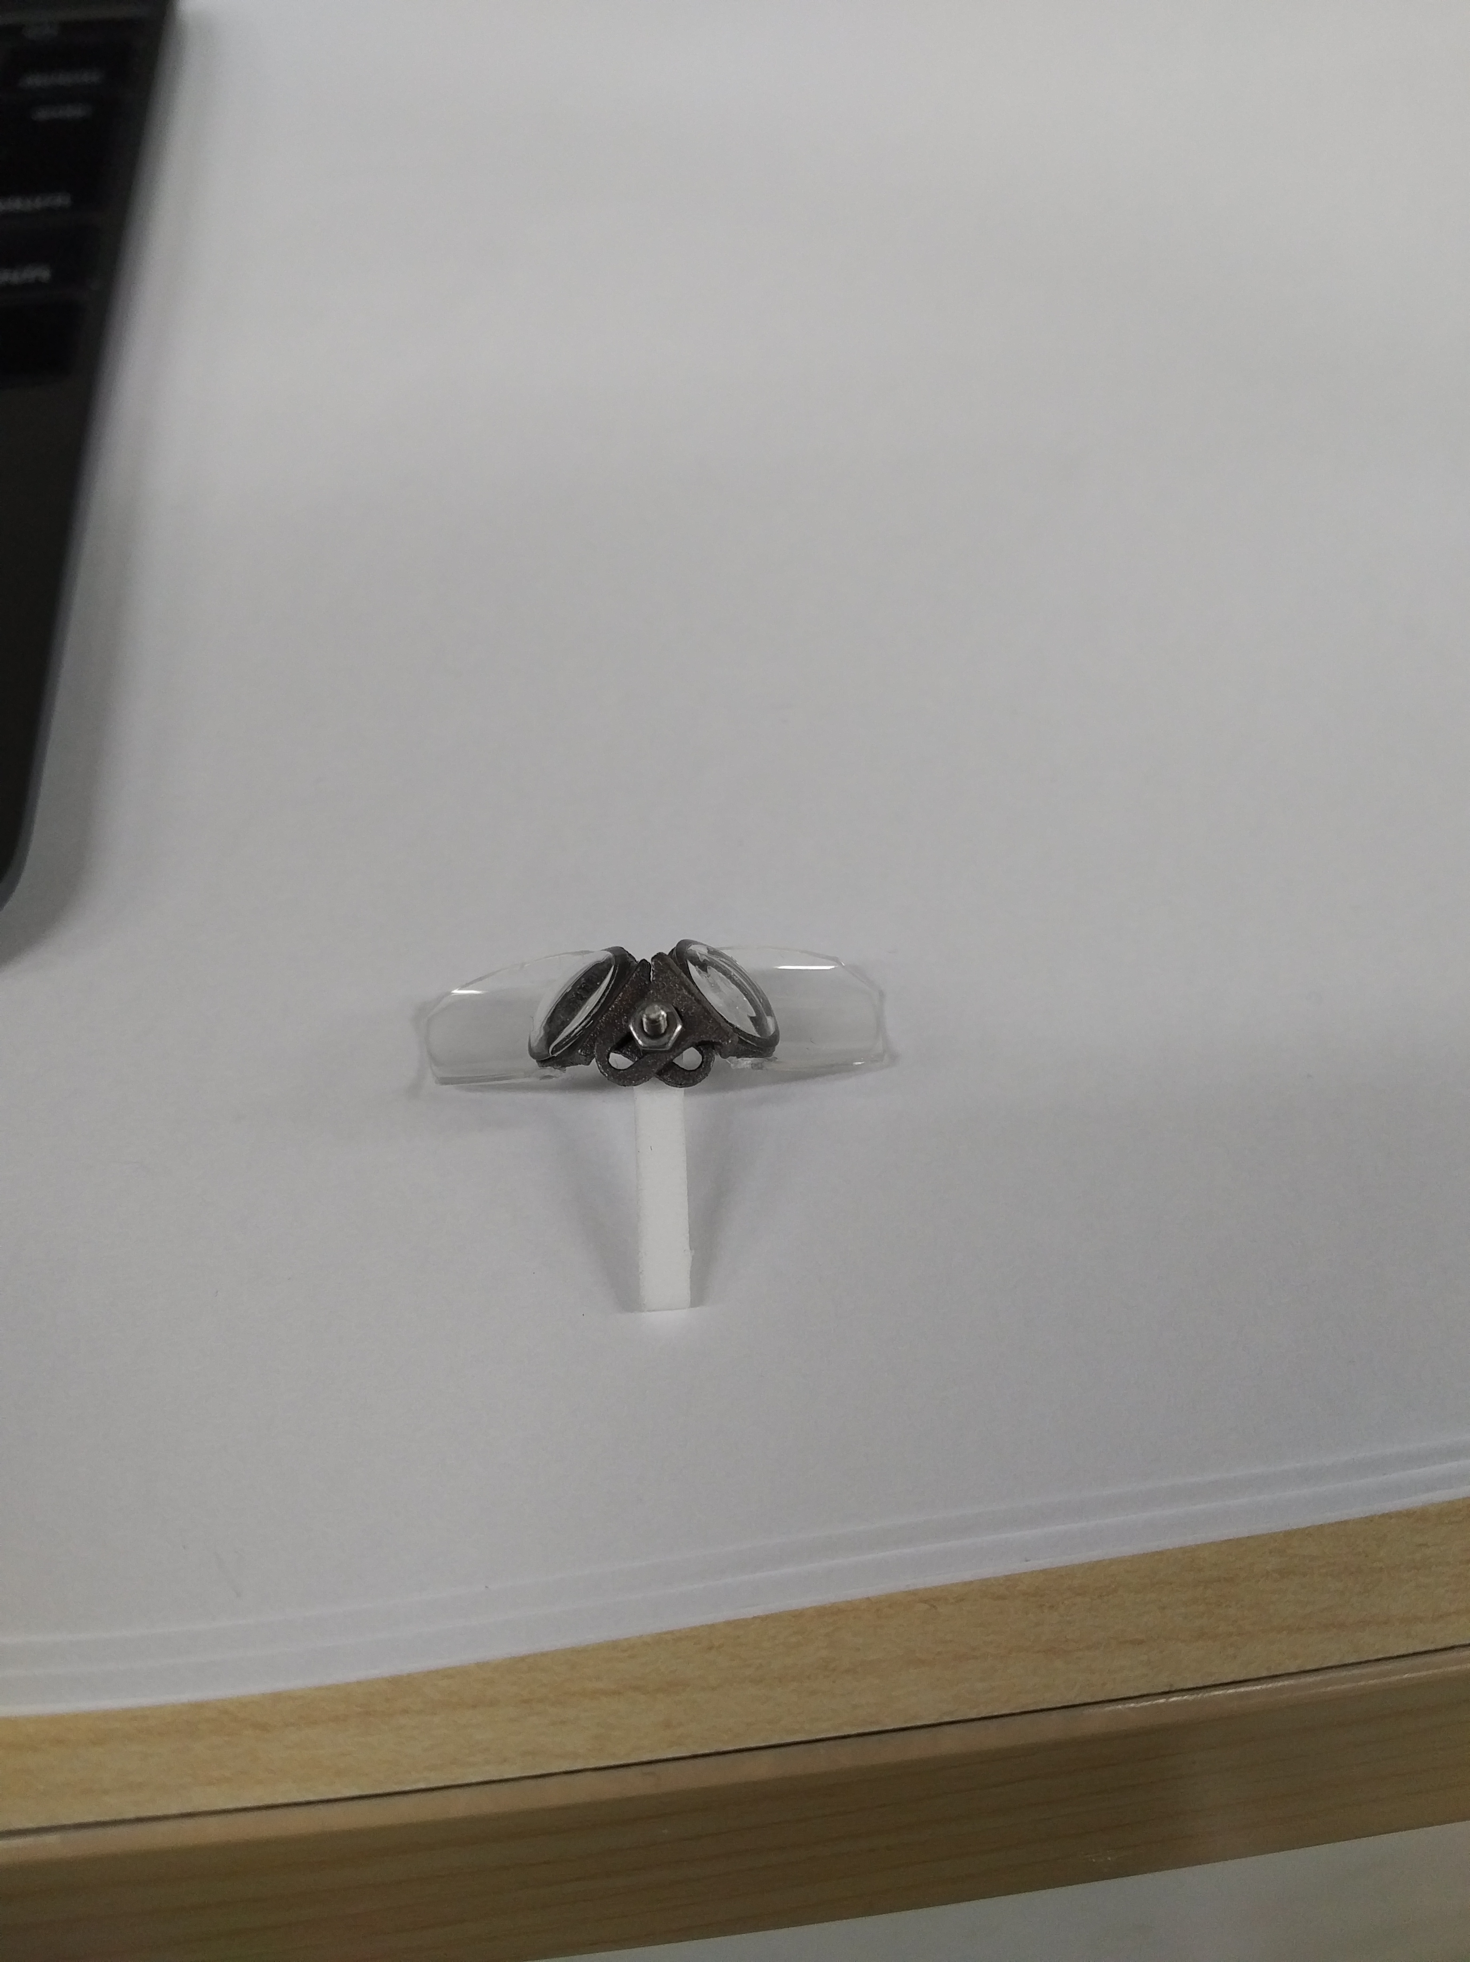
a
b
nut
stick
screw
washer
Frames (L/R)
Lenses
Nail tips
c
Notes:
OCT写真をモヤモヤ写真に変換
ABCDを付く

