Slide 1
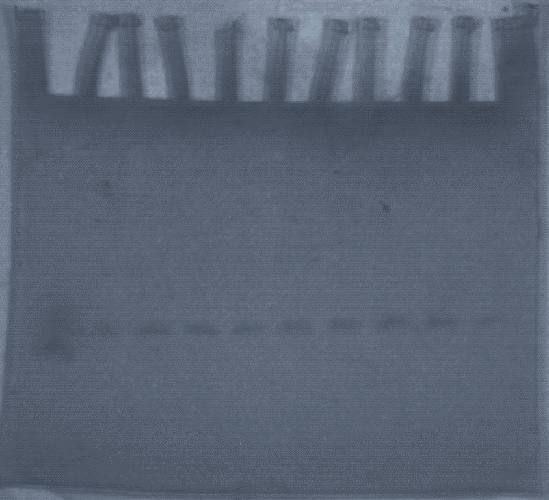
Original Figure 2
circular 64nt DNA
linear 64nt DNA
Modified Figure 2 for Filming

Slide 2
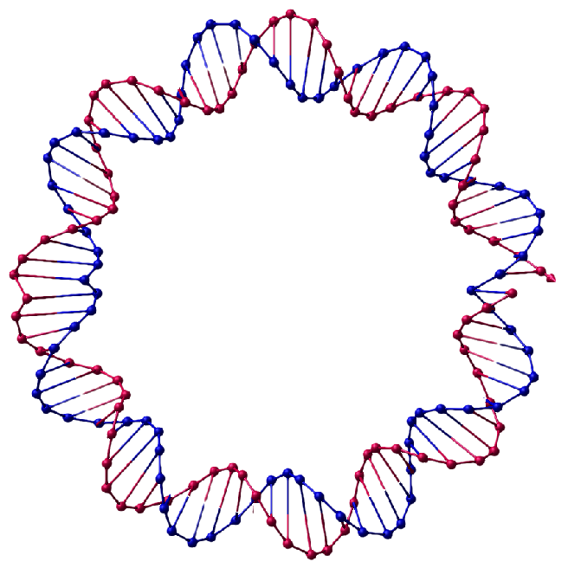
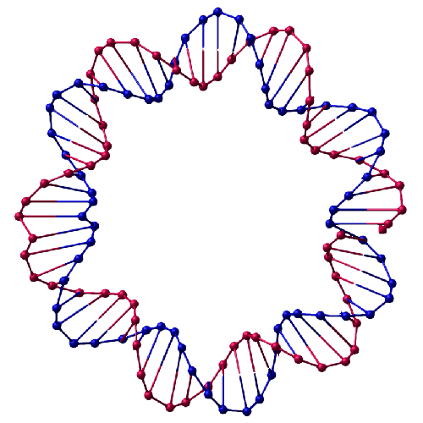
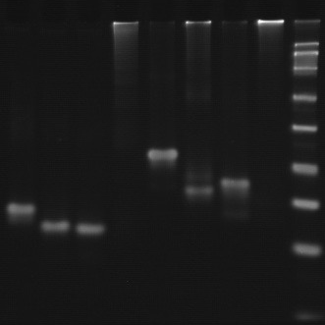
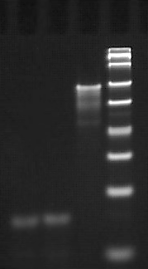
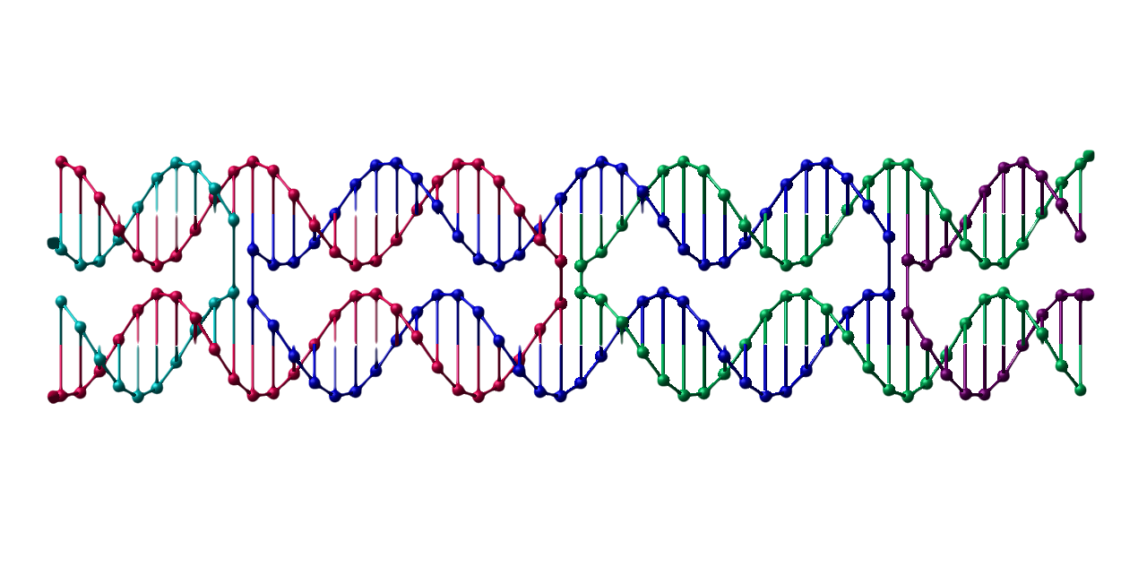
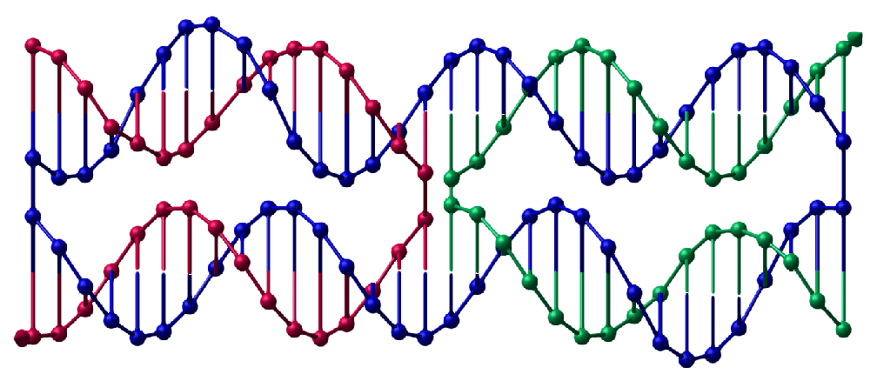
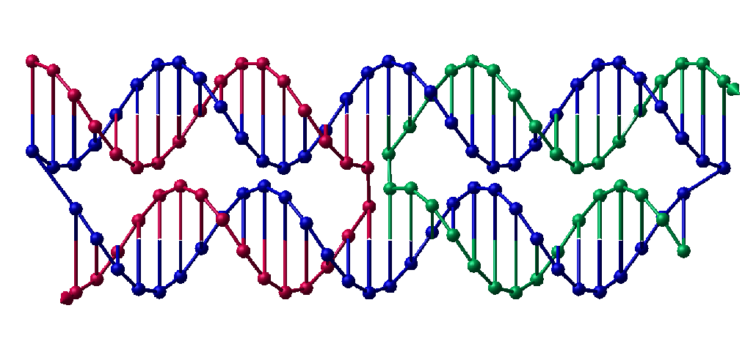
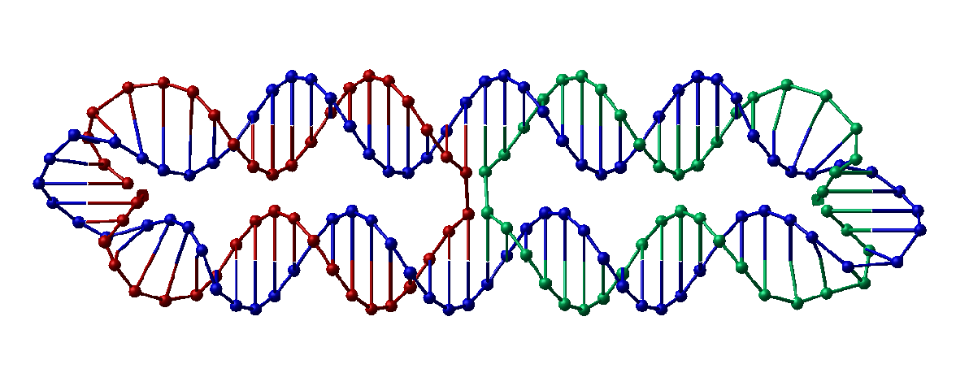
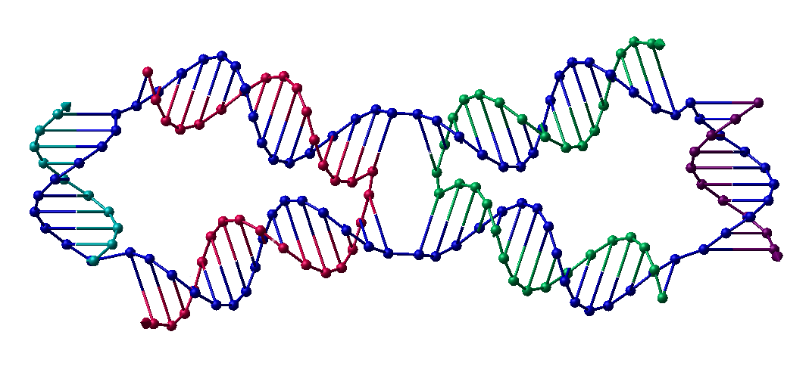
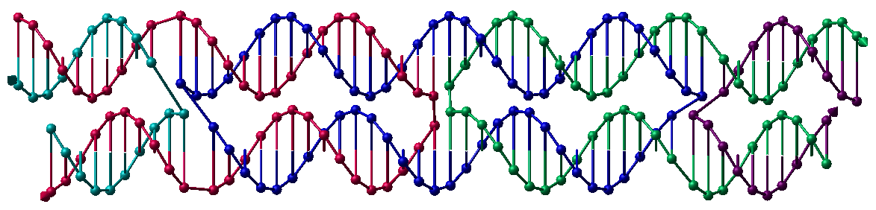
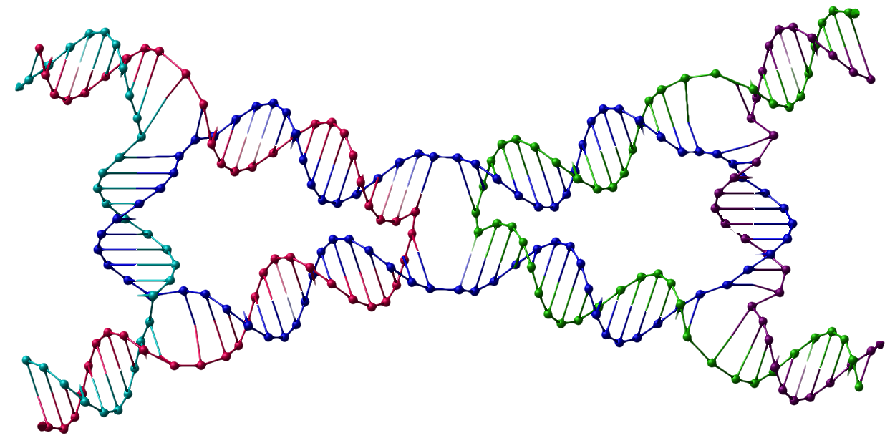
Original Figure 3
A
B
(bp)
(bp)
acDAO-64nt
HJ-c64nt
HJ-c84nt
c84nt nanowire
cDAO-64nt
aHJ-c64nt
c64nt nanowire
tHJ-c84nt
cDAO-c84nt
c64bp
c84bp
Marker
Marker
c64bp
c84bp
500
500
400
400
cDAO-64nt
300
300
HJ-c64nt
aHJ-c64nt
200
200
150
150
100
acDAO-64nt
100
HJ-c84nt
tHJ-c84nt
75
75
50
50
cDAO-c84nt
25
c64nt nanowire
c84nt nanowire
25

Slide 3
Modified Figure 3A for Filming
HJ-c64nt
HJ-c84nt
c84nt nanowire
aHJ-c64nt
c64nt nanowire
tHJ-c84nt
c64bp
c84bp
Marker
c64bp
c84bp
500
400
300
HJ-c64nt
aHJ-c64nt
200
150
100
HJ-c84nt
tHJ-c84nt
75
50
25
c64nt nanowire
c84nt nanowire

Slide 4
Modified Figure 3B for Filming
acDAO-64nt
cDAO-64nt
cDAO-c84nt
Marker
500
400
cDAO-64nt
300
200
150
100
acDAO-64nt
75
50
cDAO-c84nt
25

Slide 5
Original Figure 4
A
B
C
c64nt nanowire
acDAO-c64nt-E
cDAO-c64nt-E
D
E
F
cDAO-c64nt-O
cDAO-c84nt-E
cDAO-c84nt-O

Slide 6
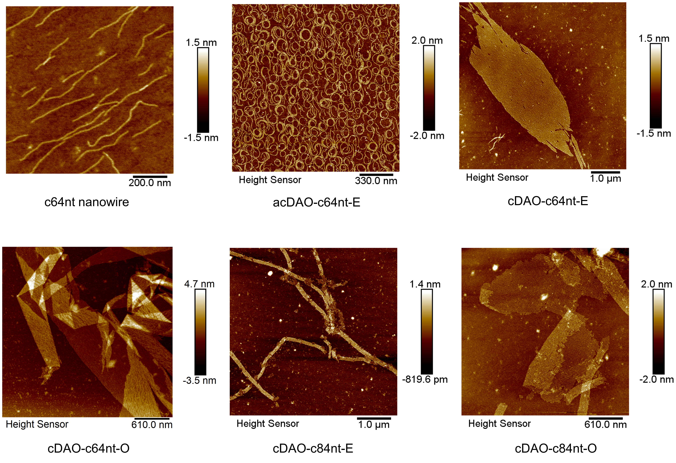
Modified Figure 4 for Filming

Slide 7
Original Figure 5
A
B
5×6 cDAO-c64nt-O
5×6 cDAO-c74&c84nt-O
Modified Figure 5 for Filming
5×6 cDAO-c64nt-O
5×6 cDAO-c74&c84nt-O

