Slide 1

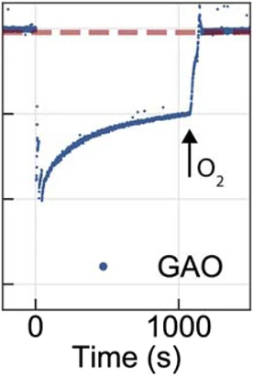
Sheet resistance (Ω)
Time (s)

