Slide 1
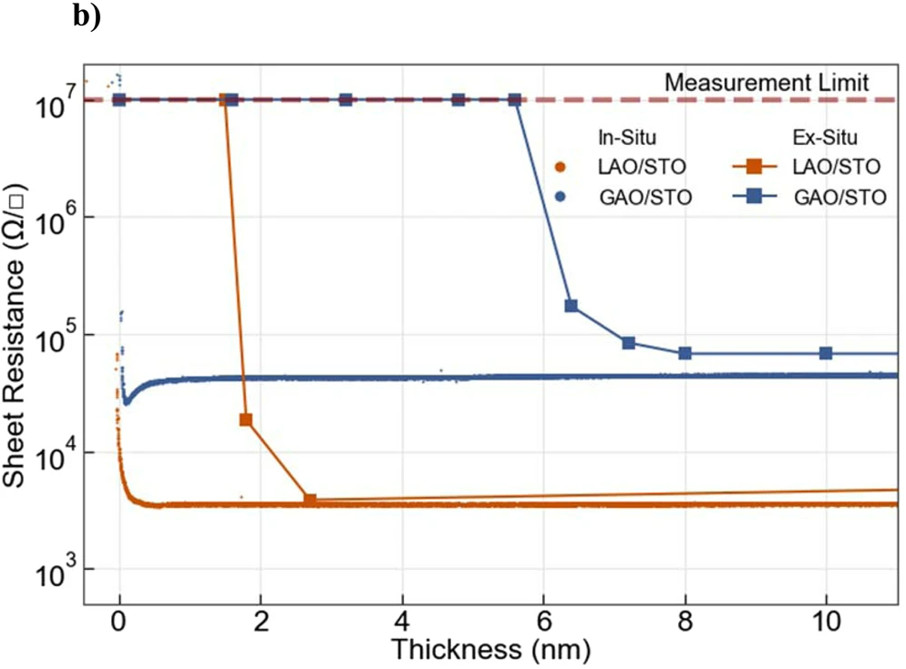
Sheet resistance (Ω)
Thickness (nm)

