Slide 1
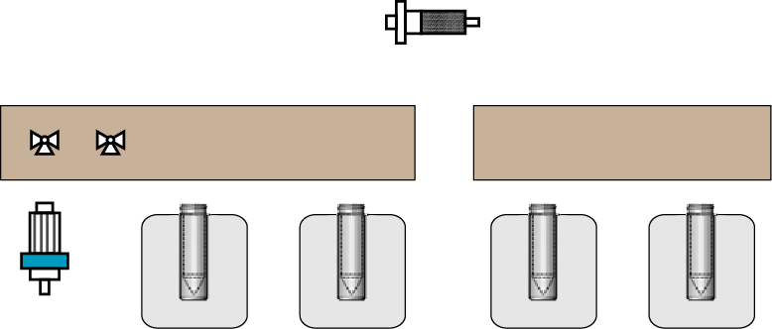
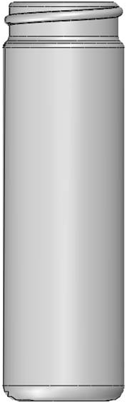
ELIXYS FLEX/CHEM Radiosynthesizer
ELIXYS PURE/FORM Module
Cassette #1
Cassette #2
Liquid Sensor
Cartridge #2
(Silica)
Injection Valve
Column Selector
Separation Column
Radiation Detector
UV Detector
HPLC Subsystem
[¹⁸O]H₂O recovery vial
Radioisotope Input ([¹⁸F]fluoride in [¹⁸O]H₂O)
Eluent
Reagents
N₂
Transfer dip tube
Reagents
N₂
Transfer dip tube
Selection Valve
Waste
Formulation Subsystem
- Syringe pump
Vent Needle
Sterile Filter (2)
Cartridge #1
(QMA)
Final Product Vial
(purified, formulated [¹⁸F]CFA)
Reactor 1
Reactor 1
Reactor 2
Reactor 2

