Slide 1
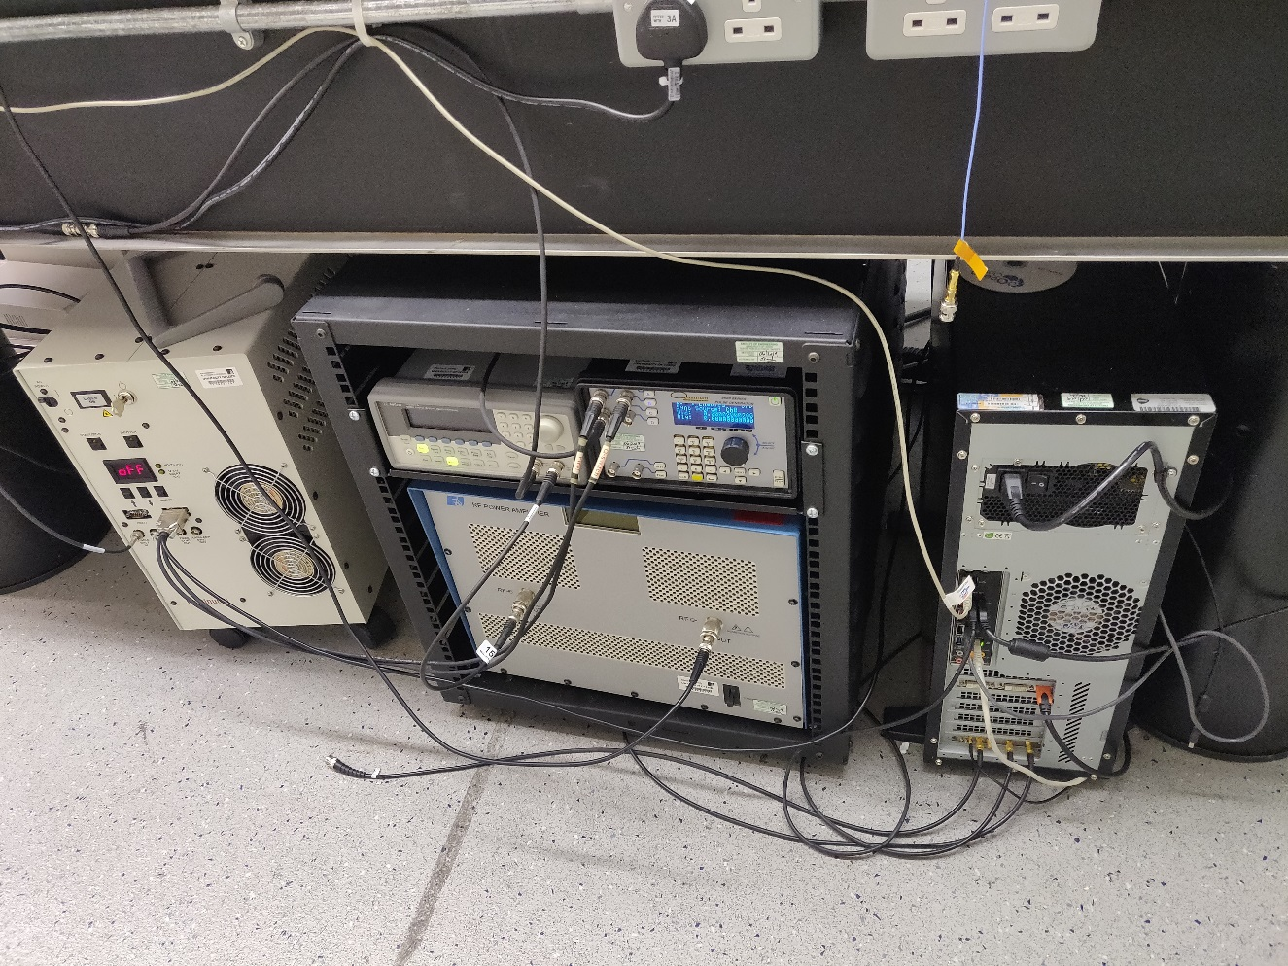
Electrical System from Figure 1
Timing box
Laser PSU
Function Generator
Power Amp
DAQ card

Slide 2
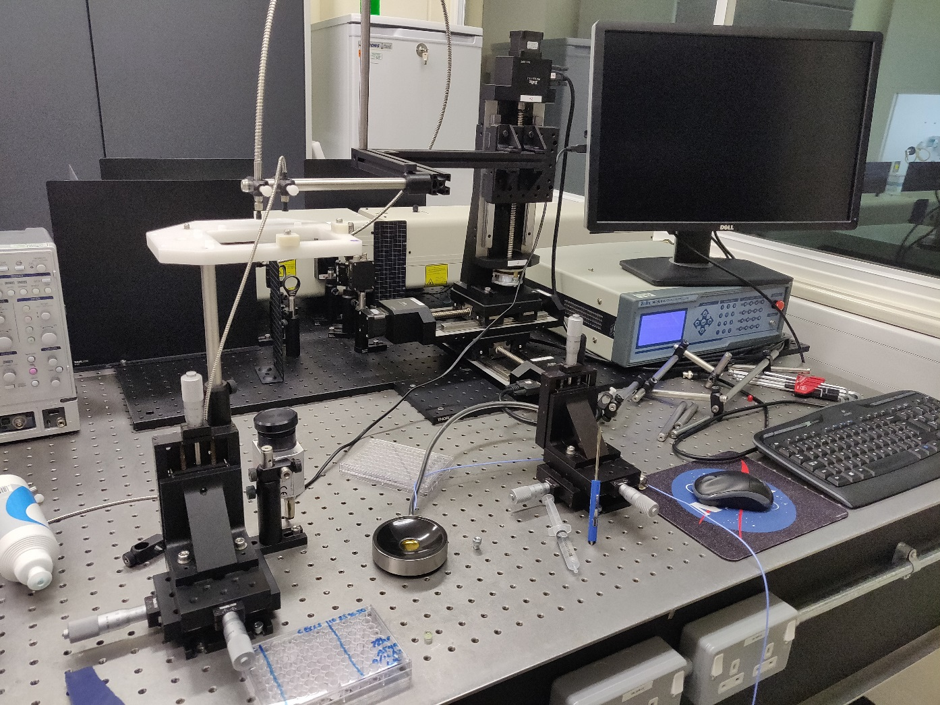
Experimental Workspace
Display used for computer
Fibre optic
Laser
Motorised XYZ stage
Manual XYZ stage

Slide 3
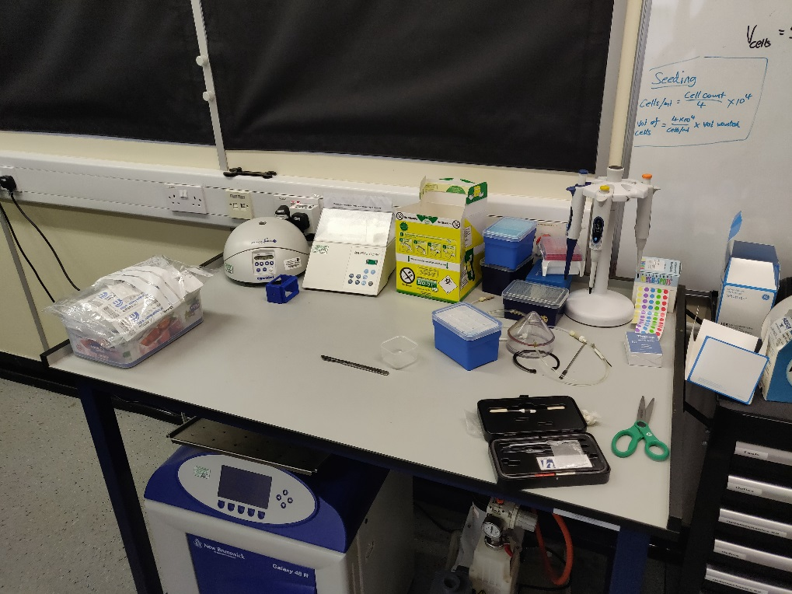
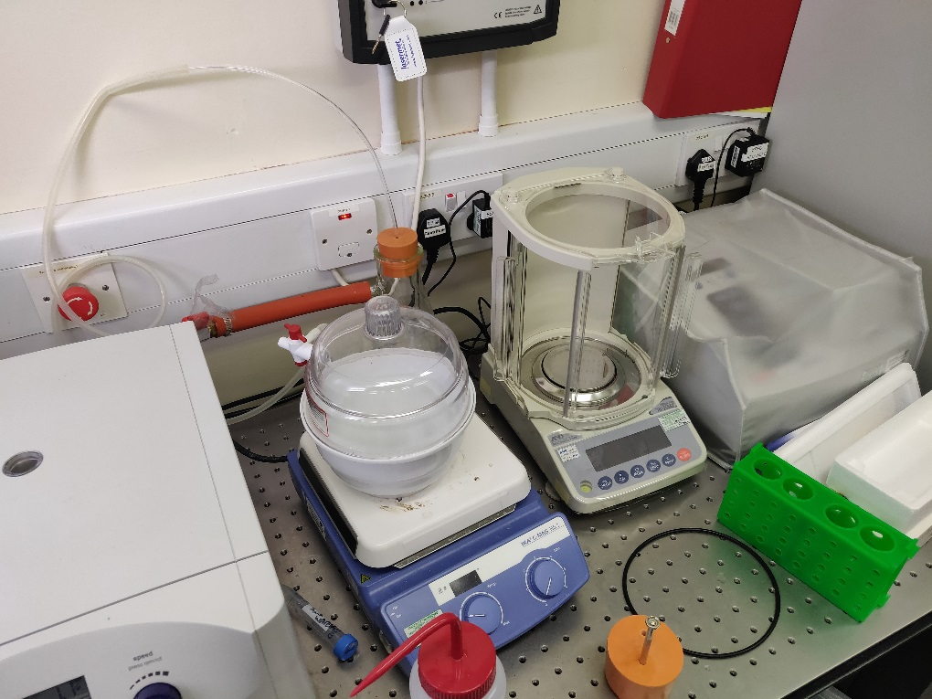
Phantom production workspace
Vacuum chamber on magnetic stirrer

Slide 4
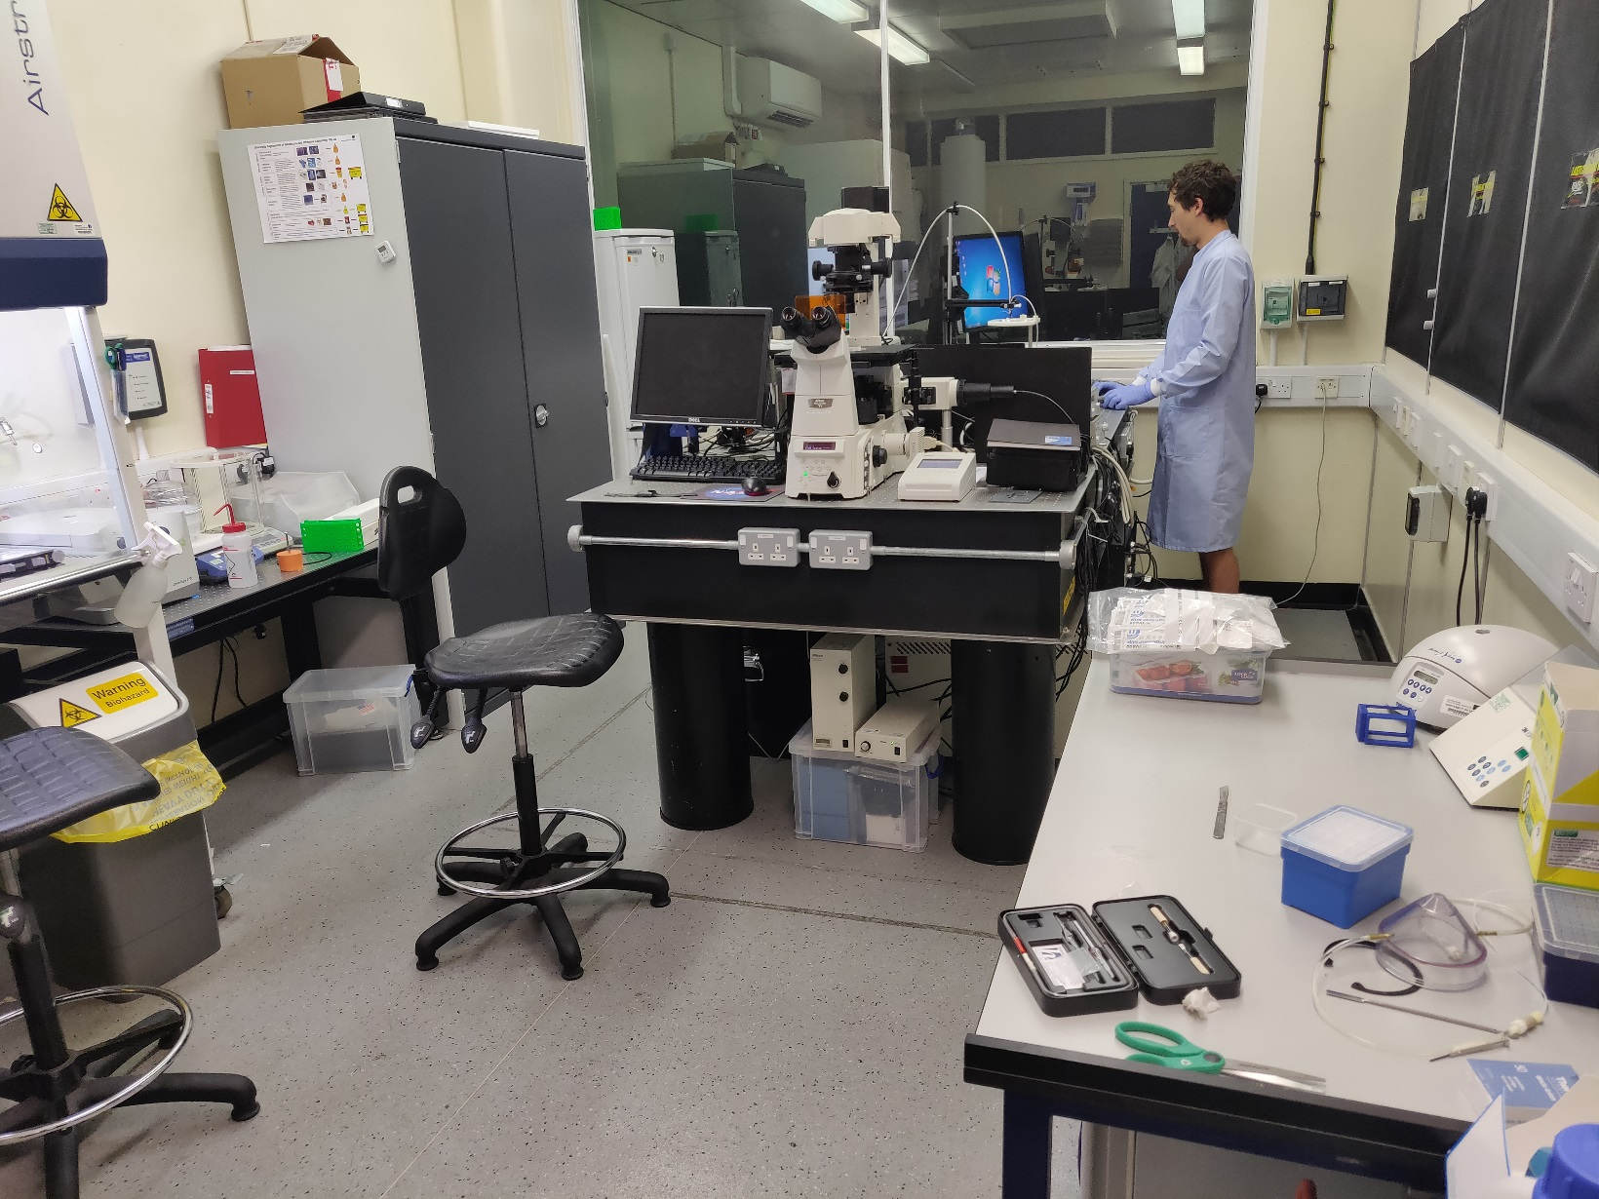
The Lab

