Slide 1
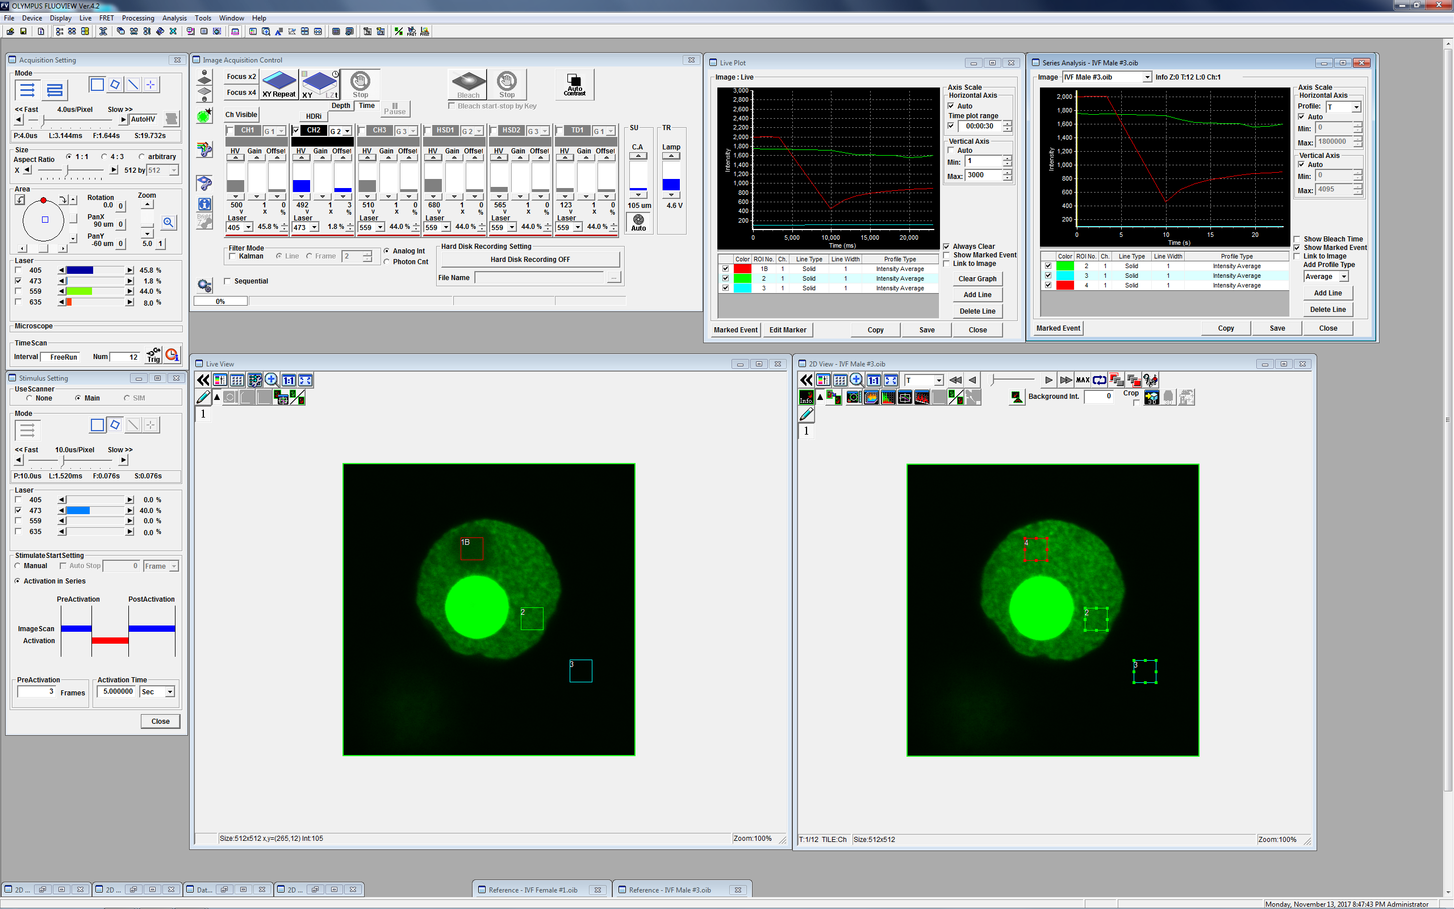
A
(1)
(3)
(6)
(7)
(2)
(4)
(5)

Slide 2
B
(1) Acquisition Setting
(2) Stimulus Setting
UseScanner
Scanning speed
Clip Rect
Size
Laser power gage for bleaching
Digital zoom scroll
Laser power
gage for imaging
PreActivation
FreeRun (1.6 s)
No. of pictures
Activation time
(3) Image Acquisition Control
Focus x 2
Dye list
Stop
“Stimulus Setting”
start button
Time
XY
HV power gage

Slide 3
B (continued)
(4) Live View
(5) 2D VIew
ROI
REF
BG
Series Analysis
(6) Live Plot
(7) Series Analysis
Fluorescence intensity

