Slide 1
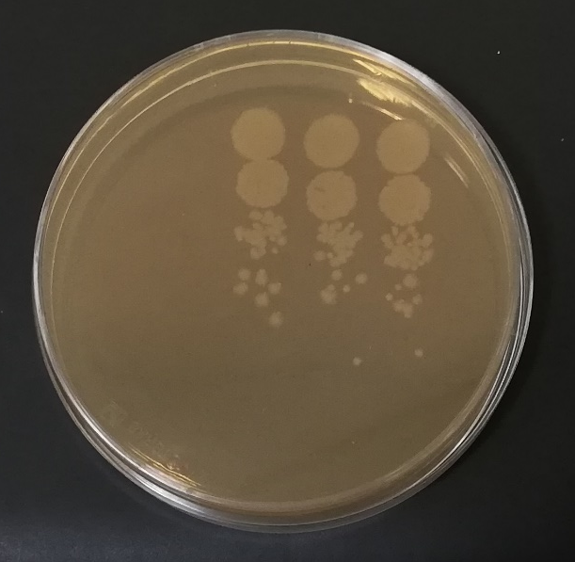
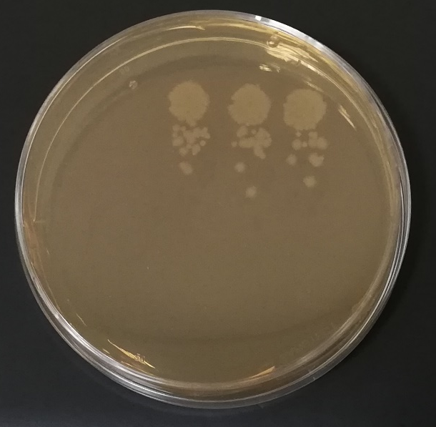
UNDILUTED
UNDILUTED
10⁻¹
10⁻¹
10⁻²
10⁻²
10⁻³
10⁻³
10⁻⁴
10⁻⁴
NOT FILTERED LIBRARY
(Chl only)
FILTERED LIBRARY
(Chl+ Amp)
LIBRARY TITRE=mean colony number x dilution factor x total library volume (μL)

