Slide 1
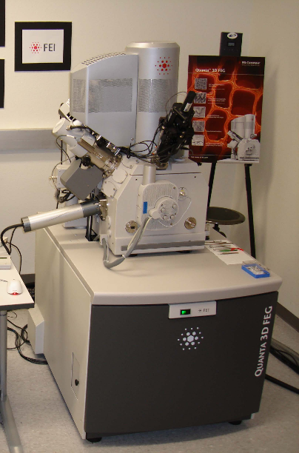
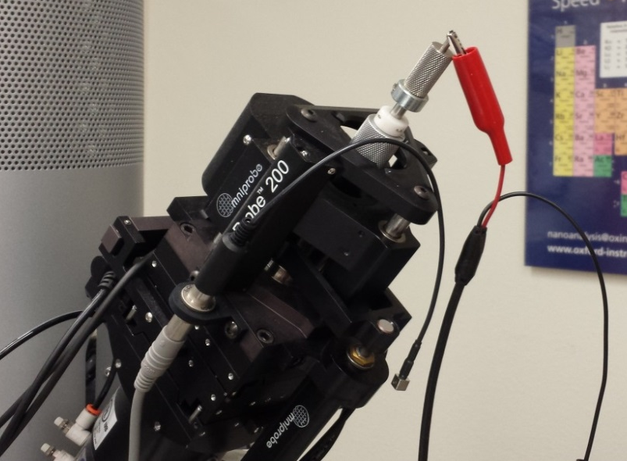
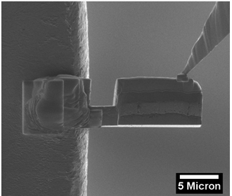
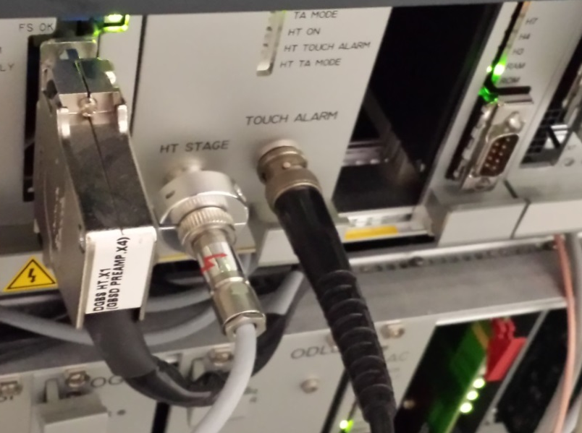
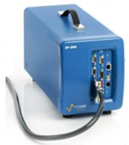
Focused Ion Beam
Micromanipulator
Anode
Connection
Cu grid
Pt/Cu/Si
Pt
LiCoO₂/Au/Al₂O₃
5 μm
Low-Current
Potentiostat
Touch Alarm Connection
Cu grid
400 μm
Stage
Cathode Connection

