Slide 1
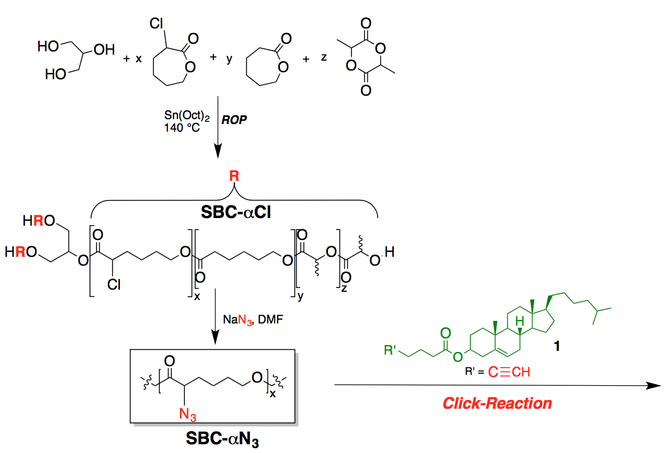
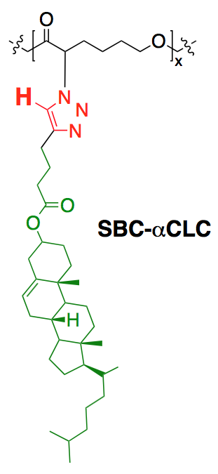
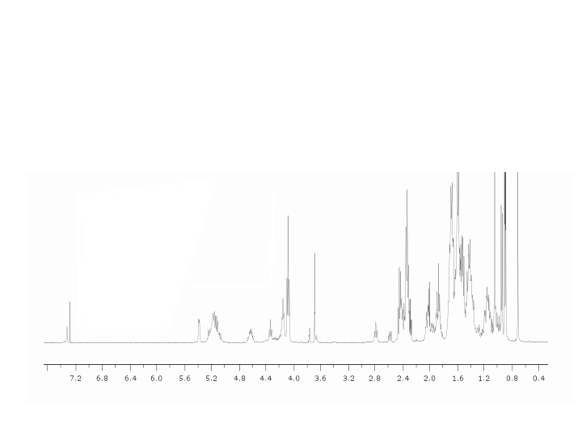
Synthesis of α-chloro Series
1,2,3-triazole ¹H chemical shift
¹H NMR
^{H}

