Slide 1
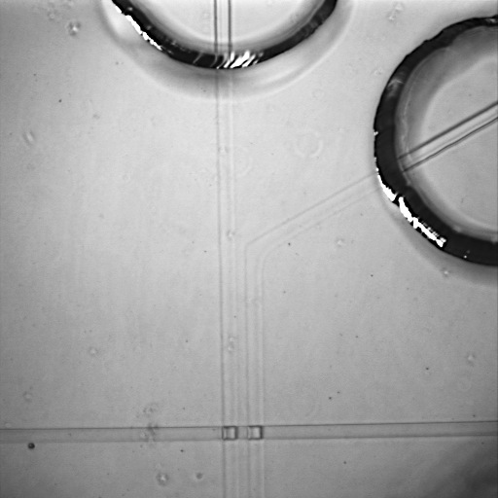
Photo 1
reservoir
patterned
membranes
microchannel

