Slide 1
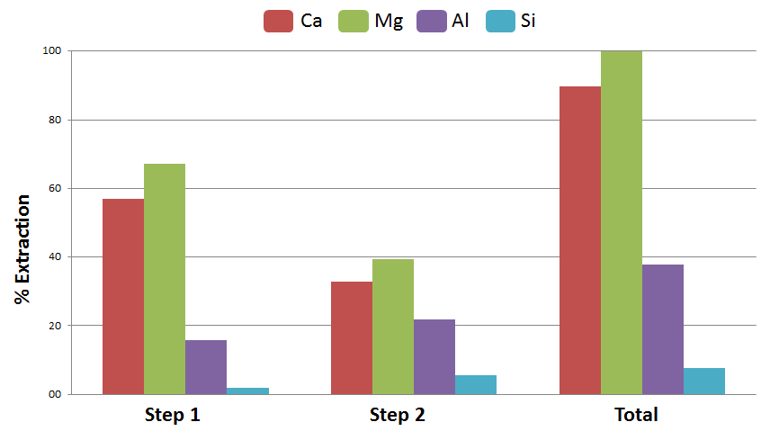
Figure 1

Slide 2
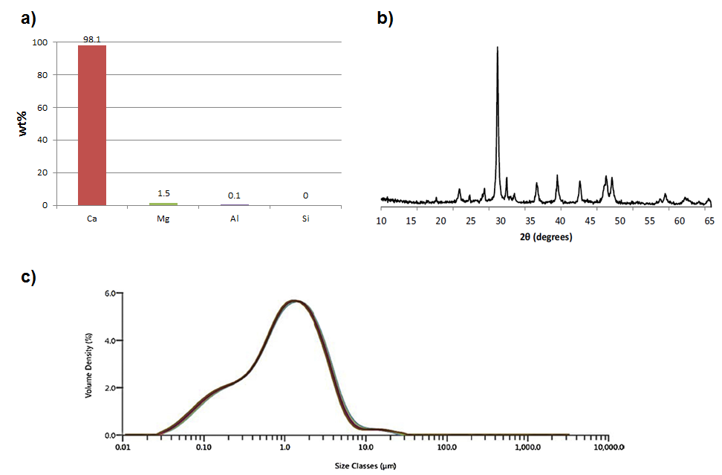
Figure 2

Slide 3
Figure 2 broken up

Slide 4
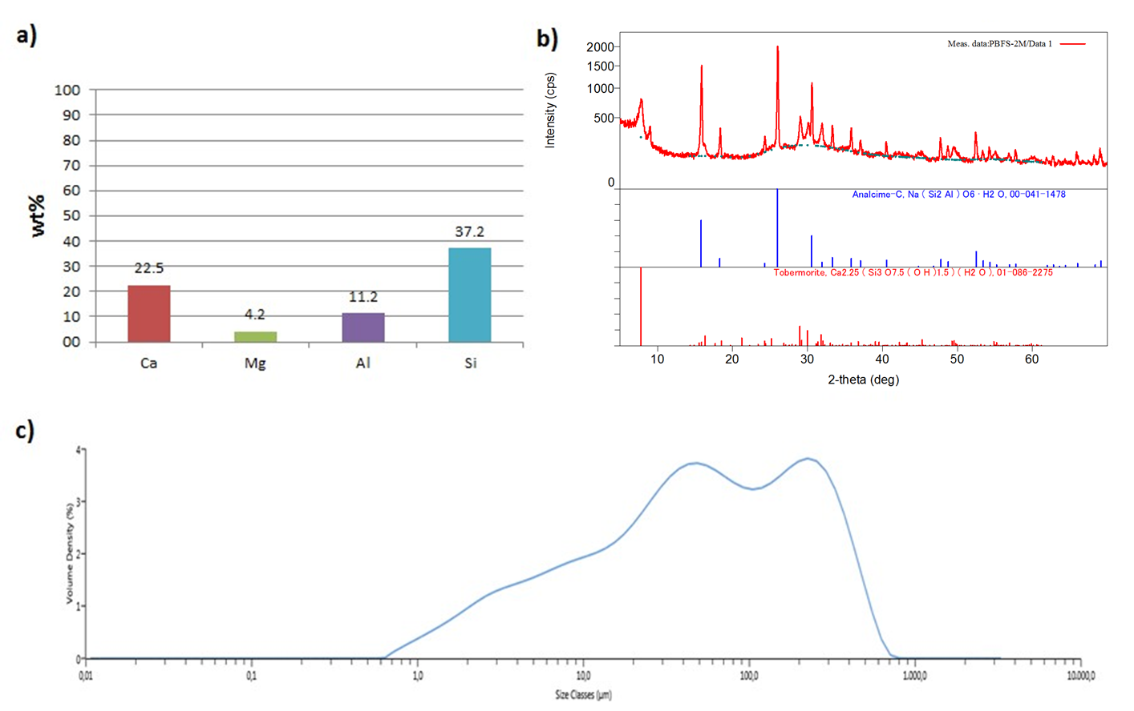
Figure 3

Slide 5
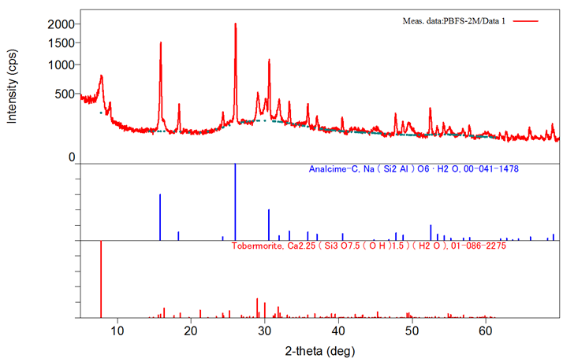
Figure 3 broken up

