Slide 1
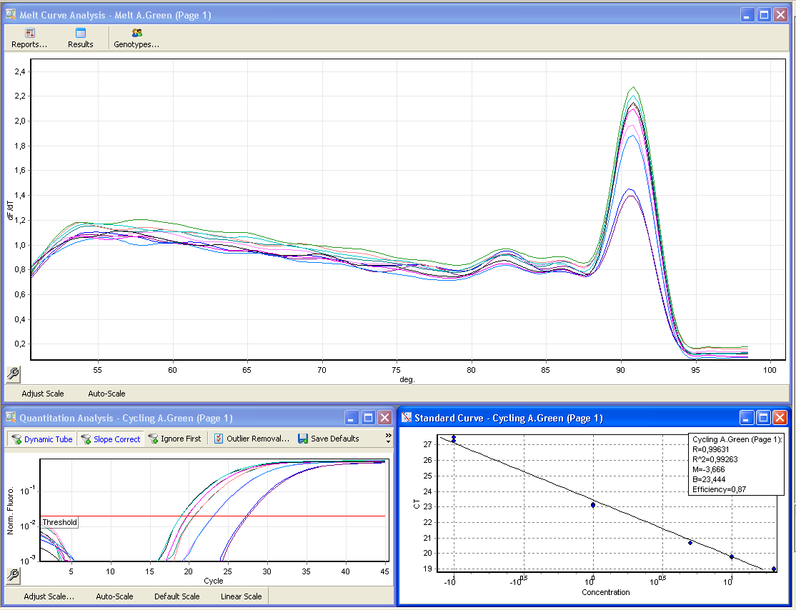
Fig. 2
1. Specificity assesment by melting analysis
2. Quantification by standard curve interpolation

