Slide 1
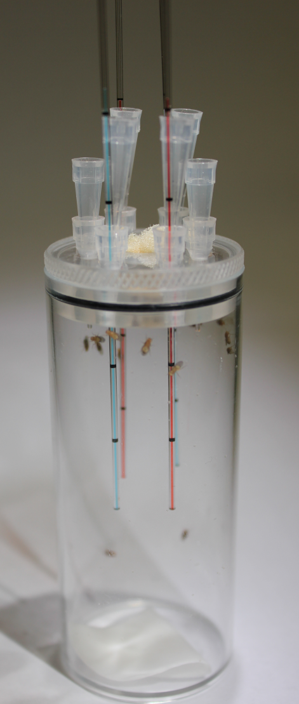
6.6.1-LM/ Figure 1A

