Slide 1
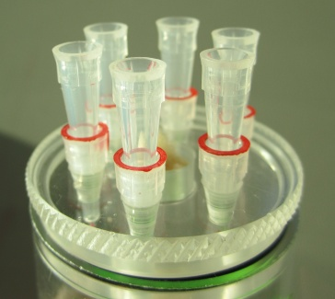
2.2.1-LM/ Figure 1B

