Slide 1
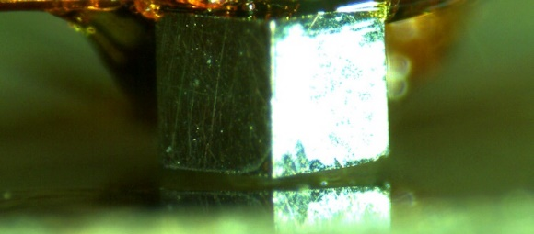


front angle
$$α$$
$$β$$

