Slide 1
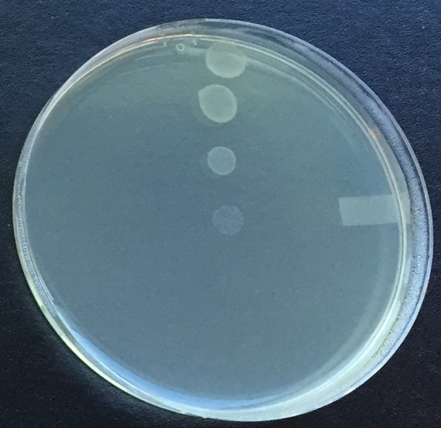
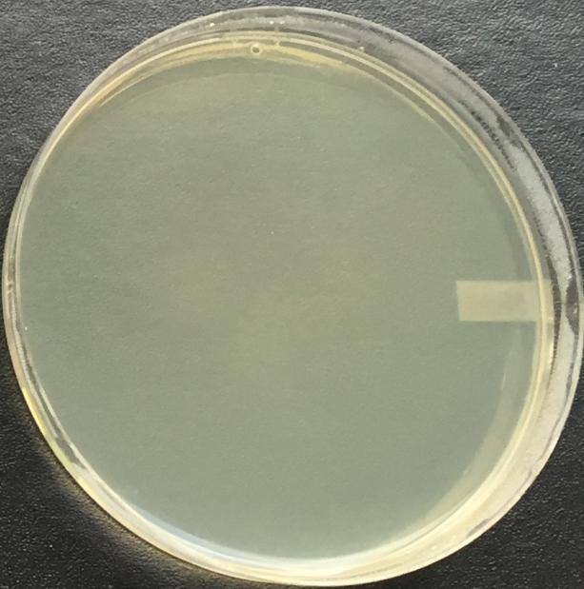
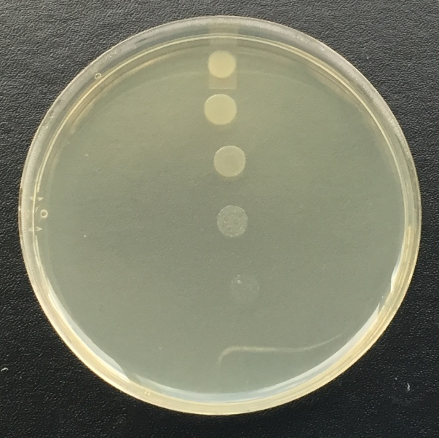
54854_Audette_Figure1
Donor
Transconjugants
Recipient
XK1200
pOX38-Tc ΔtraF::Cm
MC4100
pOX38-Tc ΔtraF::Cm
MC4100

Slide 2
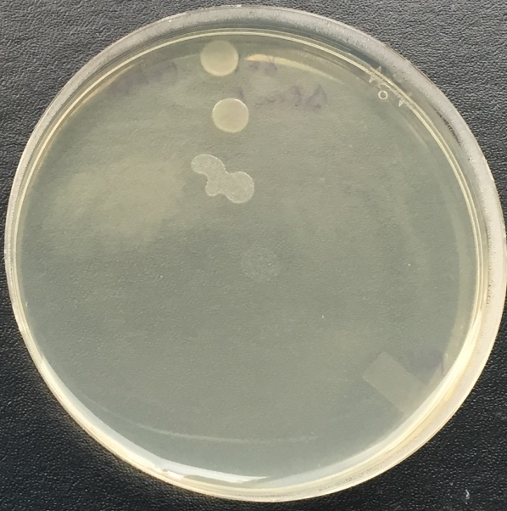

54854_Audette_Figure2
Donor
Transconjugants
Recipient
XK1200
pOX38-Tc ΔtraF::Cm
pK184-traF
MC4100
pOX38-Tc ΔtraF::Cm
MC4100

Slide 3
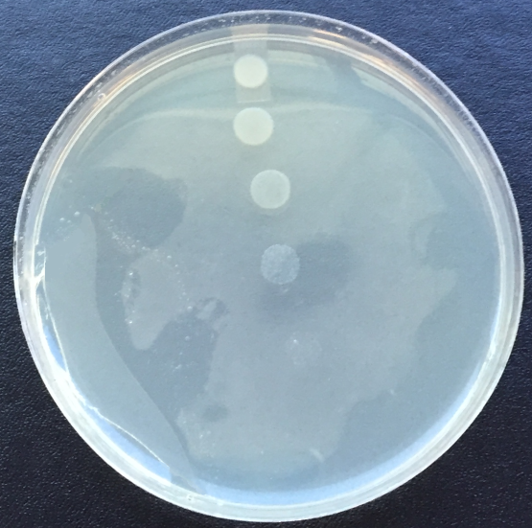
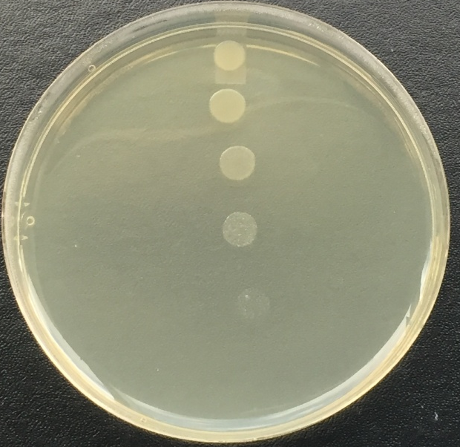
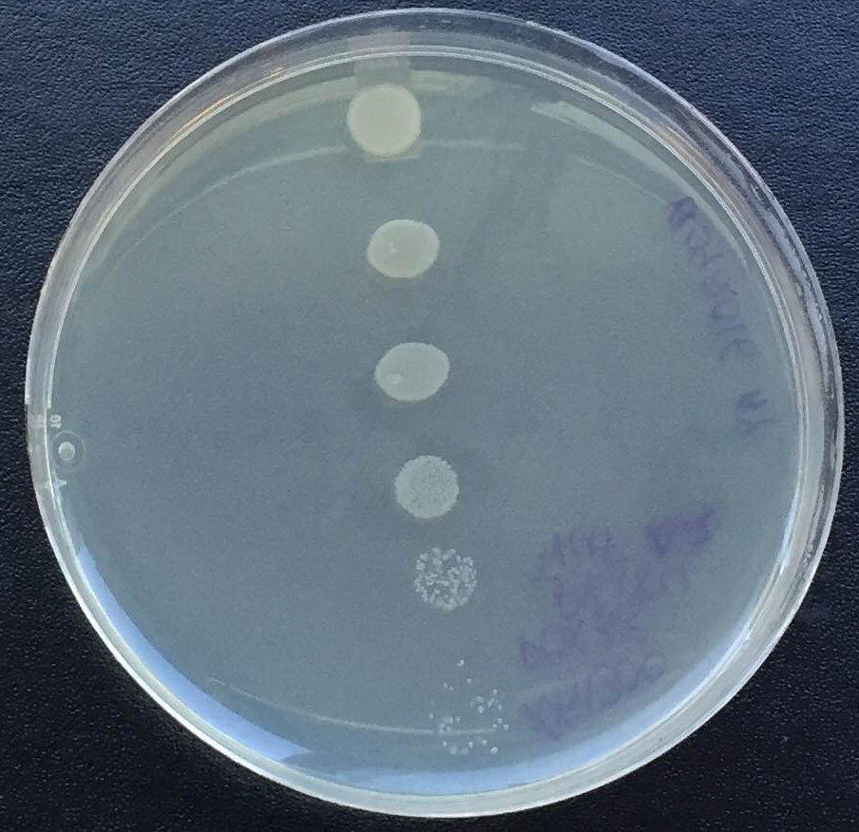
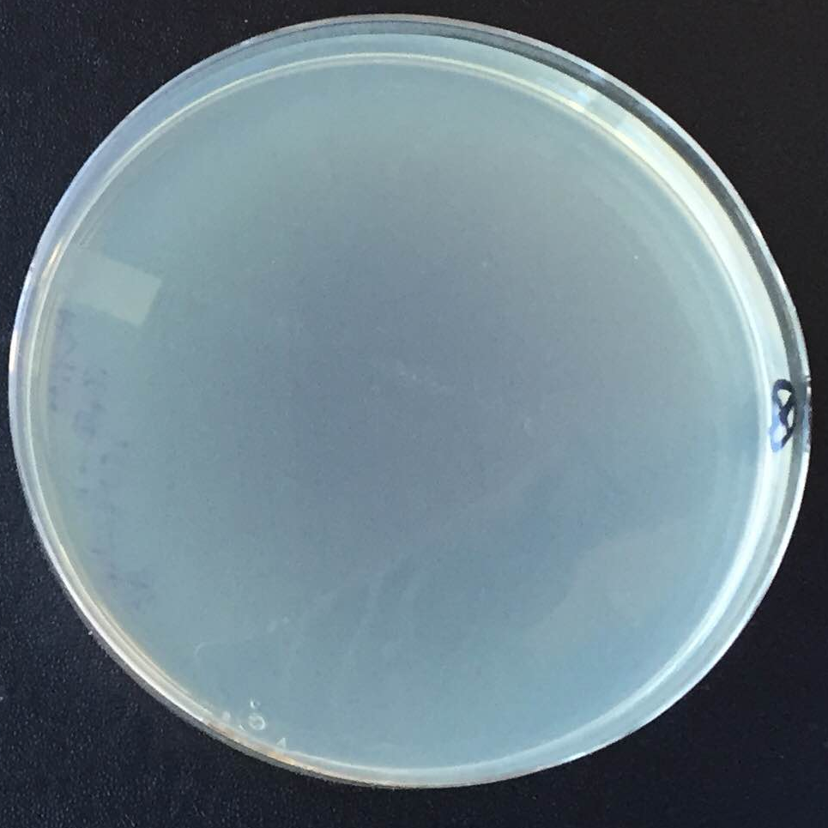
Donor
Transconjugants
Recipient
XK1200 pOX38-Tc ΔtraF::Cm
pK184-traF_{Δ1}
MC4100
pOX38-Tc ΔtraF::Cm
MC4100
XK1200 pOX38-Tc ΔtraF::Cm
pK184-traF_{Δ2}
54854_Audette_Figure3

