Slide 1
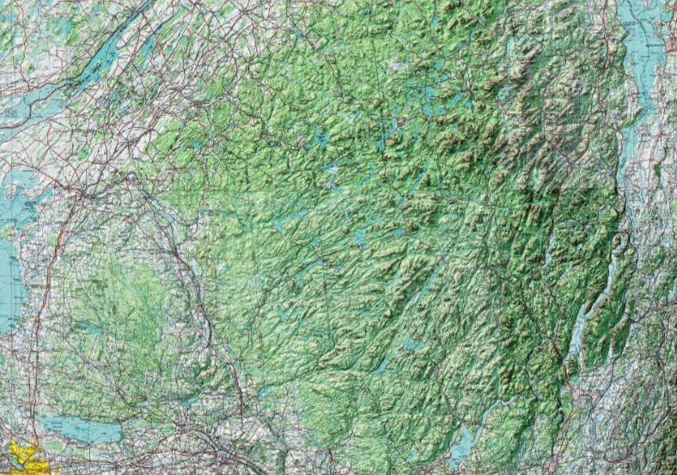
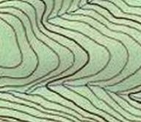
Western Adirondack Region
Stream
Study
Unit
Stream

