Slide 1
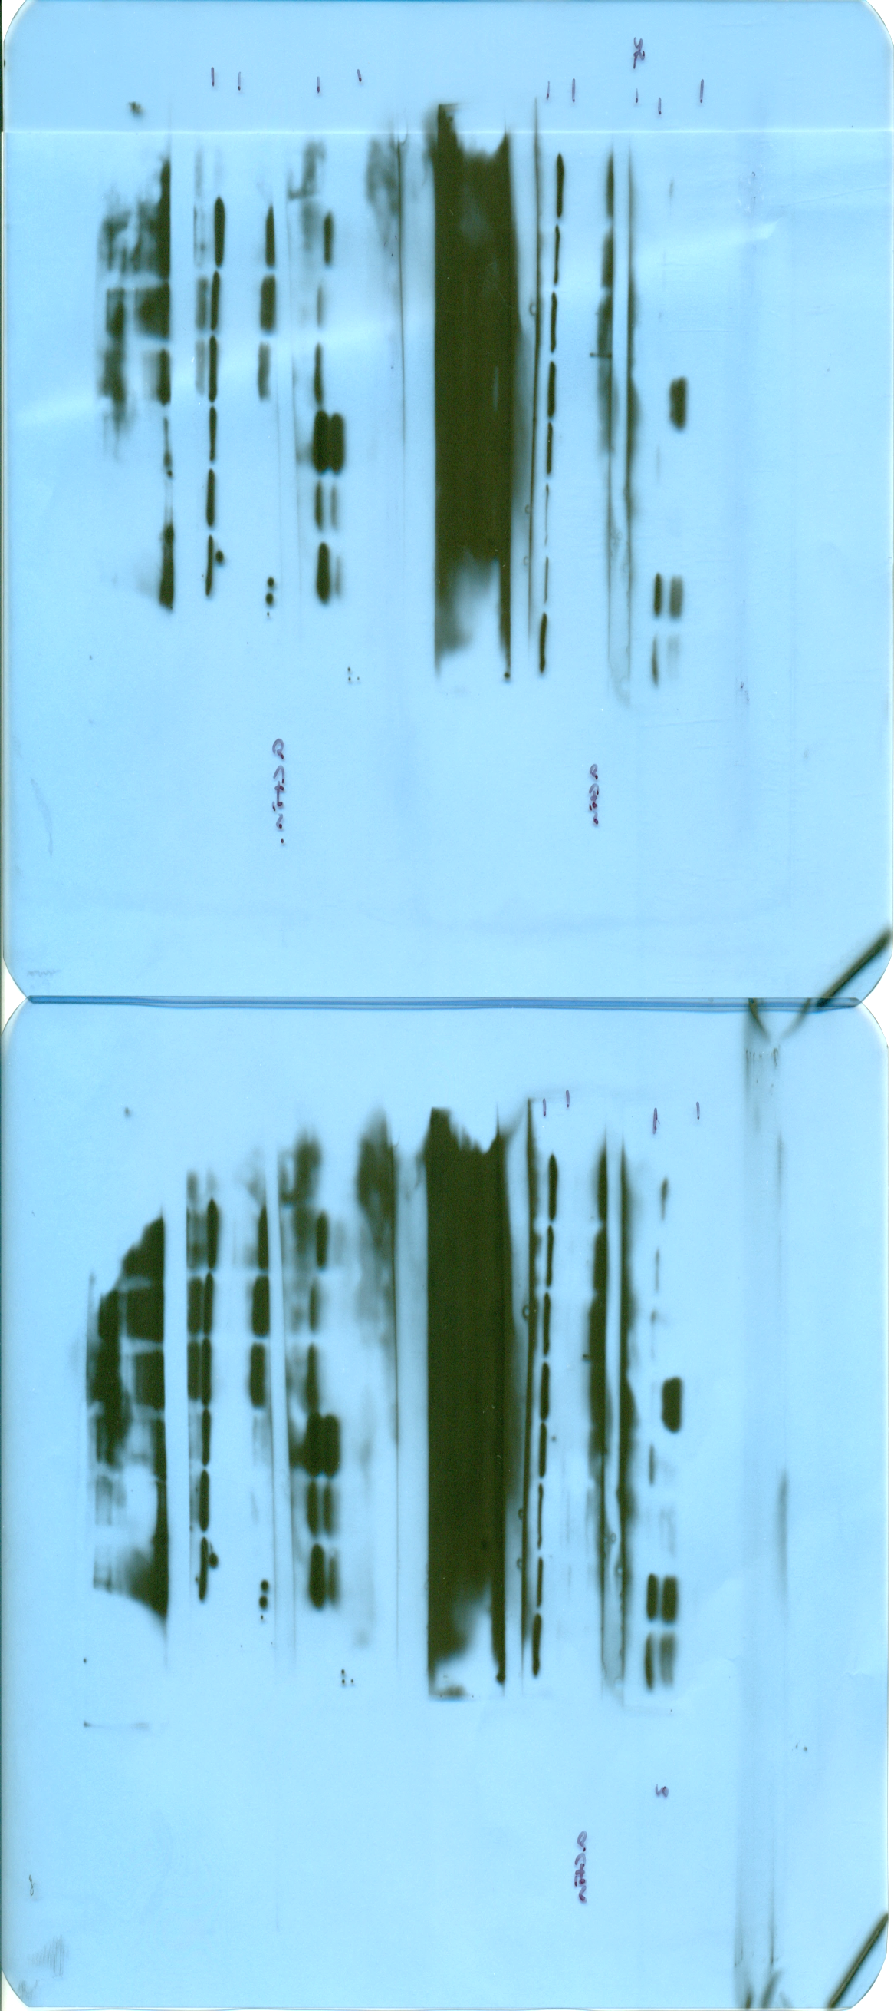

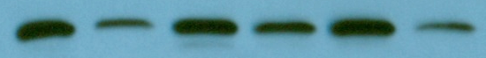

Normal Saline (NS)
Pegylated Superoxide Dismutase (PEG-SOD)
P<0.05
A
B
C
P<0.05
P<0.005
P<0.001
P<0.05
P<0.001
P<0.005
ALT (mU/mL)
MDA (nmol/mg protein)
Total Gluthathions (µmol/g protein)
NS
PEG-SOD
NS
PEG-SOD
NS
PEG-SOD
NS
PEG-SOD
NS
PEG-SOD
NS
PEG-SOD
Pre Hilar Clamp
Post Hilar Clamp and Reperfusion (120 min)
Right lobe
Non-Hilar Clamp
Left lobe
Post Hilar Clamp and Reperfusion
Right lobe
Non-Hilar Clamp
Left lobe
Post Hilar Clamp and Reperfusion
D
Post Hilar Clamp and Reperfusion
F
G
Non-Hilar Clamp
P<0.05
P<0.05
Cleaved caspase - 3
β-actin
E
Left Lobe Post Hilar Clamp and Reperfusion
Cleaved caspase-3/β-actin
Cleaved caspase-3/β-actin
- + - + - +
(PEG-SOD)
Cleaved caspase - 3
β-actin
Non-Hilar Clamp
Post Hilar Clamp and Reperfusion
-
+
(PEG-SOD)
Left lobe Post Hilar Clamp and Reperfusion

