Slide 1
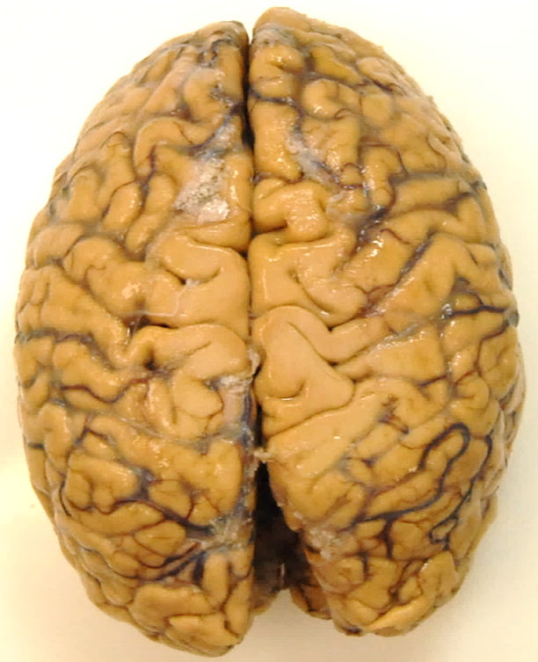
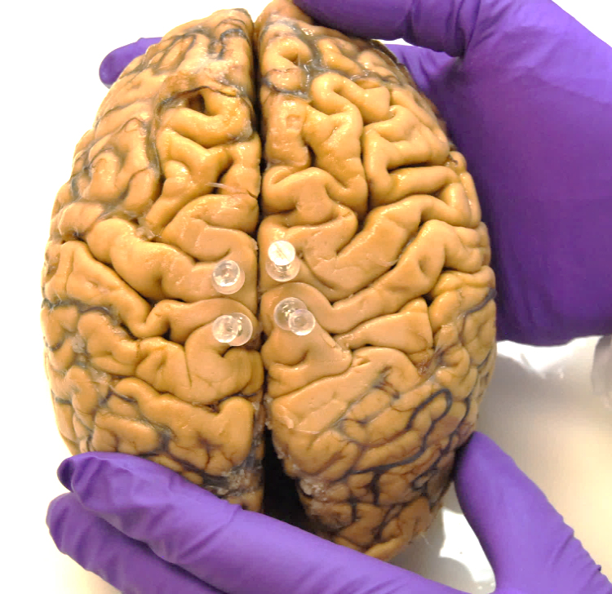
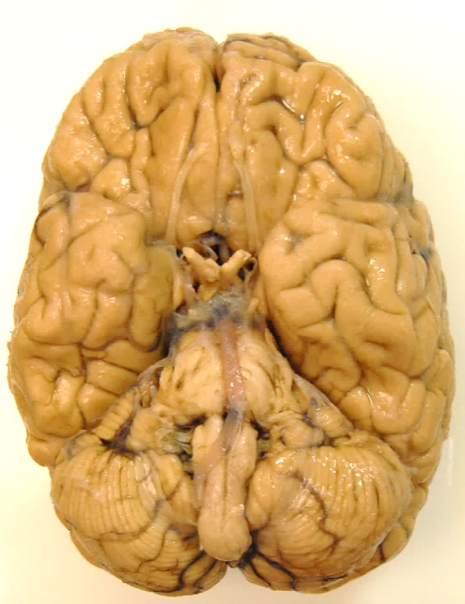
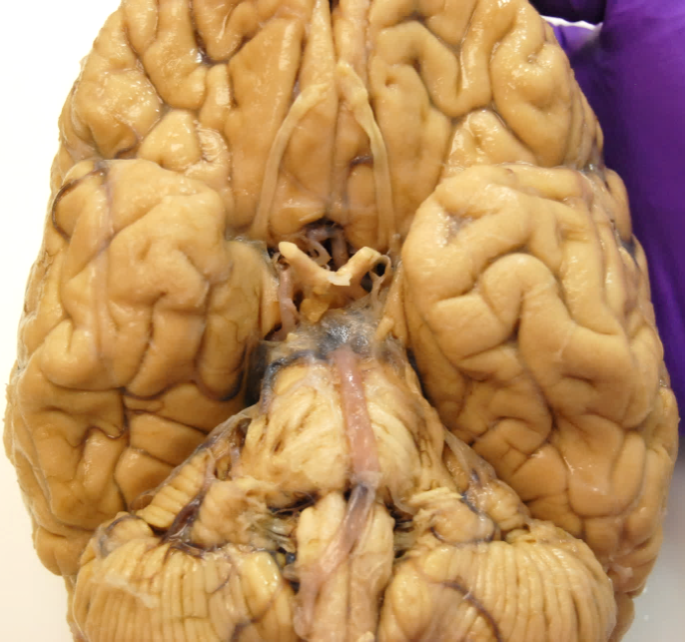
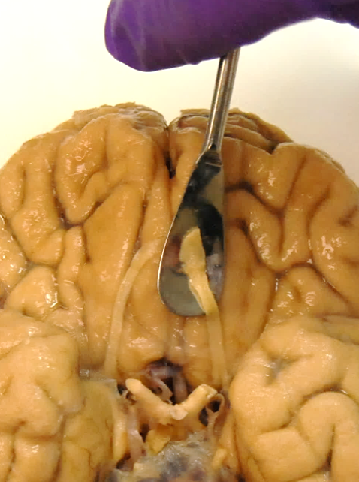
Preliminary Brain Assessment Before Bi-Hemispheric Brain Cutting
Right Pre-central Gyrus
(Primary Motor Cortex)
Right Post-central Gyrus
(Primary Somatosensory Cortex)
Superficial aspects of the cerebrum
a
b
Base of the cerebrum
Brainstem (Pons)
Left Olfactory Bulb and Tract
Cerebellum
c
d
e
Figure 1

Slide 2
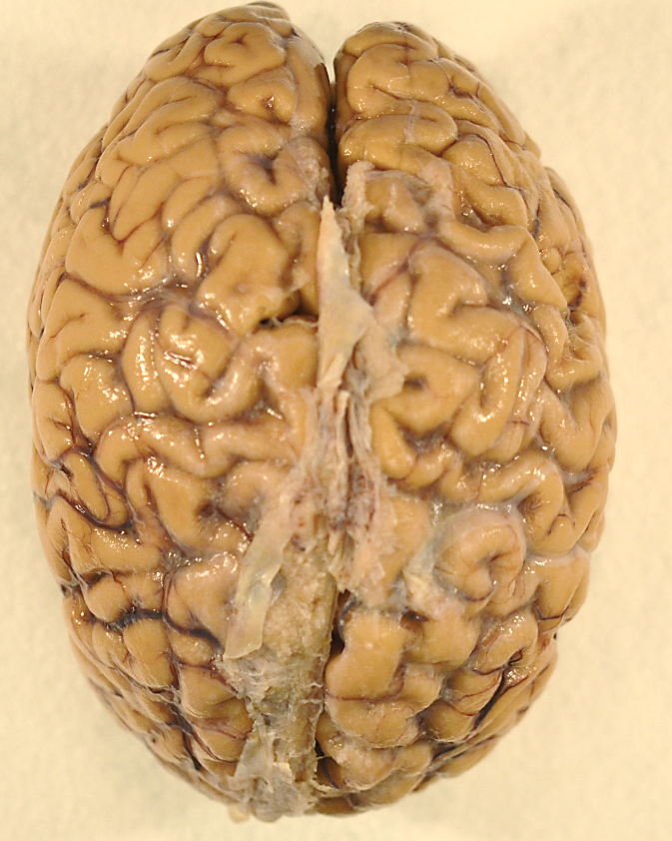
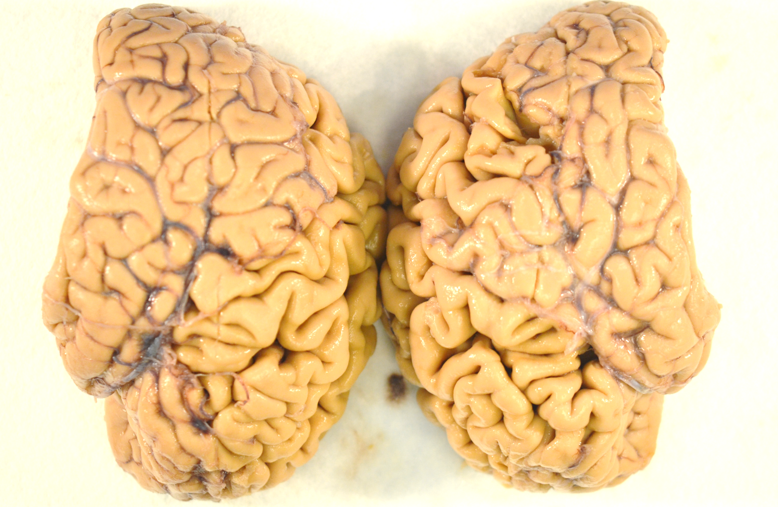

Bi-Hemispheric Brain Cutting For Human Neuropathologic Analyses
a
Frontal Poles
b
Frontal Poles
Fronto-Occipital
Cutting Direction
Longitudinal Fissure
1 cm
Occipital Poles
Occipital Poles
Left-H
Right-H
Left-H
Right-H
Figure 2

Slide 3
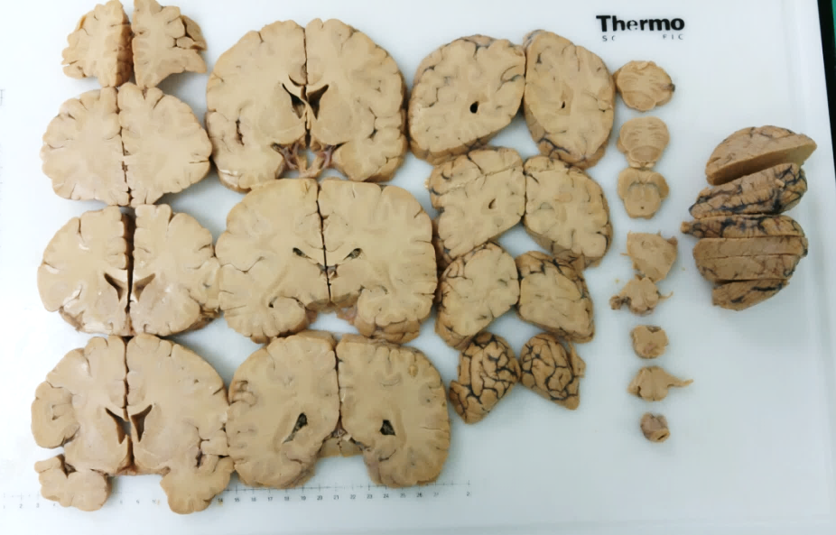
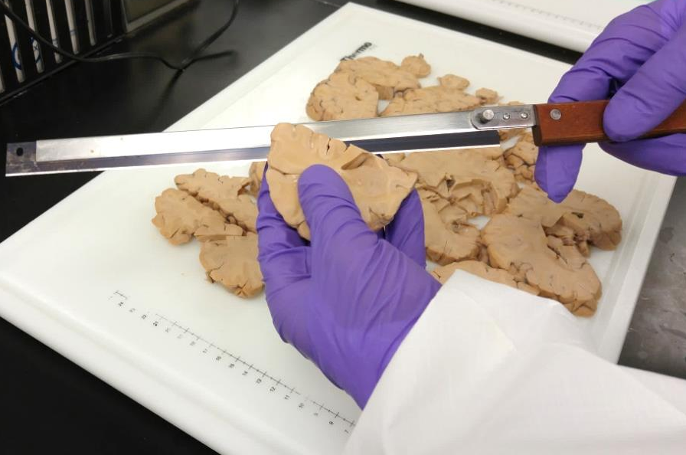
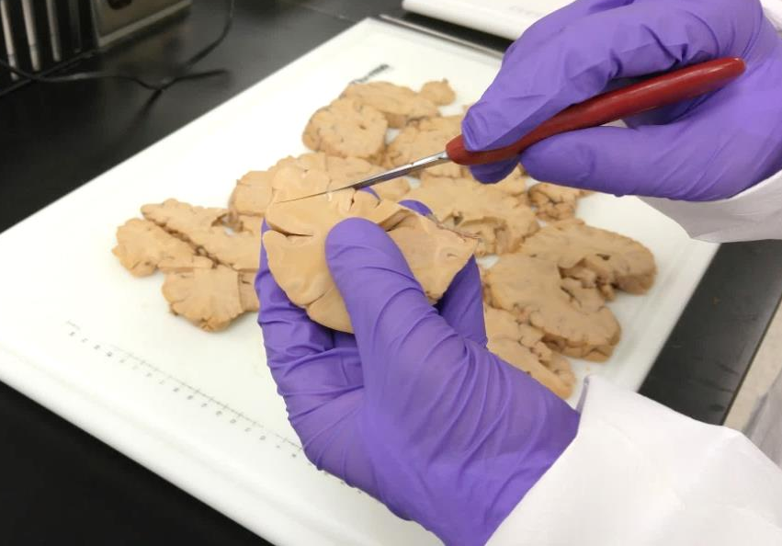
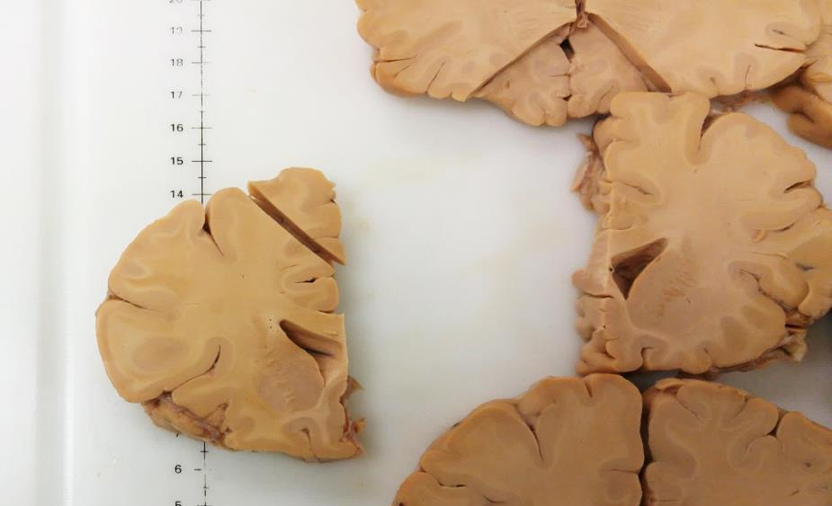
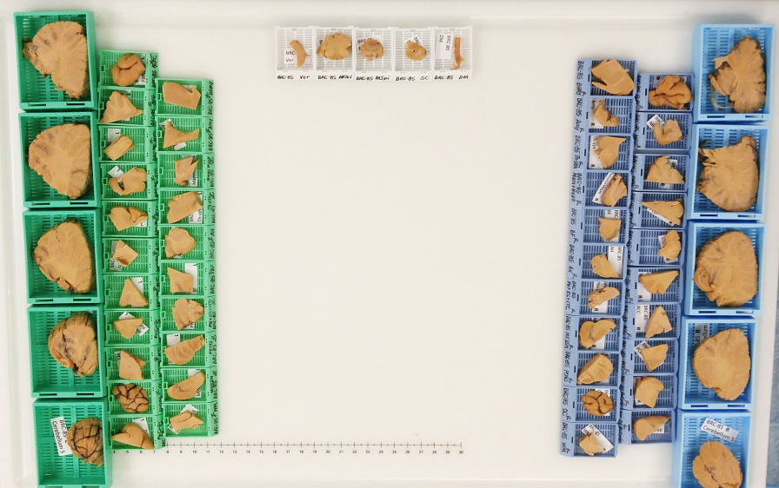
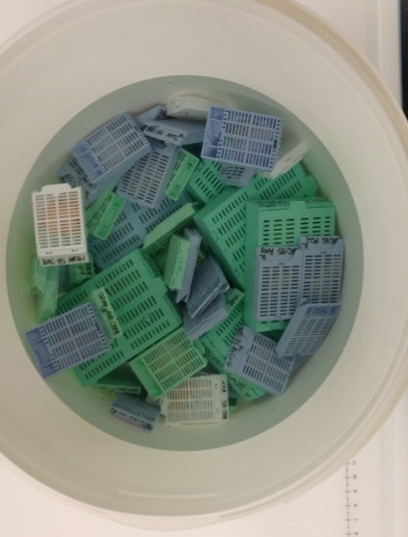
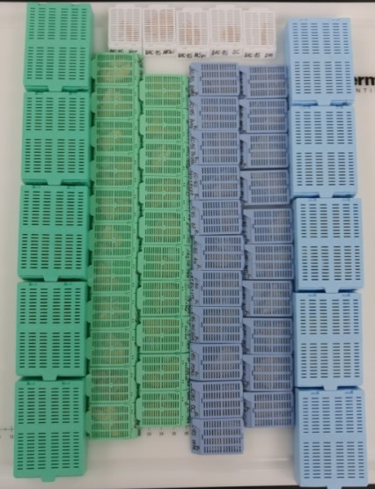
Bi-Hemispheric Brain Cutting Procedures
a
b
c
a
b
c
d
e
f
g
d
e
f
g
Figure 3

Slide 4
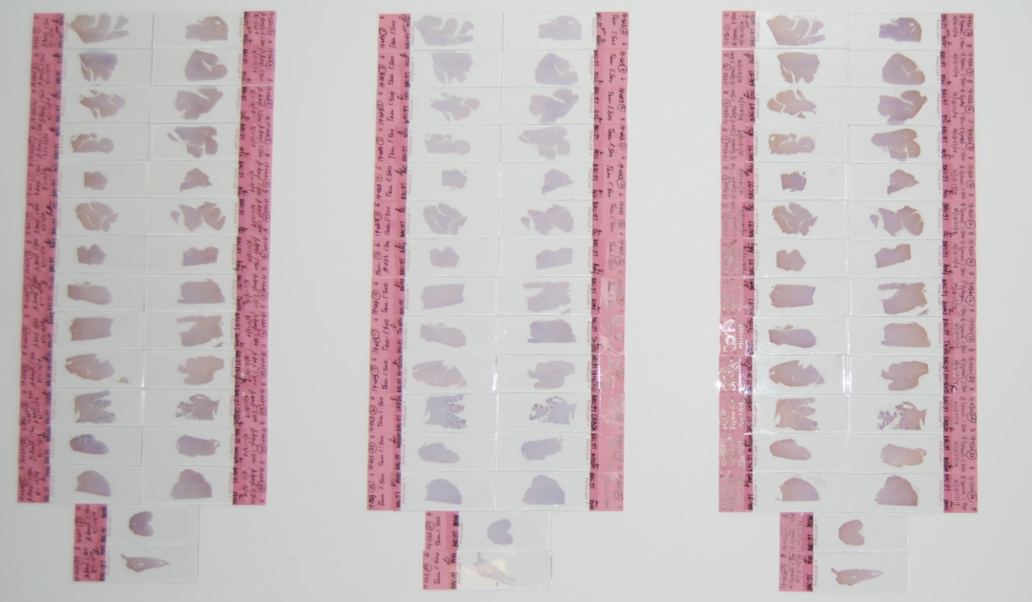
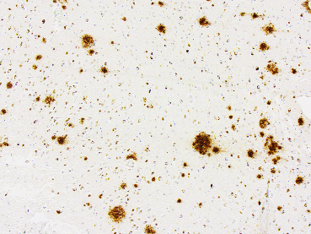
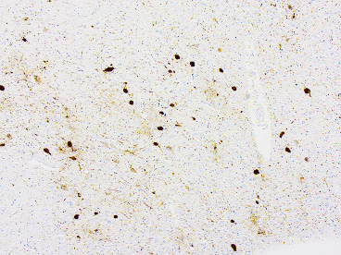
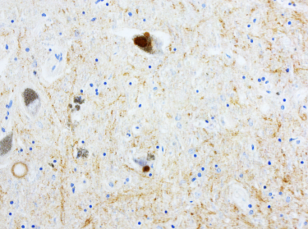
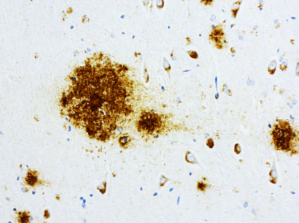
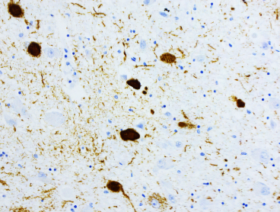
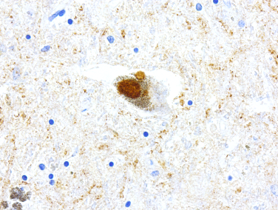
Tissue Sections From Each Cerebral Hemisphere Stained for Different Antigens by Immunohistochemistry
β-Amyloid
Tau
α-syn
LH
RH
LH
RH
LH
RH
A
5x
5x
20x
B
20x
20x
40x
Figure 4
Beta-Amyloid Neuritic Plaques
Tau-Neurofibrillary Tangles
Alpha-syn Lewy Bodies

