Slide 1
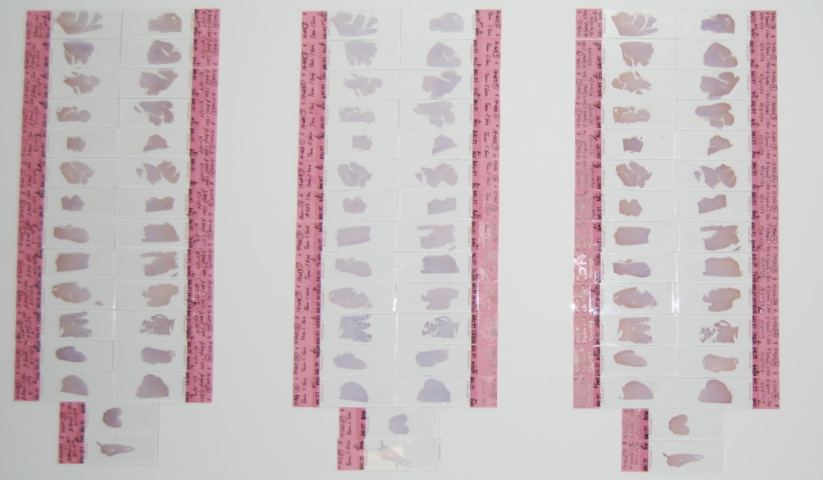
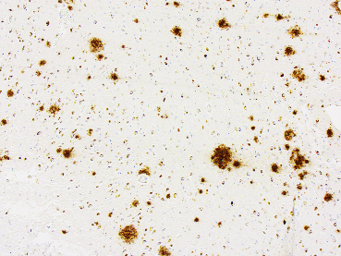
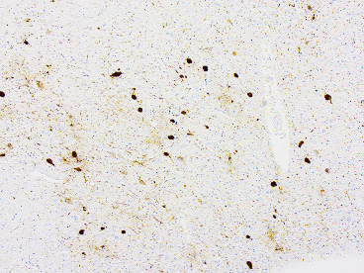
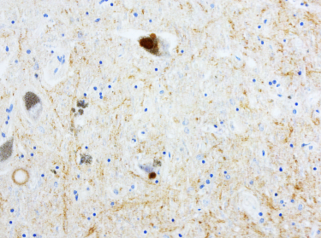
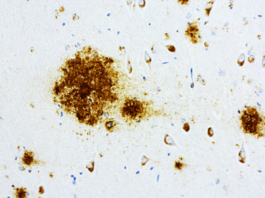
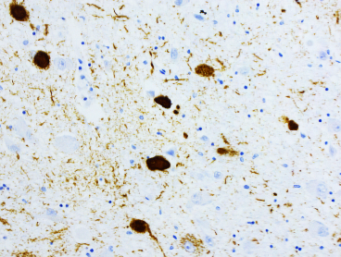
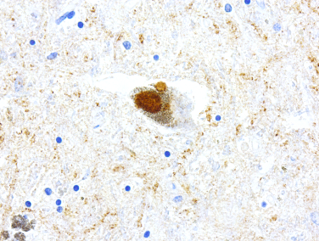
Tissue Sections From Each Cerebral Hemisphere Stained for Different Antigens by Immunohistochemistry
β-Amyloid
Tau
α-syn
LH
RH
LH
RH
LH
RH
A
5x
5x
20x
B
20x
20x
40x
Figure 4
Beta-Amyloid Neuritic Plaques
Tau-Neurofibrillary Tangles
Alpha-syn Lewy Bodies

