Slide 1
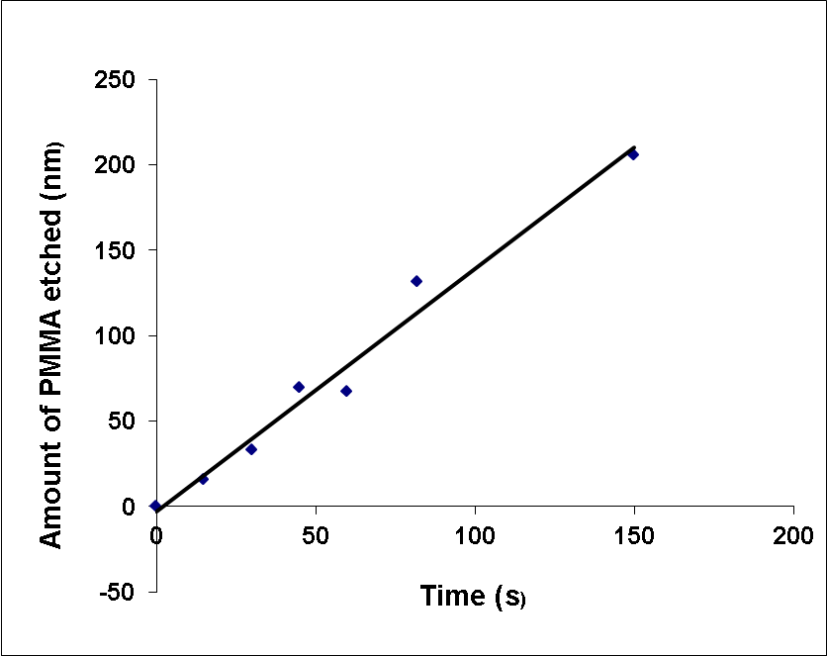
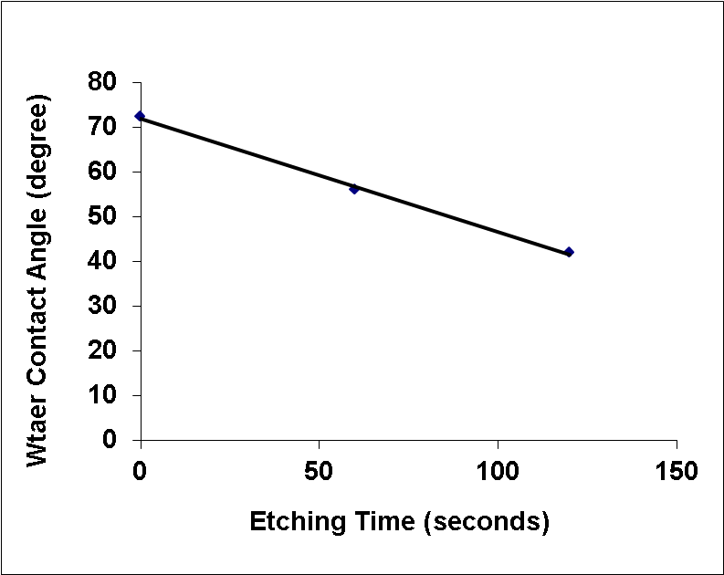
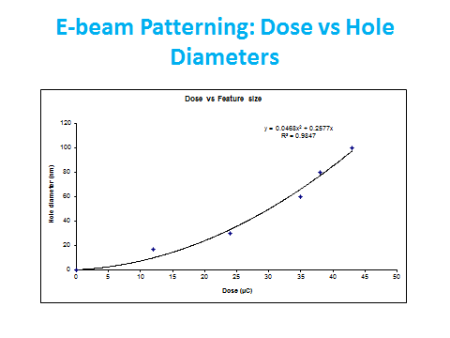
Supplementary Information
a
b
c
d
Figure Sa)Average rate of etching in oxygen plasma was 1.5 nm/sec for 950 kD PMMA b) change in the contact angle as function of etching. Water contact angles of PMMA decreases with etching time (0.25 nm/sec) confirming hydrophilicity of PMMA surface due to conversion of ester RCOOR group to COOH group c) During GNP wet etch their particle diameter decreased with approximately first order rate constant of 0.3 min⁻¹ d) E-beam dose vs. feature size. We were unable to pattern features below 30 nm consistently.

