Slide 1
Shankar B. Rananavare Moshood K. Morakinyo
Use of Sacrificial Nanoparticles to Remove the Effects of Shot-Noise in Contact Holes Fabricated by E-Beam Lithography
Submission ID #: 54551
Editor Name: Tara Cass

Slide 2
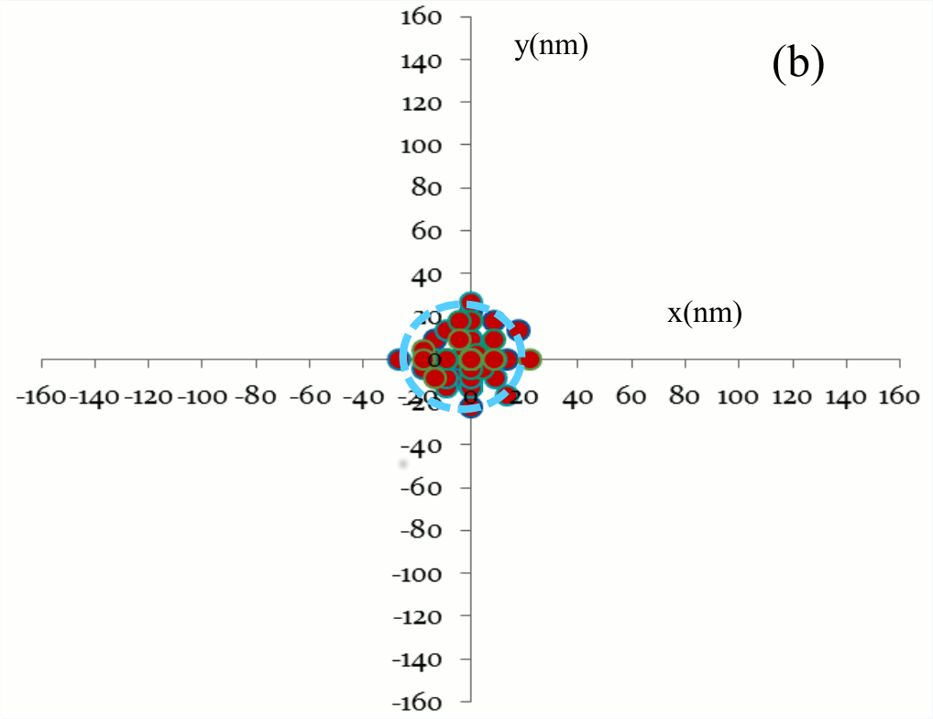
Figure 2a Histogram

Slide 3
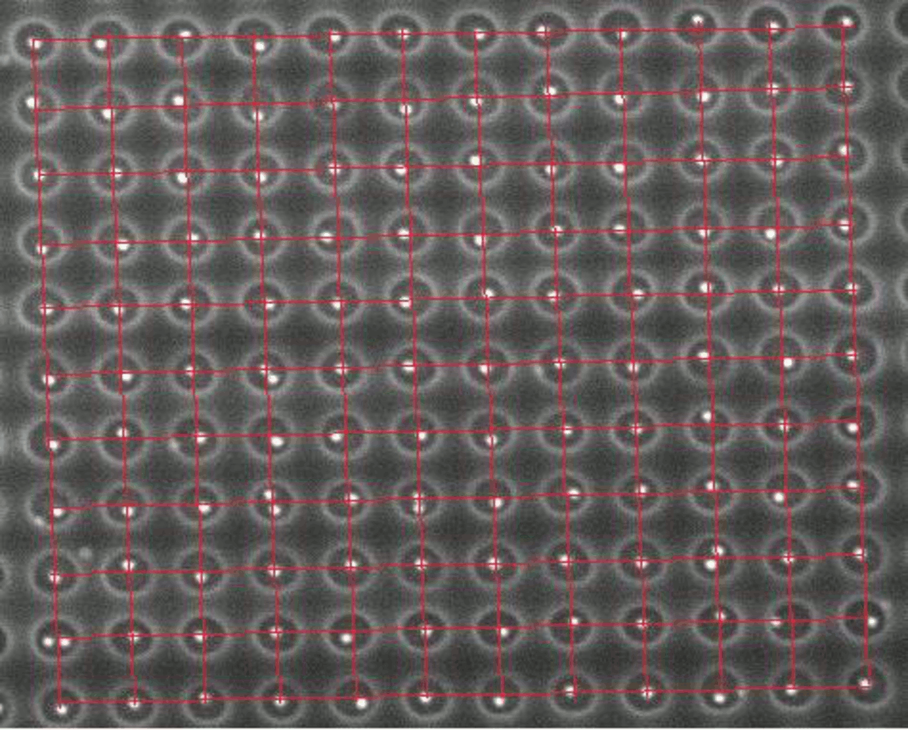
Figure 2a SEM

Slide 4
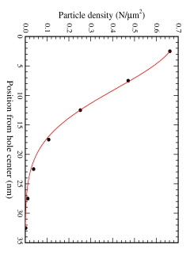
Figure 2a-Gaussian

Slide 5
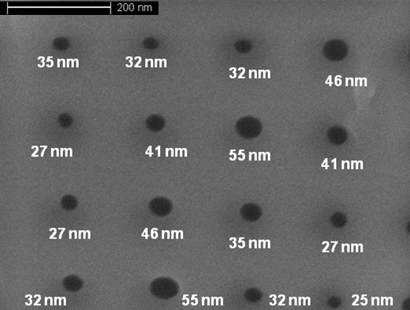
Figure 1 inset

Slide 6
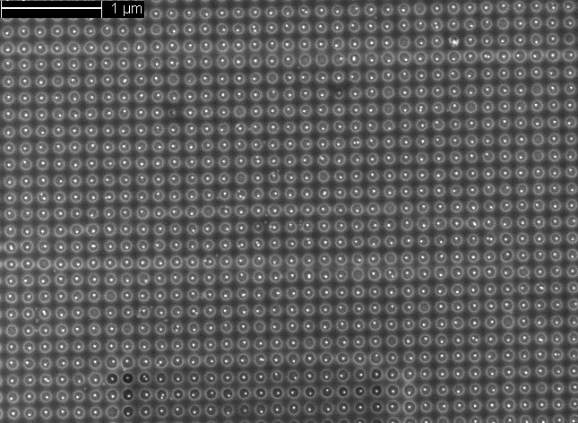
Figure 2b

Slide 7
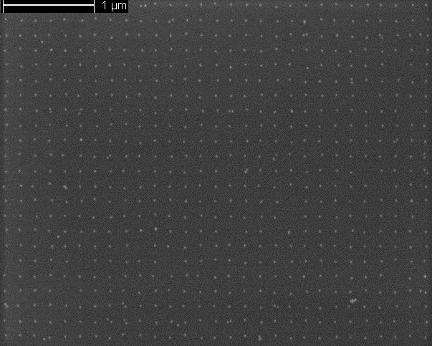
Figure 2c

Slide 8
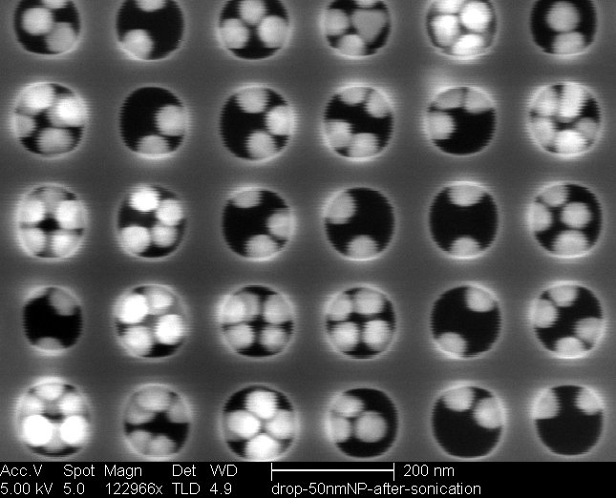
Figure 3 SEM Evaporative Deposition

Slide 9
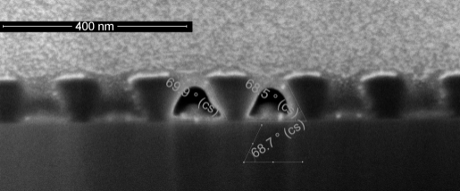
Figure 3: Cross-sectional SEM

