Slide 1
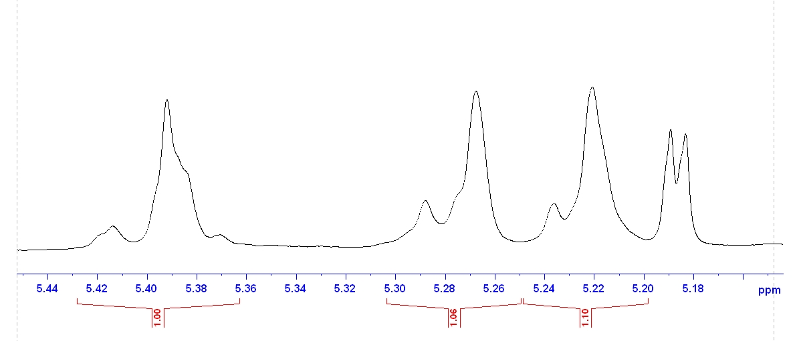
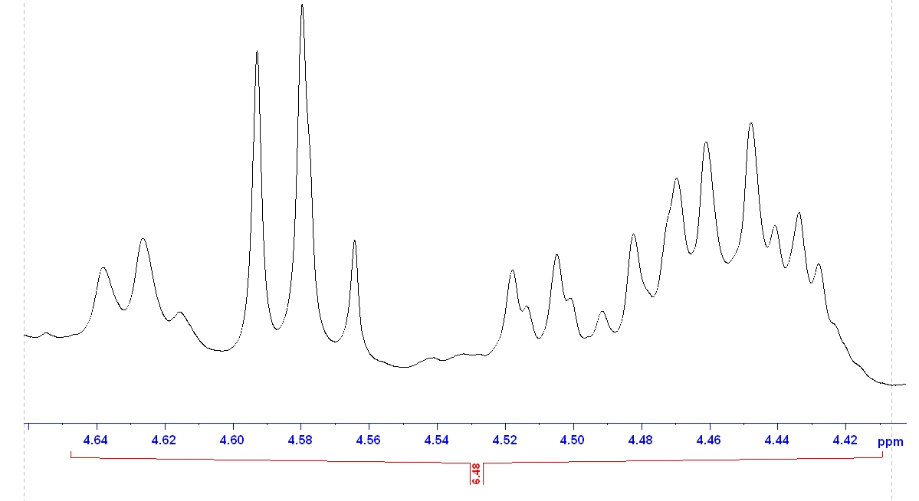
Figure 5
β-D-Xylp-1
T-α-L-Araf→2^{D+D}
T-α-L-Araf→3^{D}
T-α-L-Araf→2^{D}
T-α-L-Araf→3^{S}
α-D-Xylp-1
T-α-L-Araf→3^{S+D}
T-α-L-Araf→3^{D+D}

