Slide 1
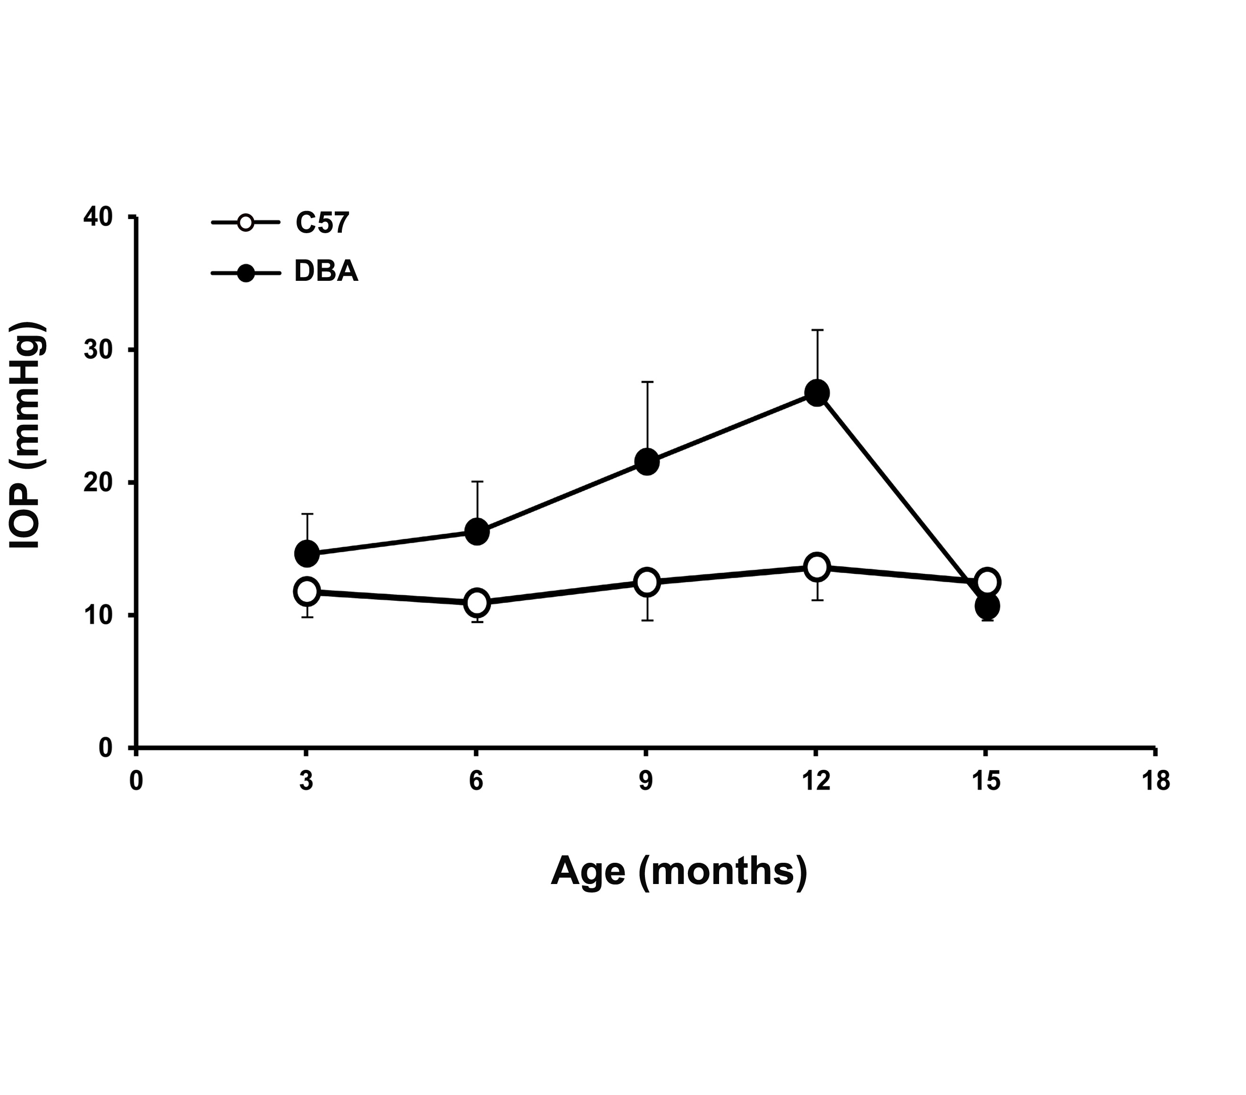
FIGURE 1

Slide 2
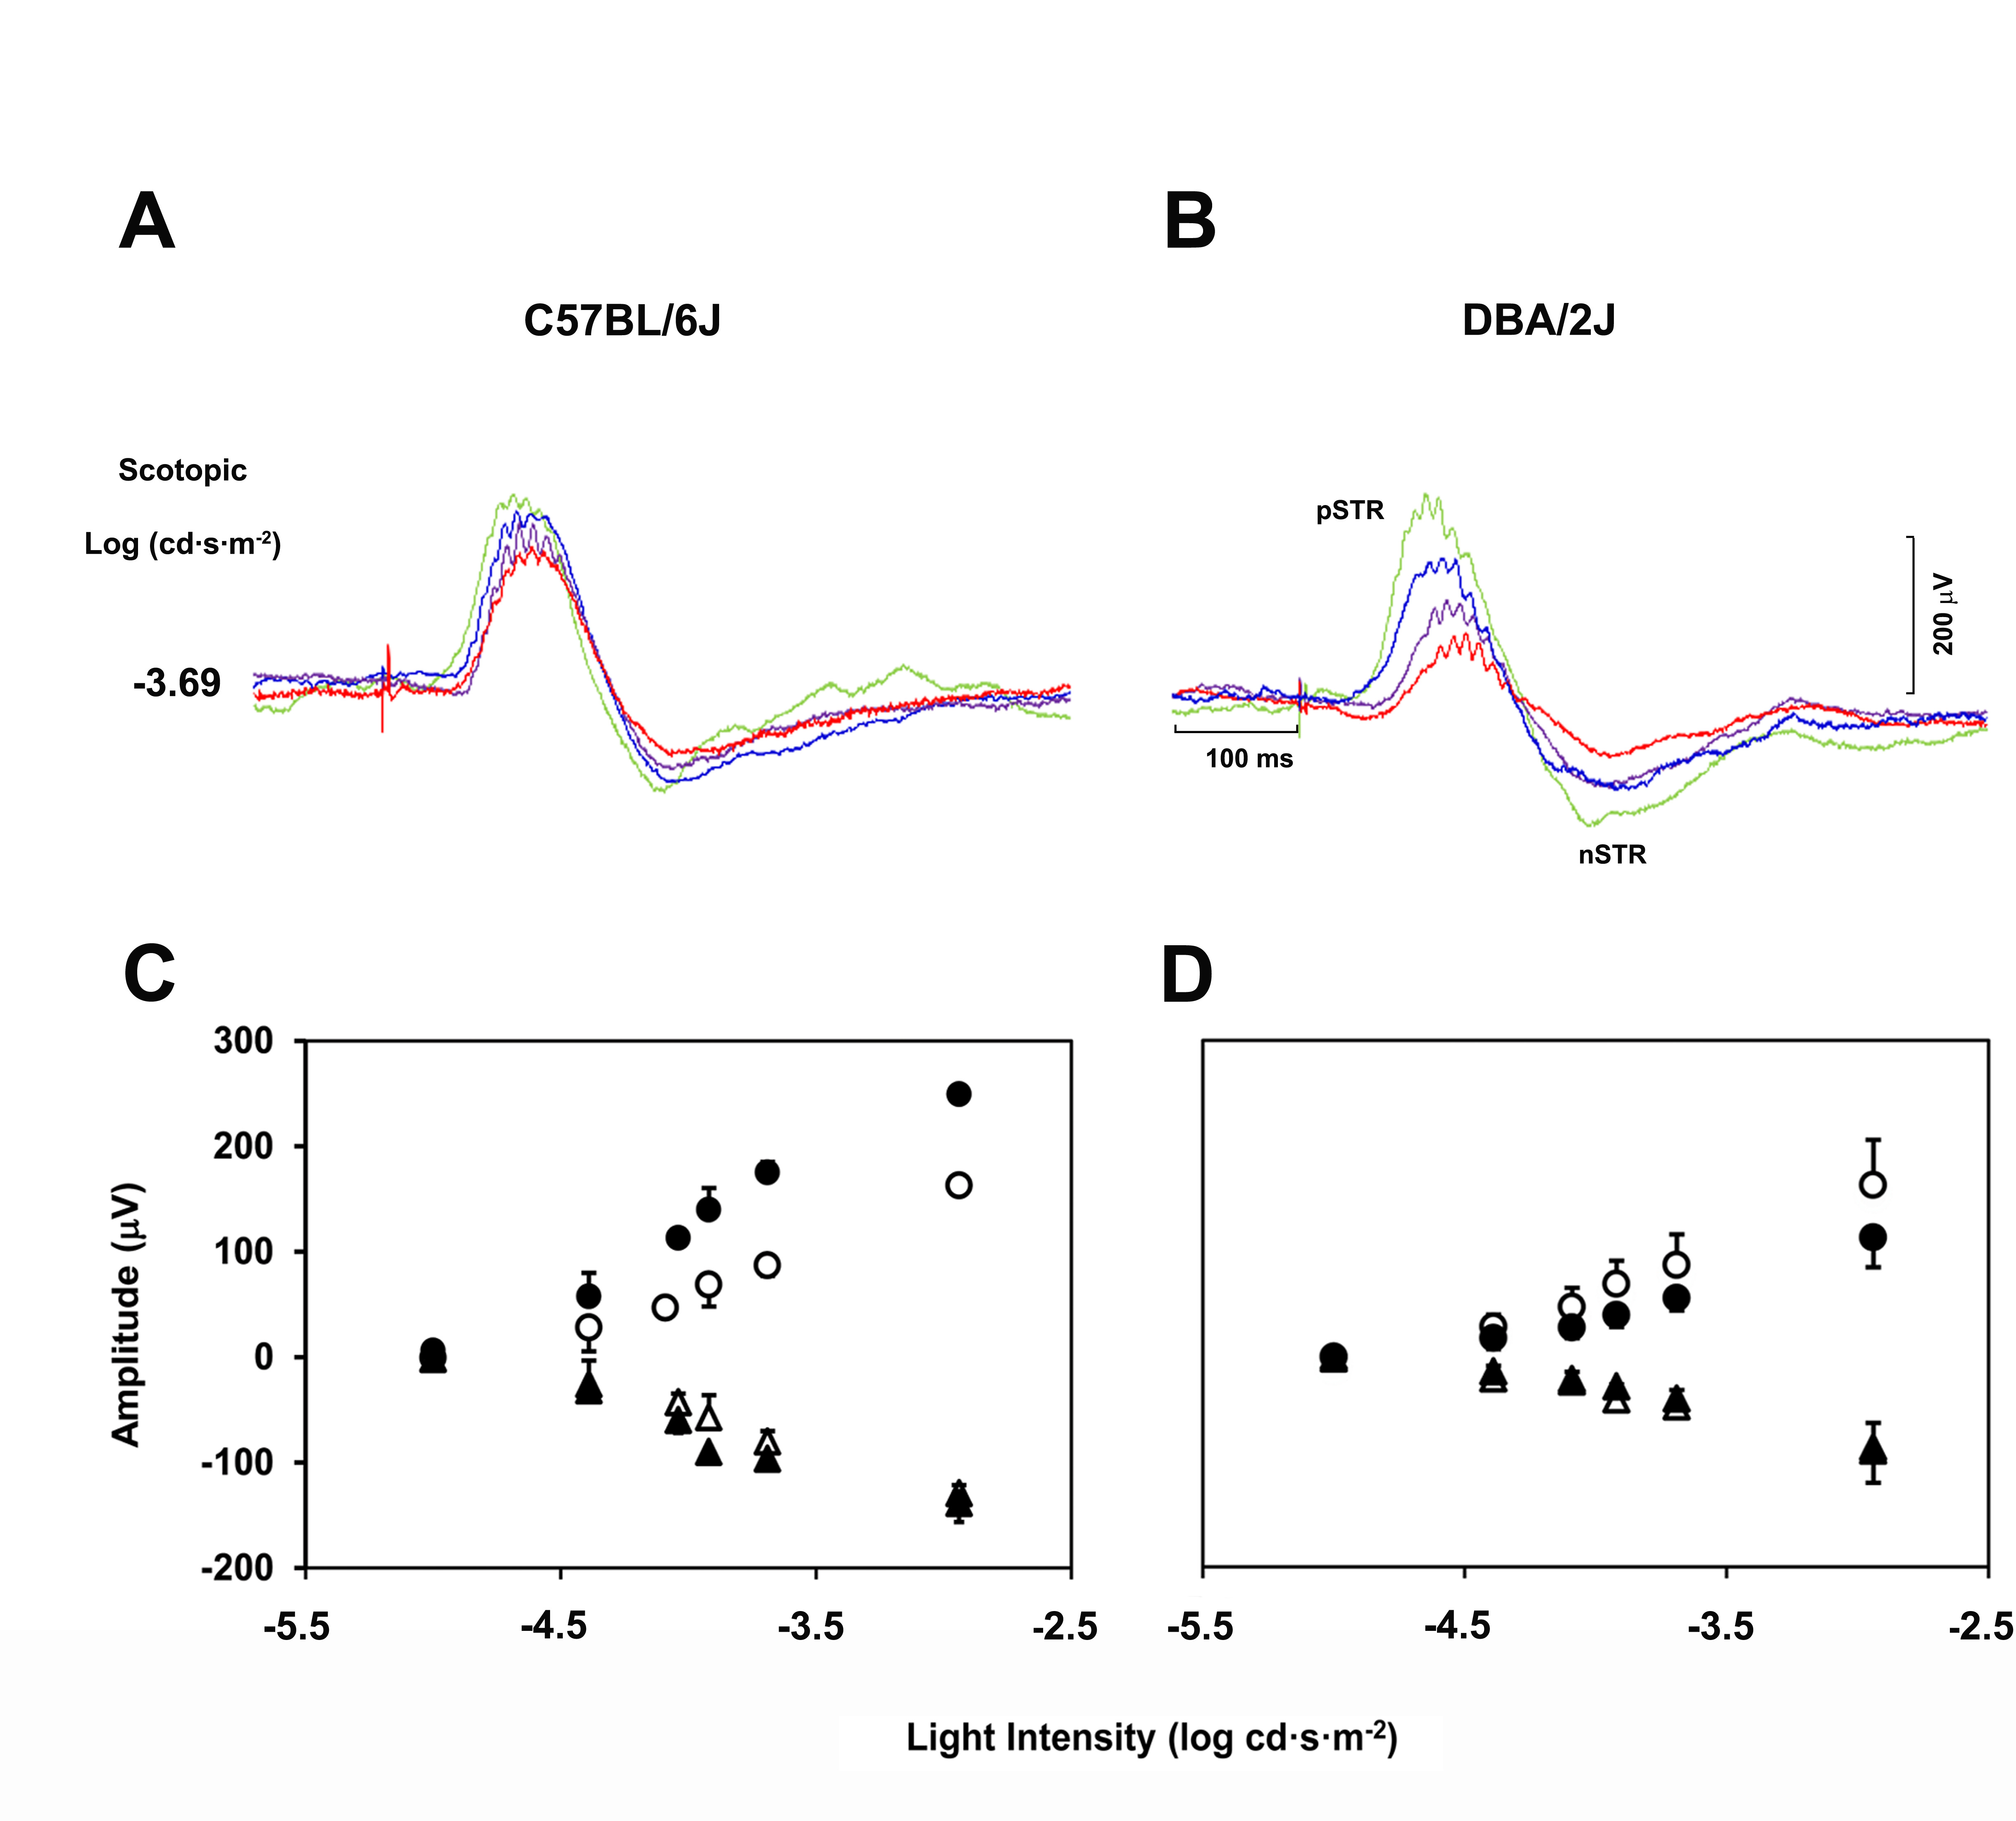
FIGURE 2

Slide 3
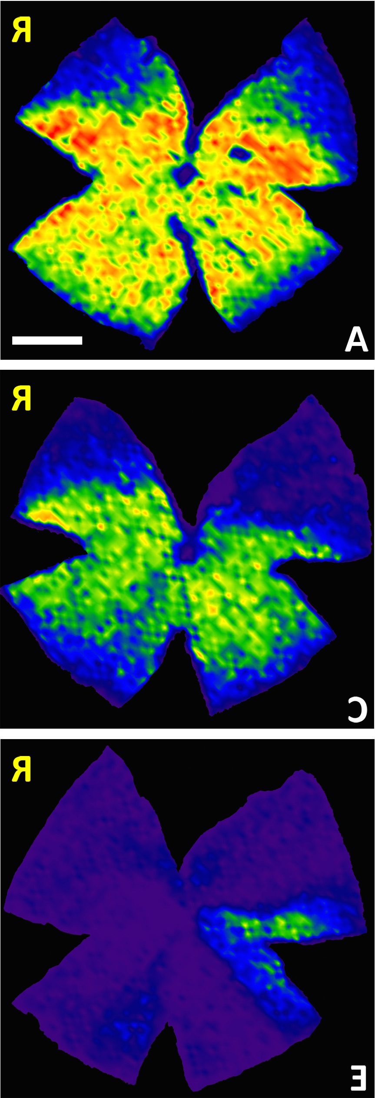
A
B
C
FIGURE 3

