Slide 1
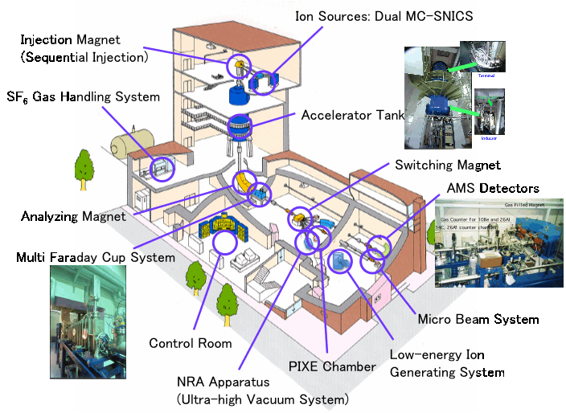
0 MALT: Facility Overview
BM-04
BM-04
FC-04
BL-2C
BL-1E

Slide 2
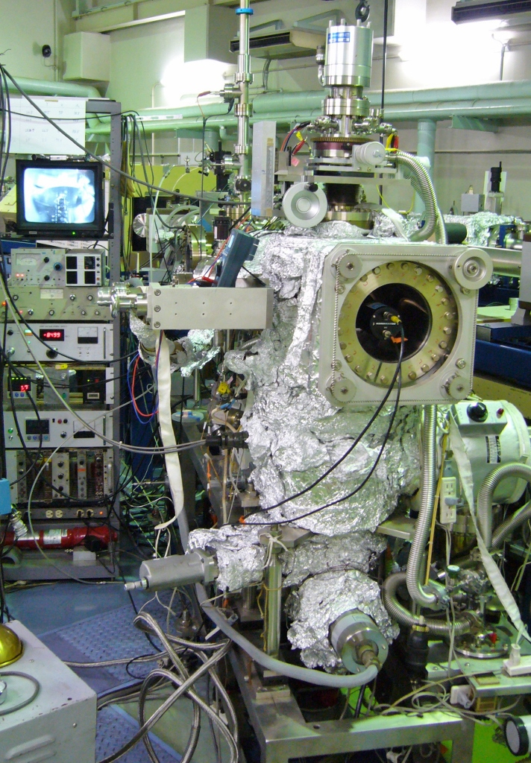
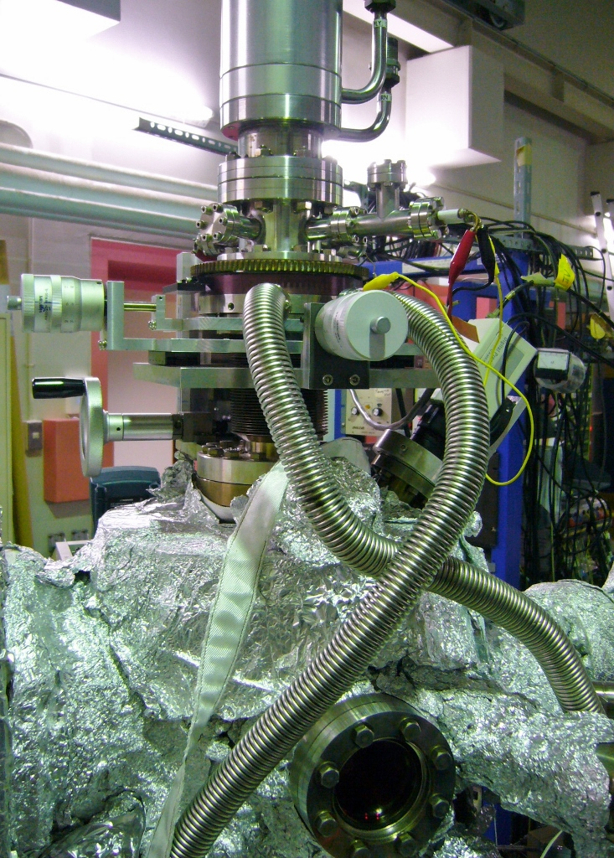
(lab member will perform actions here)
1 BL-1E UHV chamber, outside
UHV Manipulator & Viewport

Slide 3
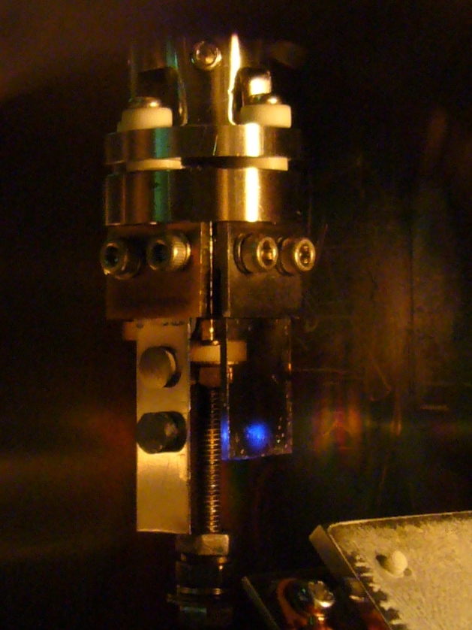
2 UHV chamber, inside
(seen through viewport)
Position (x, y, z) and rotation angle manipulations of the sample as well as the flashing of a filament heater behind the sample upon heating and annealing can be seen.
(Steps 2.2.1, 2.2.5, 2.3.1)

Slide 4
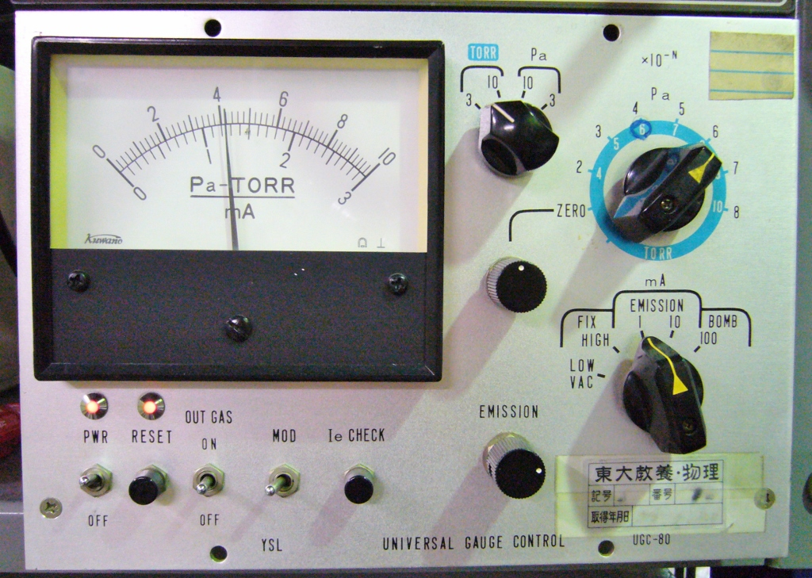
3 UHV Pressure gauge
(displays pressure change when lab member performs gas introduction into the UHV chamber, Steps 2.2.2) and 2.2.5)

Slide 5
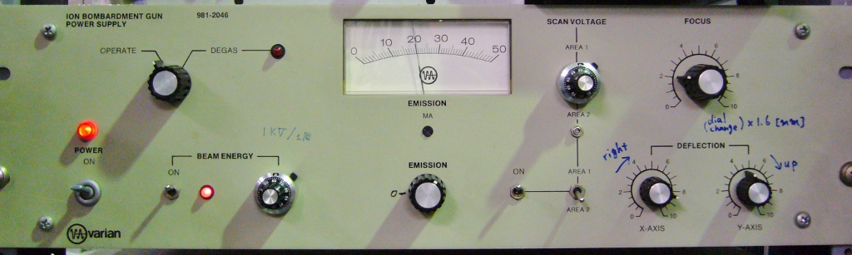
4 Ion gun controller
(lab member will set parameters in Steps 2.2.1 and 2.2.2)

Slide 6
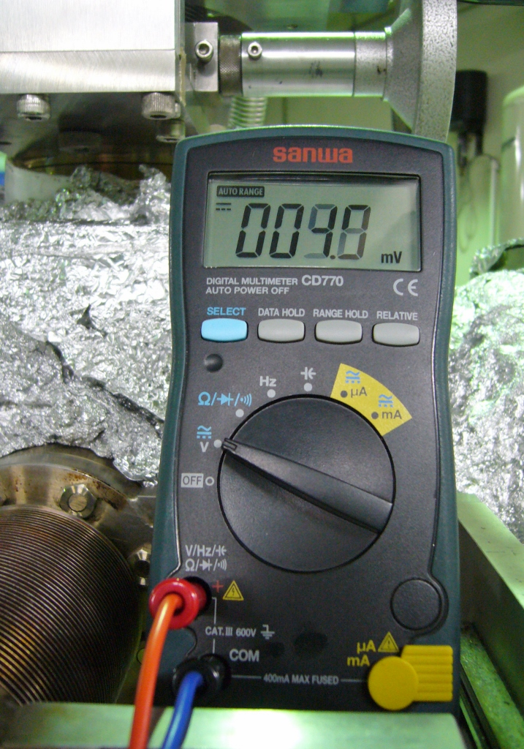
5 Digital tester
(will indicate change of sputter current and sample temperature when lab member sets parameters in Steps 2.2.2 and 2.2.5)

Slide 7
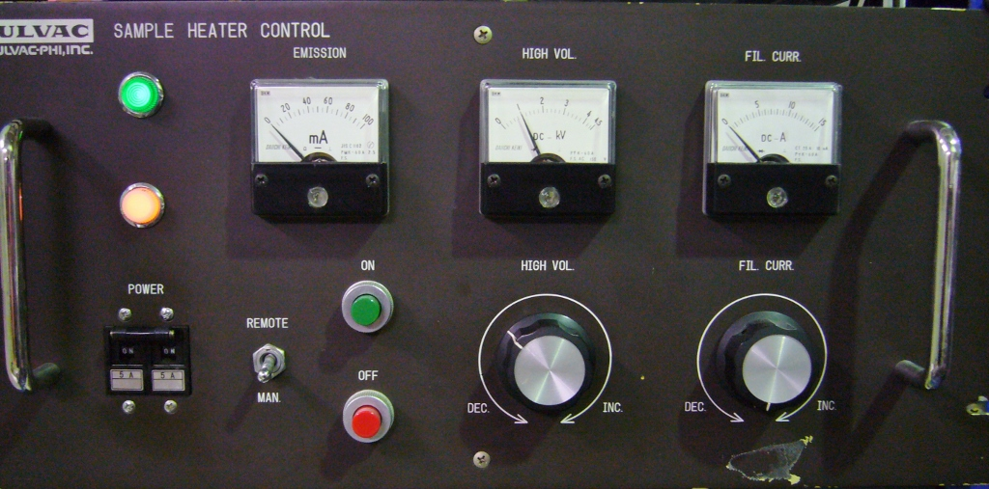
6 High voltage power supply
(sample bias)
(lab member will set parameter in Step 2.2.4)

Slide 8
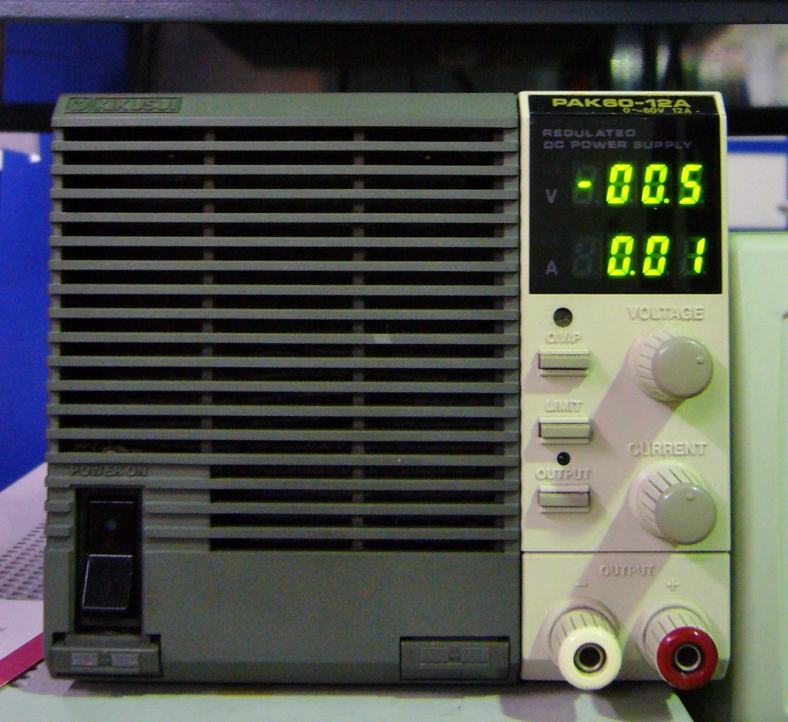
7 Filament heater supply
(lab member will set parameter in Step 2.2.5)

Slide 9
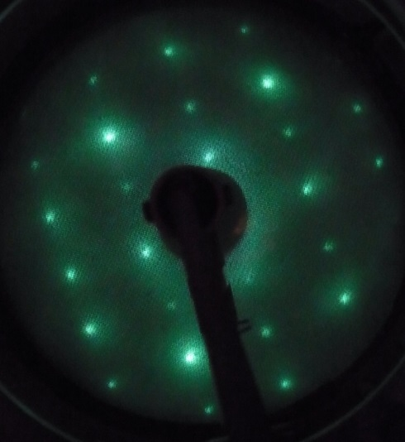
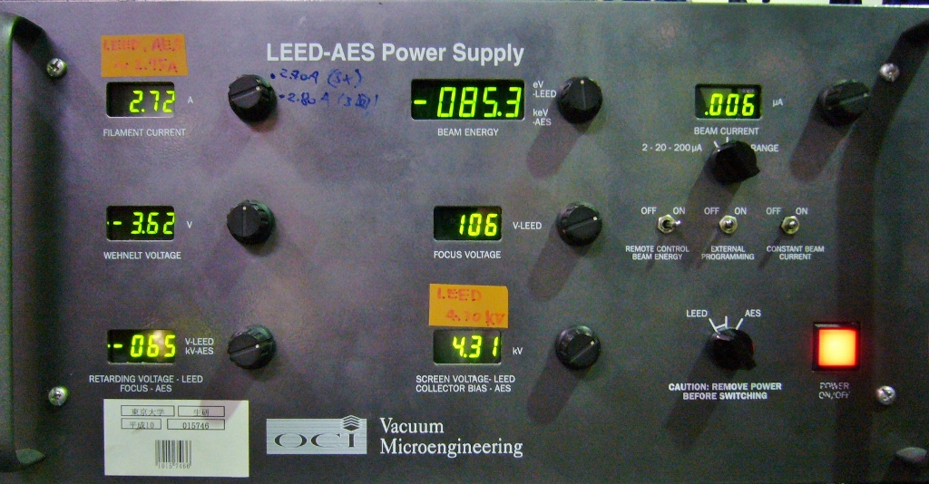
8 LEED, Screen & Controller
Fig. 3
(lab member will set controller parameters in Step 2.2.6,
advance LEED optics at 1E UHV chamber towards sample,
LEED pattern appears on Screen (Fig. 3)

Slide 10
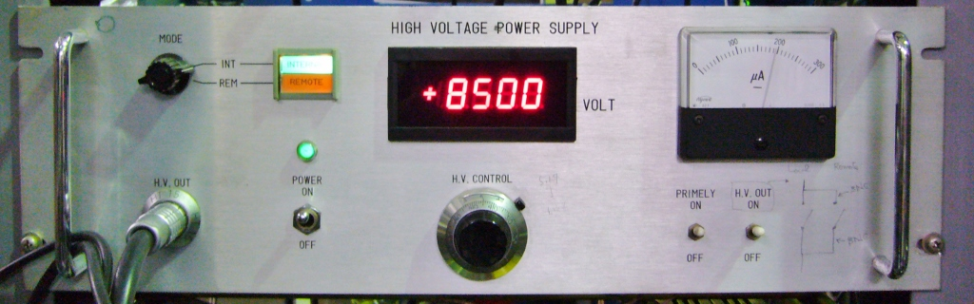
9 High voltage power supply
(electrostatic ion beam deflection)
(lab member will set parameter in Step 2.3.2)

Slide 11
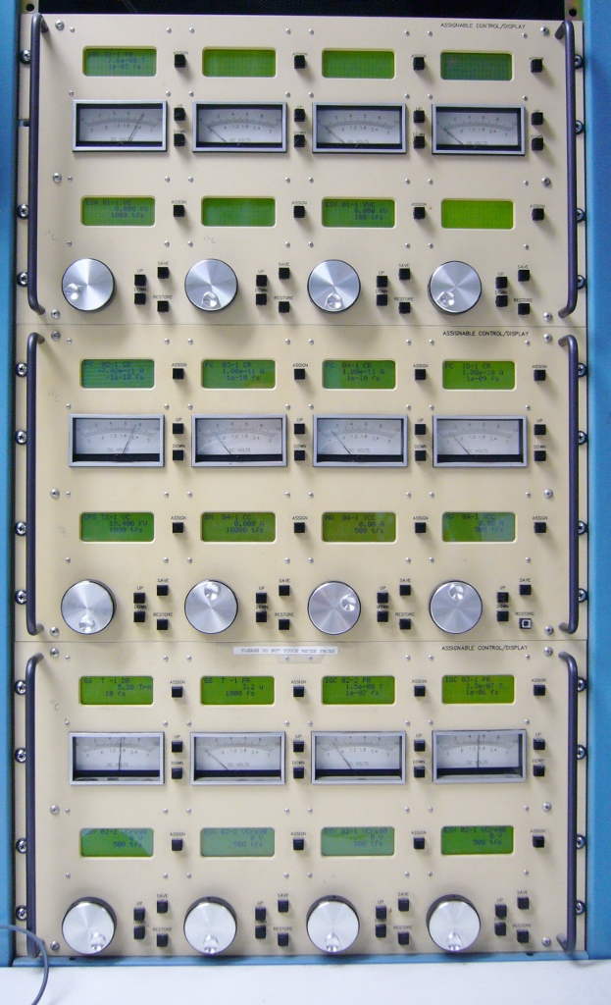
10 Control Panel
(lab member will perform parameter changes in Steps 2.3.4, 2.3.5, 3.9, 3.10, 4.3, and 5.1.)

Slide 12
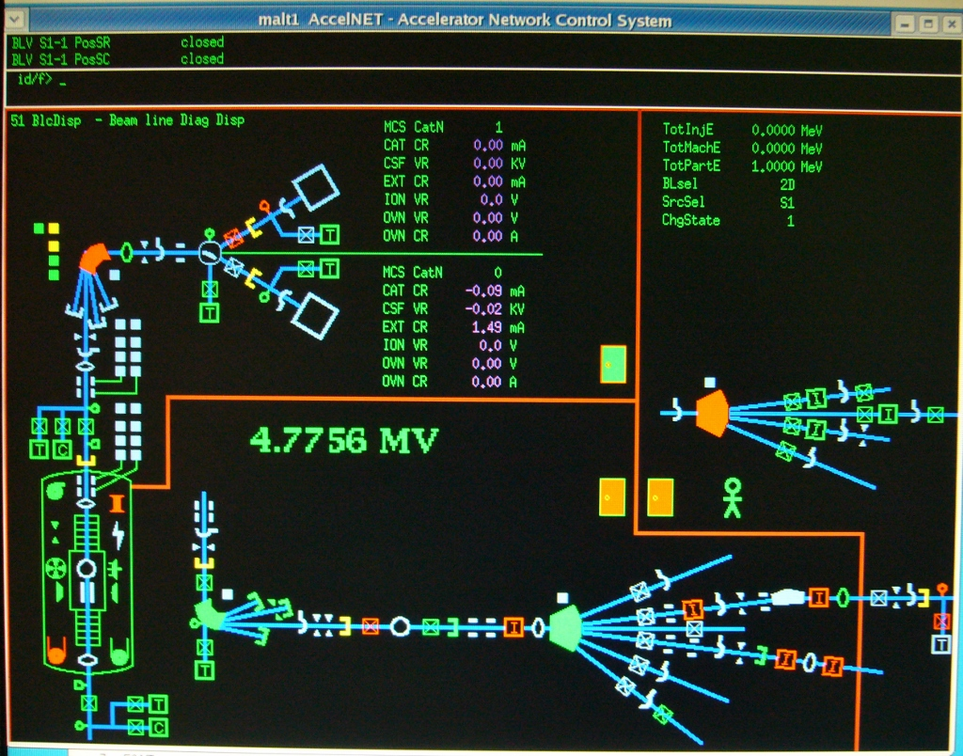
(lab member will perform parameter change (open FC04) in Step 2.3.5)
11 Control System
(computer screen)

Slide 13
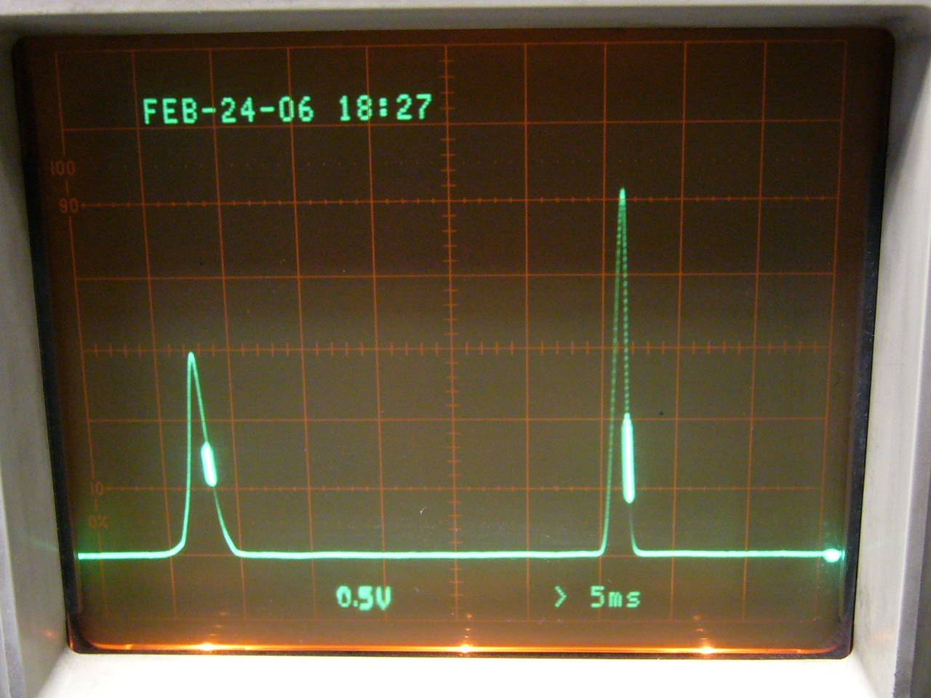
12 Beam Profile Monitor
(Oscilloscope)
(will visualize changes of the ion beam profile when lab member performs ion beam focusing onto the target in Step 3.10)

Slide 14
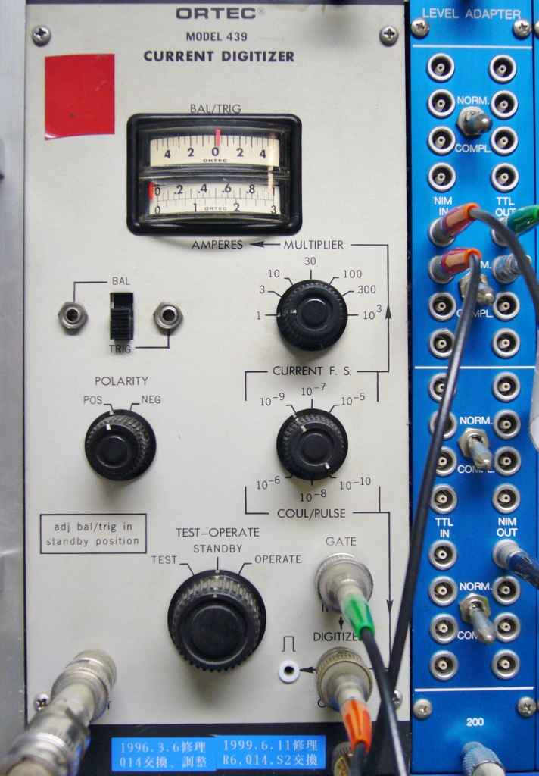
13 Current Integrator
(lab member will switch from STANDBY to OPERATION mode in Step 2.3.4)

Slide 15
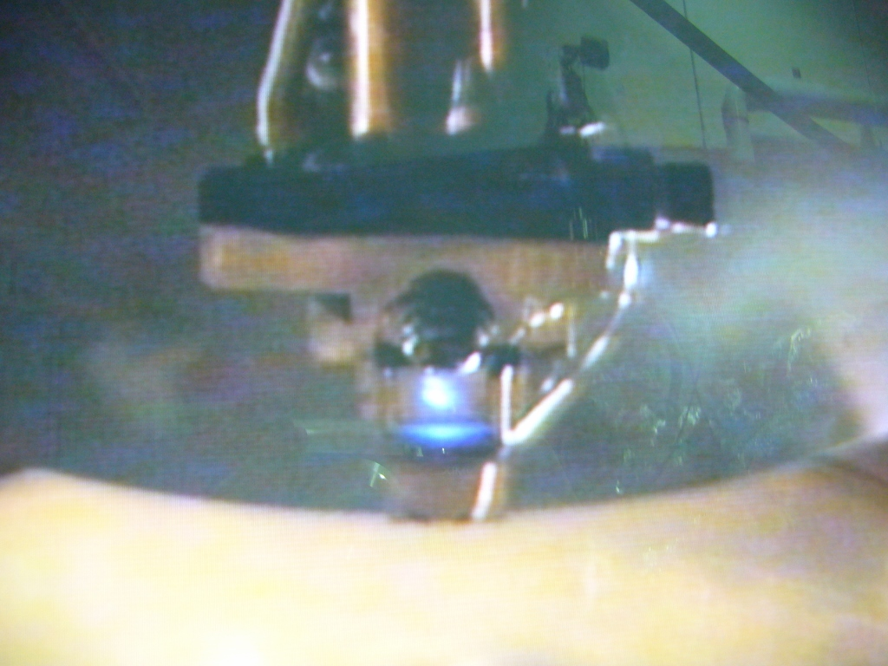
14 TV Screen
(Ion beam profile on quartz plate monitor in UHV chamber, seen as camera image on TV screen)
(will visualize ion beam profile changes when a lab member performs beam focusing operations in Steps 2.3.5, )

Slide 16
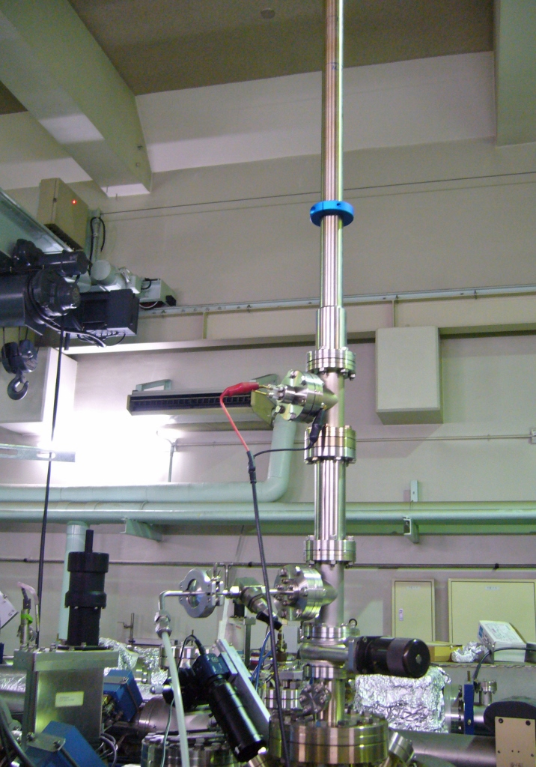
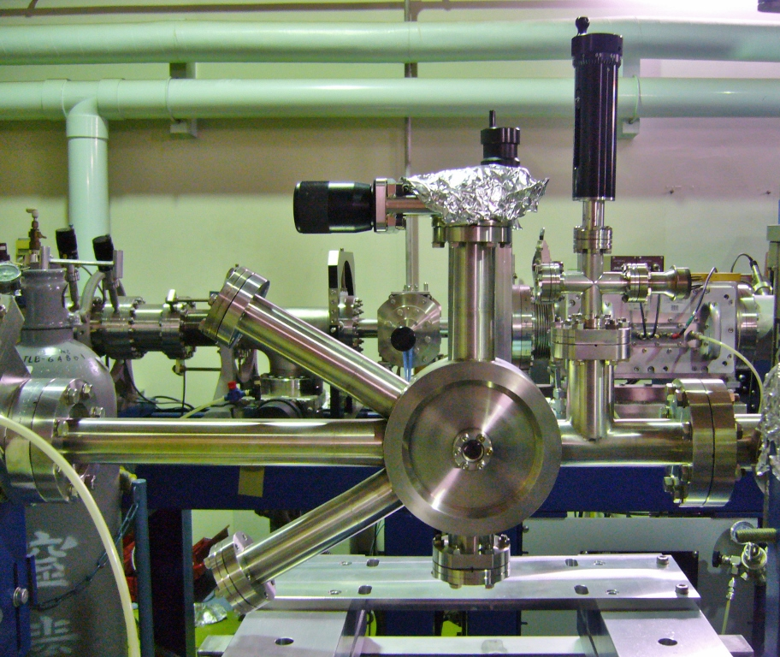
15 BL-2C Chamber
(lab member will perform actions in Steps 3.1, 3.2, 3.5, 3.7)
(Chamber, outside)
(Manipulator, transfer tube)

Slide 17
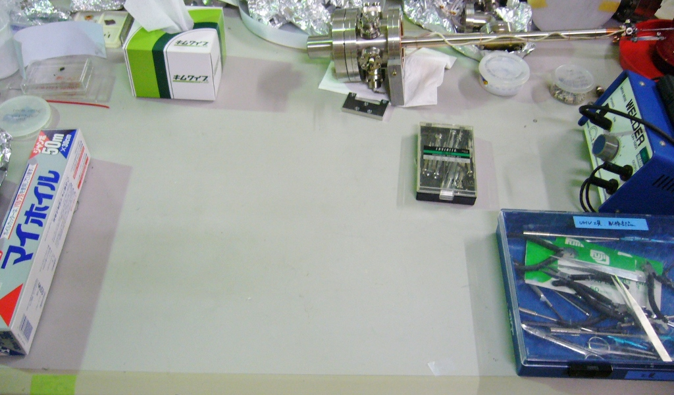
16 Preparation table
(lab member will perform actions in Steps 3.3 and 3.4)

Slide 18
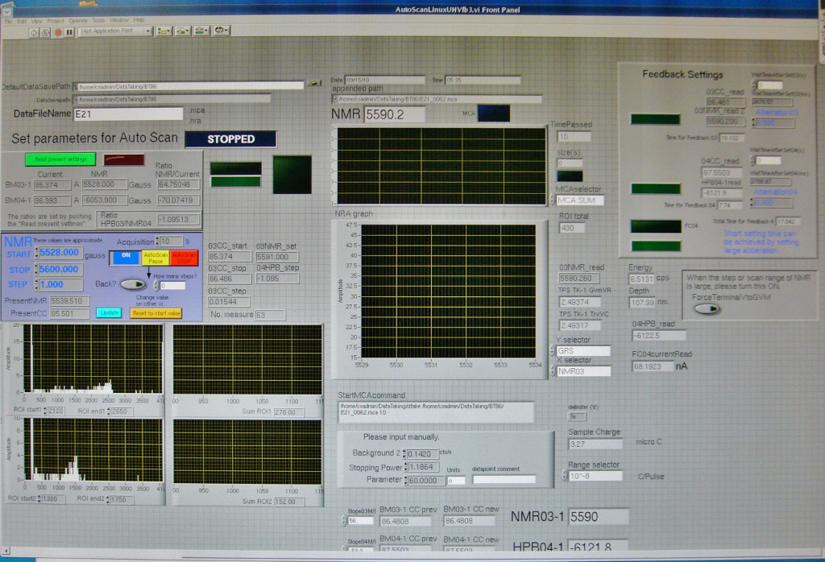
17 Measurement PC
(homebuilt data acquisition software, screen shot)
(lab member will perform parameter changes in Steps 4.6, 4.7, 5.2, and 5.4)

