Slide 1
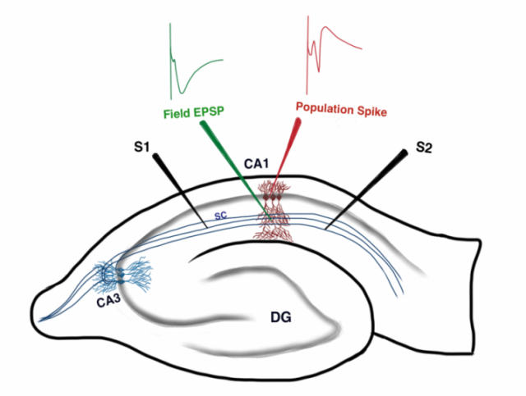
A
B
C
Shetty et al., 2014
Figure. 3

