Slide 1
Figure 1: Scheme of the experimental procedure.
1.2.1) Mechanical lysis of tissues or tumors
Total Tissue Extract
Incubate/Centrifuge
1.2.2) Supernatant = Fraction C
1.2.3) Washes
1.2.4) Chemical lysis
(High salt Buffer, DNaseI)
Incubate/Centrifuge
1.2.5) Supernatant = Fraction N
1.2.6) Membrane protein solubilization (DOC, NP-40)
Section 1: Decellularization / ECM Enrichment
Incubate/Centrifuge
1.2.7) Supernatant = Fraction M
1.2.8-1.2.10) Cytoskeletal protein solubilization (SDS)
Incubate/Centrifuge
1.2.9-1.2.11) Supernatant = Fraction CS
Insoluble fraction:
ECM-enriched sample
1.2.12) Washes
Section 2: Quality control of the ECM enrichment by western blot
3.1) Resuspension in 8M urea / Reduction
3.2) Alkylation
3.3) Deglycosylation
Section 3: In-solution digestion of proteins to peptides for MS analysis
3.4 – 3.5) Digestion with
LysC and Trypsin
3.6) Desalting
Spectrophotometric measurement of peptide concentration
Peptide solution ready for mass spectrometry analysis

Slide 2
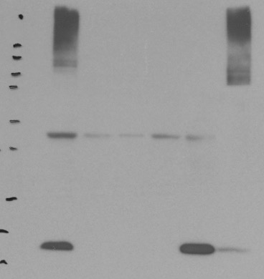


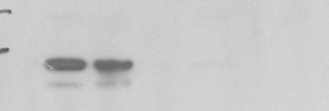
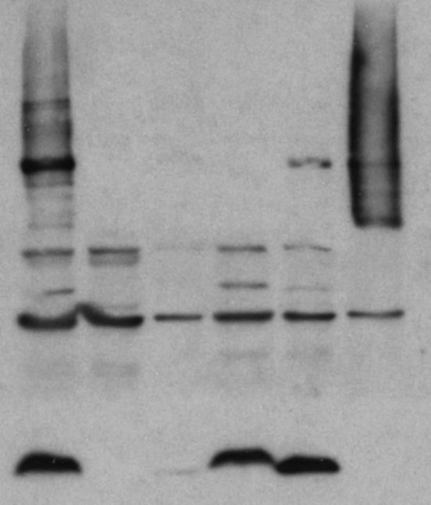
Figure 2: Quality control of the decellularization procedure by western blot.
A. Murine Lung:
Total tissue extract
ECM-enriched fraction
Fraction C
Fraction N
Fraction M
Fraction CS
250-
150-
100-
< Collagen I
75-
100-
< β1 Integrin
50-
37-
< Actin
37-
< GAPDH
20-
*
15-
< Histones
B. Mammary carcinoma xenograft:
250-
150-
**
100-
< Collagen I
75-
50-
***
< Actin
20 -
< Histones

