Slide 1
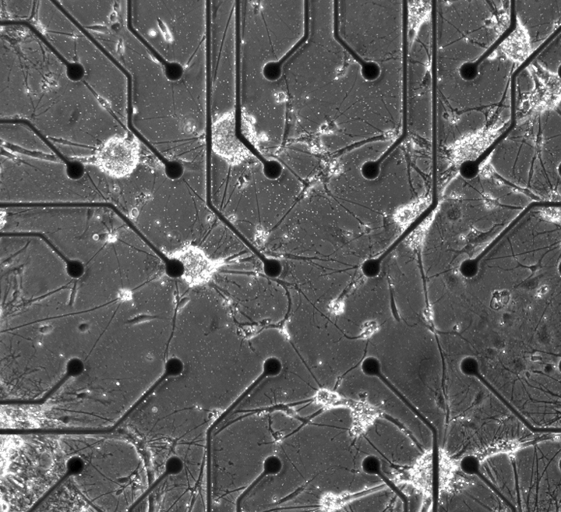
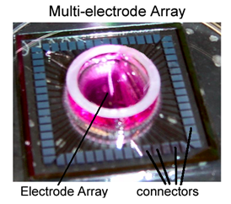
Network Development in Culture
Embryonic cortical neurons form functional networks ex vivo
Culture dishes contain “multi-electrode arrays” (60 electrodes)
Subject to electrical and chemical stimulation
Readily reproducible
Spontaneous Signals from Mature Network

Slide 2
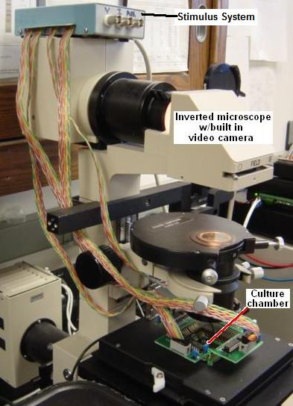
Multi-electrode Array System
Place inside
Culture Chamber
Connectors interface with amplifier
Amplifier
Stimulator
PC
MatLab
Additional
software
Reports
•Excel,
•raw

Slide 3

Neurons form a functional network

Slide 4
Model of Sensory Input
We pioneered the use of a digitized Synaptic Signal recorded from a mature culture for stimulation
Generates improved neuronal response versus that elicited by “classical” biphasic square wave
Zemianek J, Serra M, Guaraldi M, Shea TB (2012) Biotechniques 52:177-182.

Slide 5
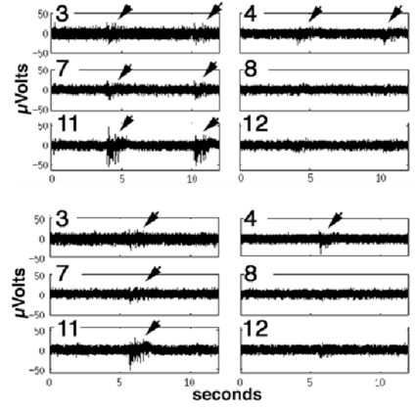
Localized stimulation & recording
The low amplitude of this digitized Synaptic Signal allows localized stimulation of REGIONS of the network
Input
Ground
This localized approach reveals regional connectivity and allows regional stimulation
Zemianek J, Serra M, Guaraldi M, Shea TB (2012) Biotechniques 52:177-182.

Slide 6
Networks can “learn” Dependent upon inhibitory activity
Stimulation increased complex signaling
Prevented by Bicuculline (inhibitory antagonist)
Supports the purported role for inhibitory activity in long-term potentiation and learning in situ.
Zemianek J, Serra M, Lee S, Guaraldi M, Shea TB. (2013) Int J Dev Neurosci 31: 308-310.

Slide 7
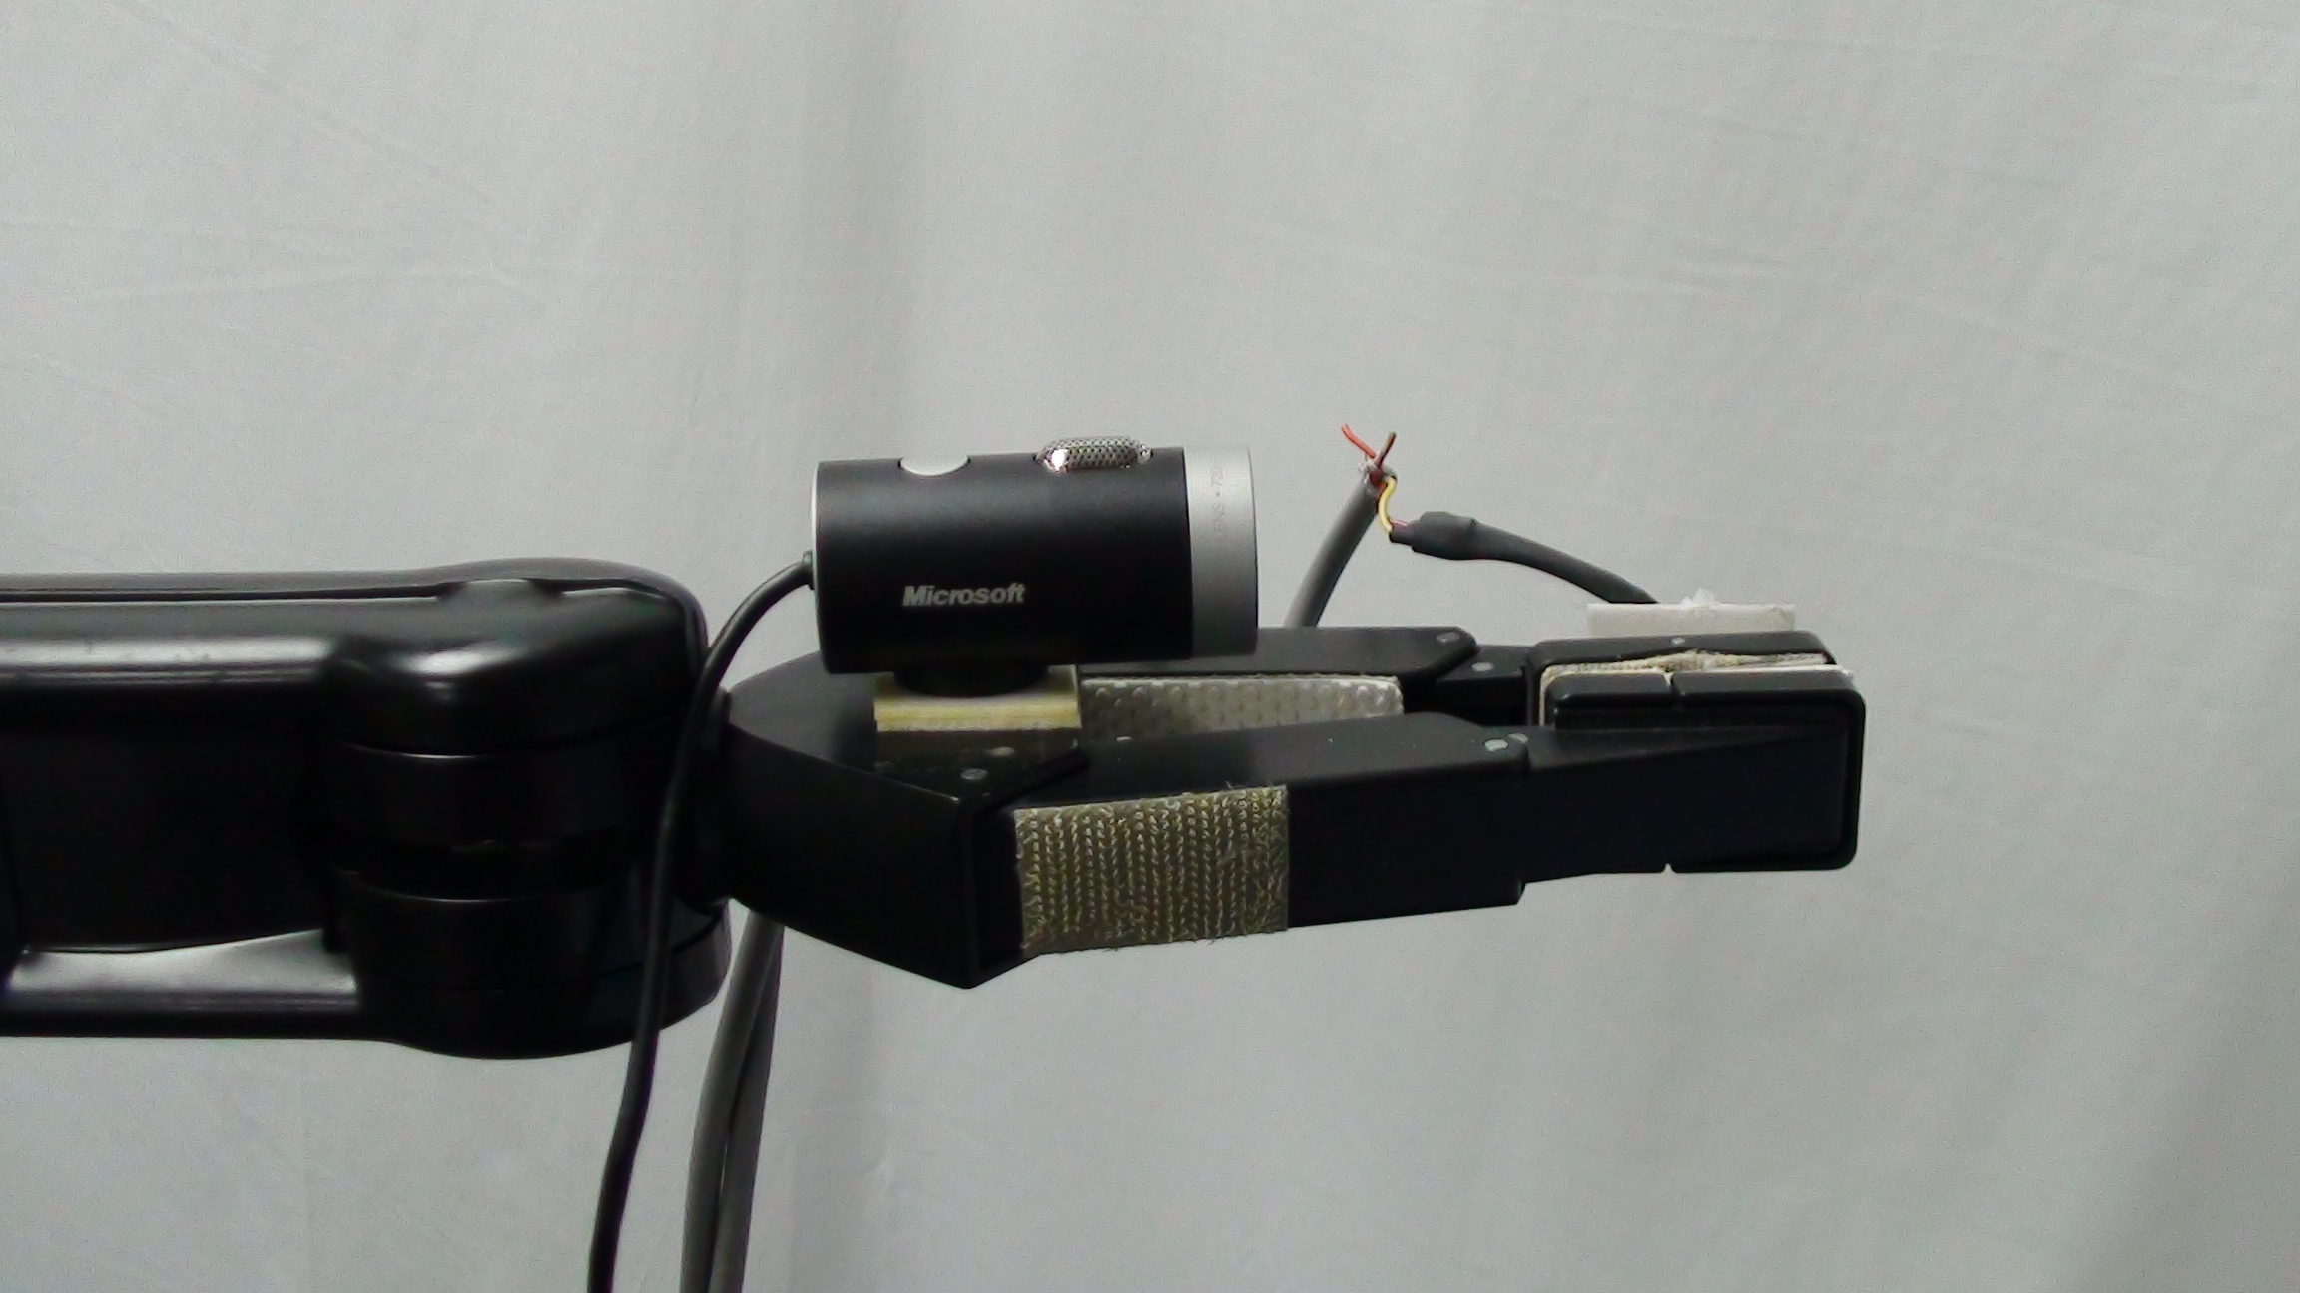
The Manus Assistive Robotic Manipulator
Interaction of neuronal networks with robotics
16 parameter control (up, down, left, right, forward, back,
grip, twist)
Also has a “free action” mode (input via touch pad, joy-stick.)
pre-programmed subroutines: orients to user-defined “home” via live camera input mounted just above its grasping “hand”.
You can view the arm in action and learn more at: http://robotics.cs.uml.edu/research/current-research/visual-control-interface-for-manus-arm/
A camera is mounted on the hand

Slide 8
Target Tracking
Video recording of moving target (red cup)
Thresholding settings record only full red pixels
Target pixels were recorded in 5 vertical strips, L to R
Target at Left: pixel recordings: 3306, 436, 0, 0, 37
Target in Center: 0, 332, 3897, 95, 32
Target at Right: 0, 0, 5, 433, 3251
Moving target can be tracked within a complex image
Generate Left and Right channels to stimulate neuronal network
Left = strips 1,2,3 Right = 3,4,5

Slide 9
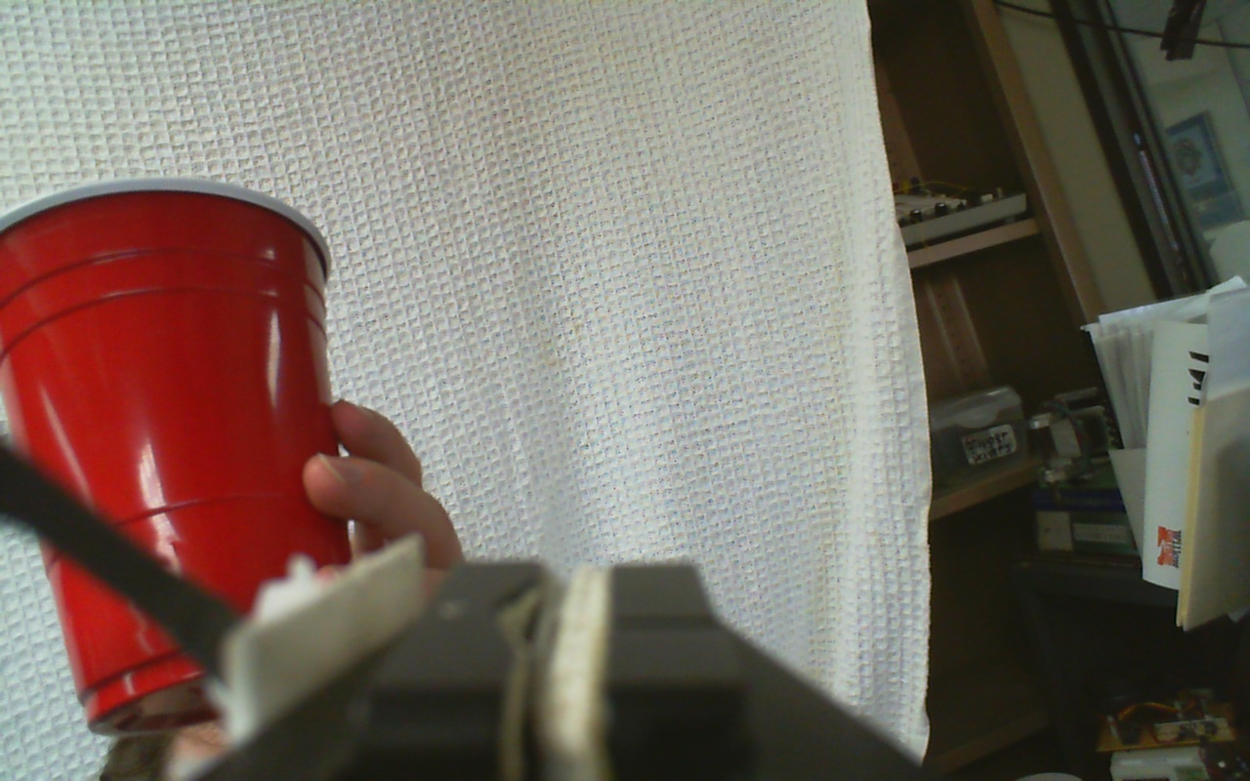
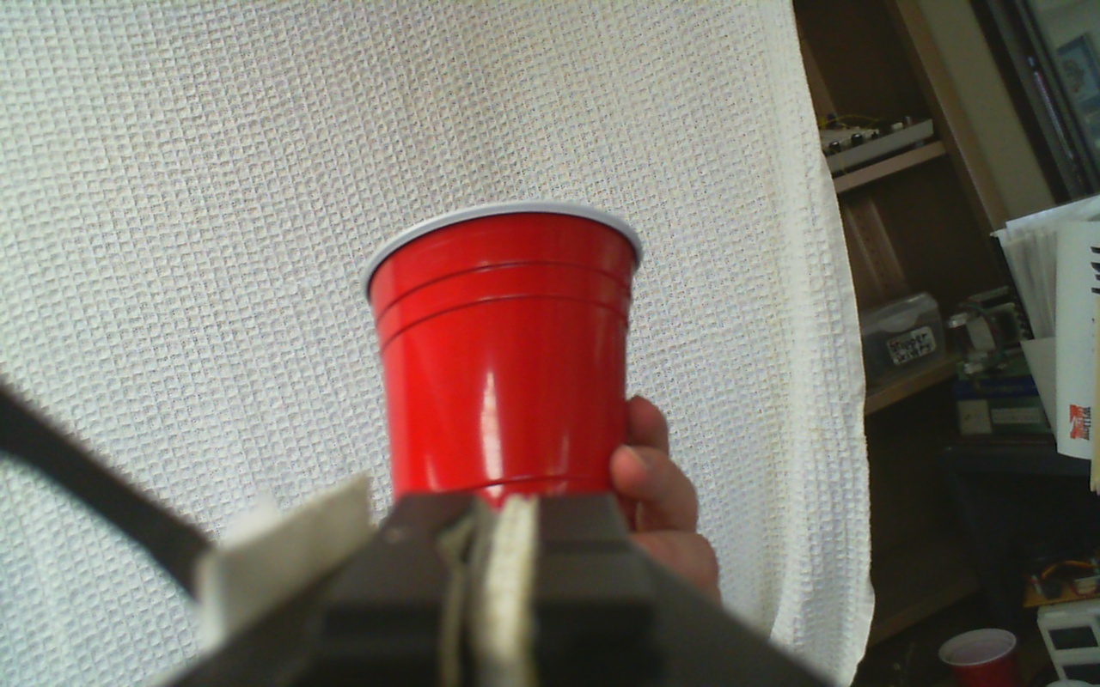
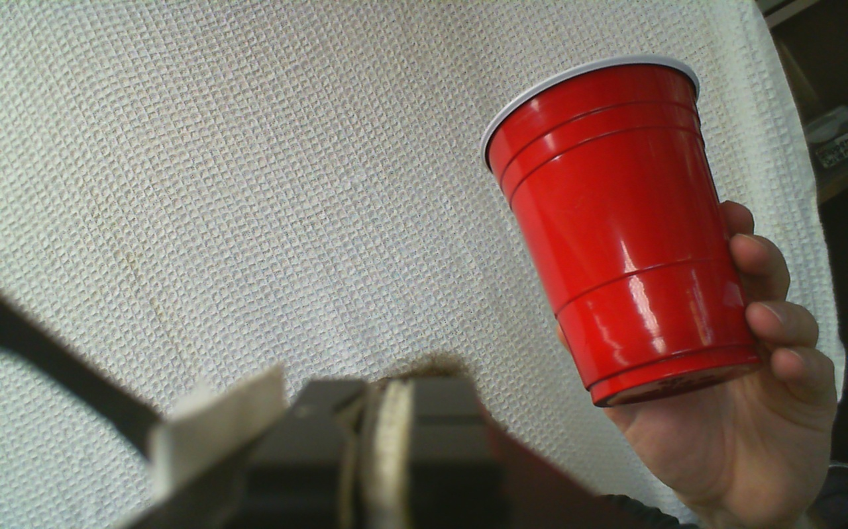
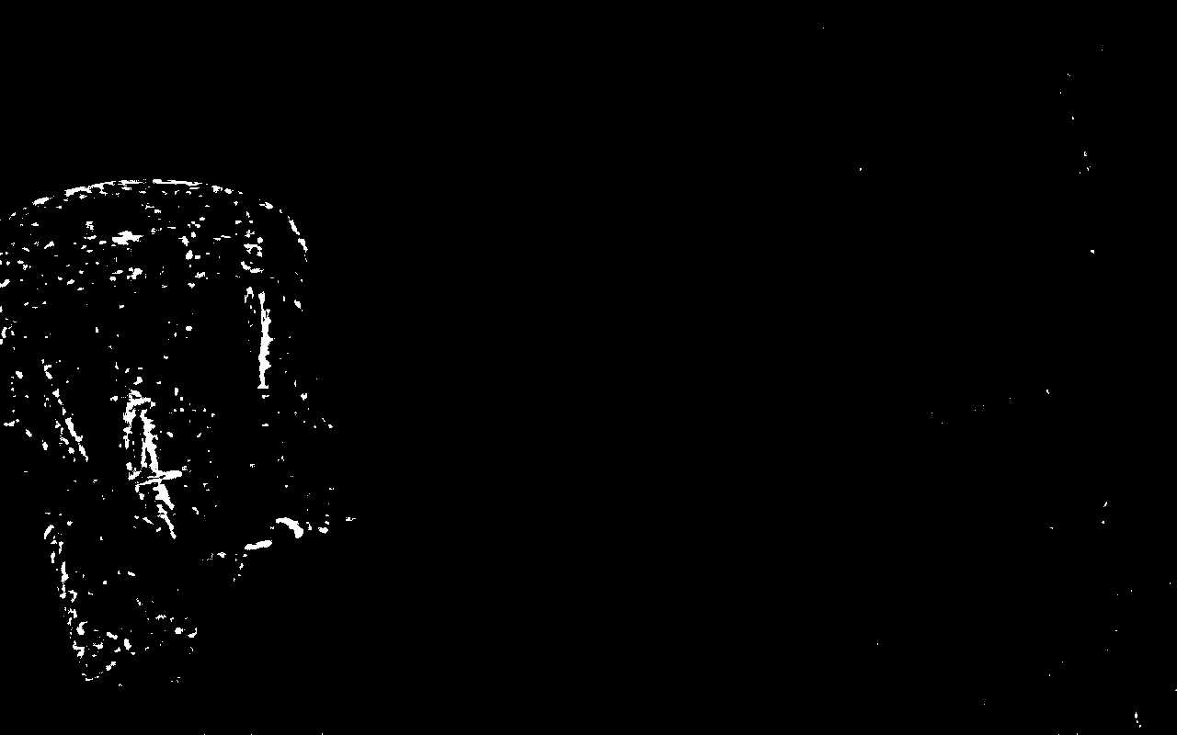
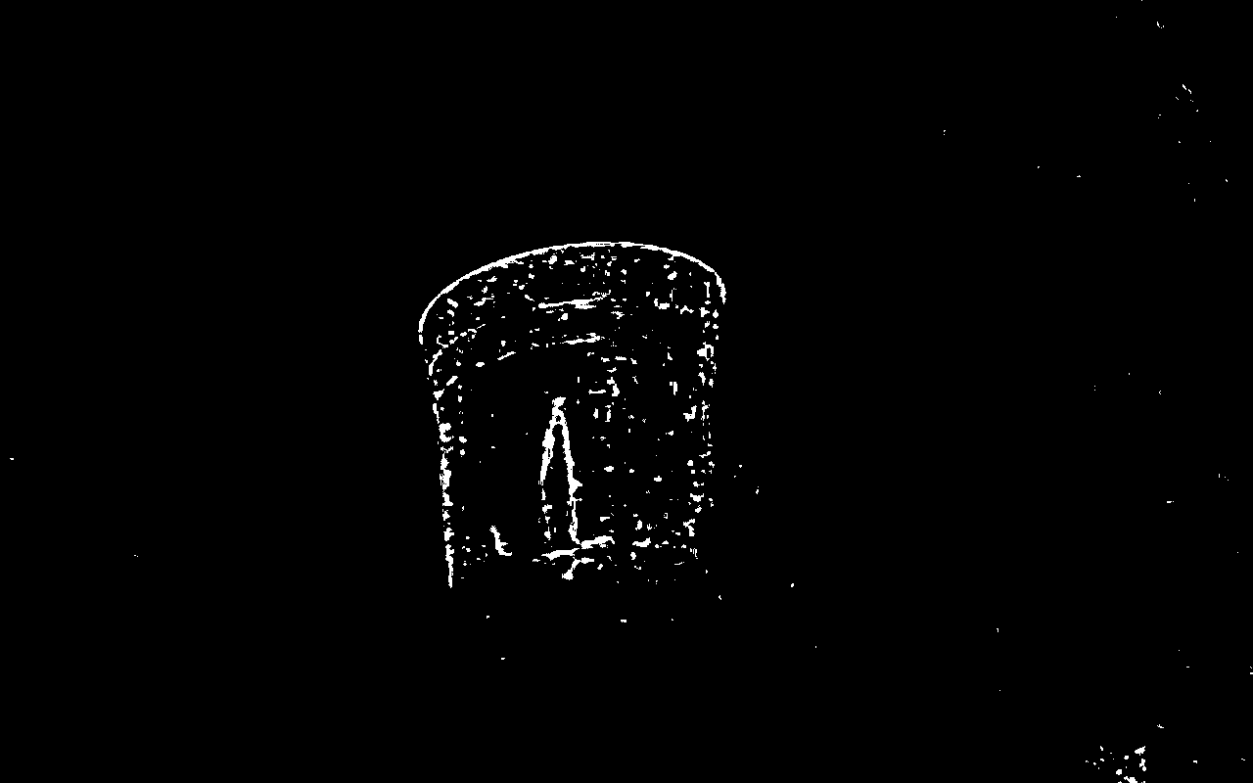
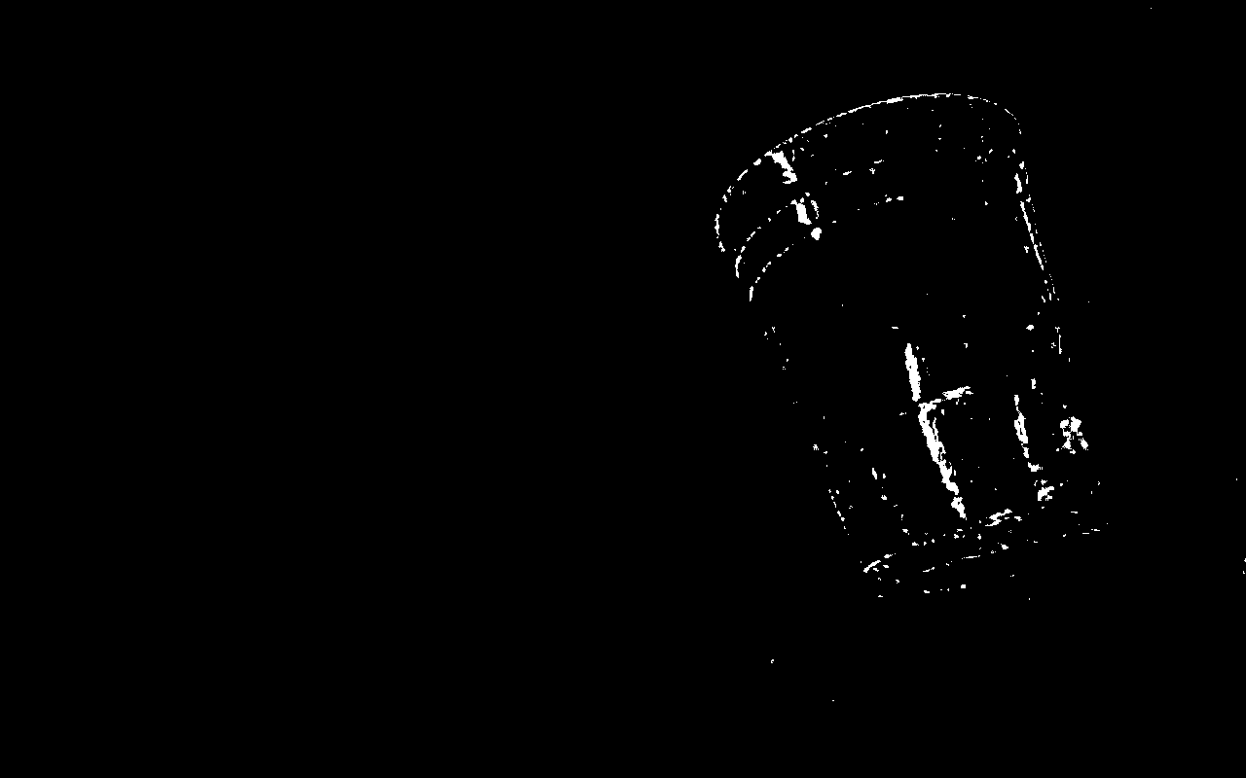
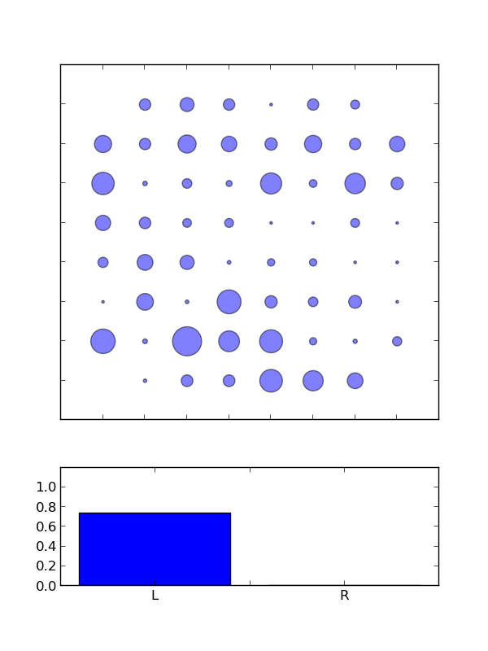
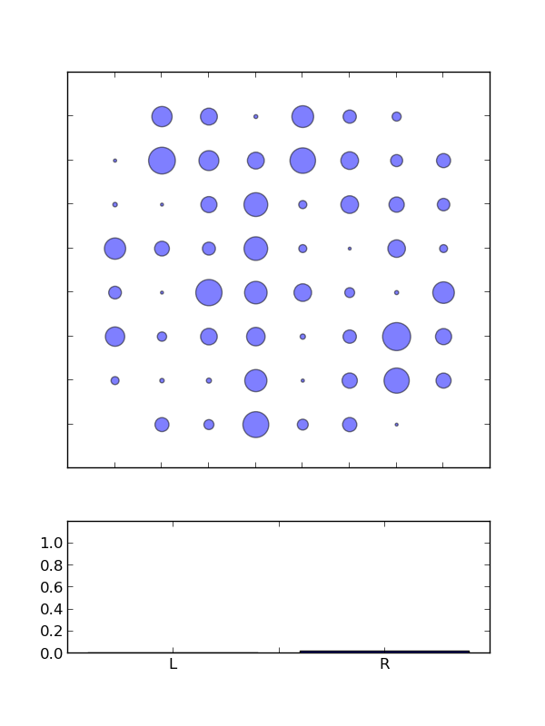
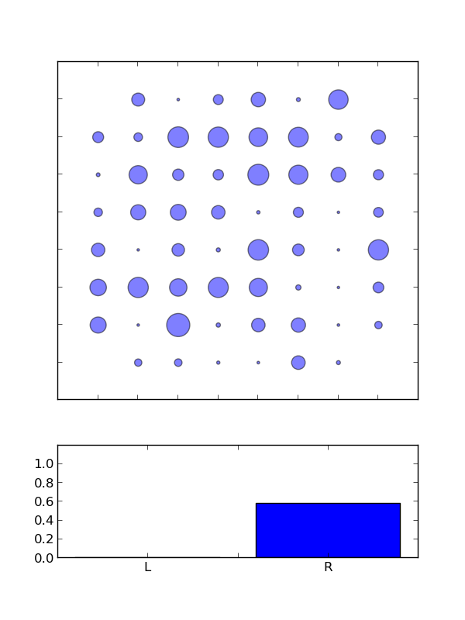
Target Tracking
Left Center Right
Image from camera
Filtered for red pixels
Pixels for 5 vertical regions
0 0 270 4257 1812
7322 2308 0 9 118
10 2592 7218 33 372
Resulting network activity
Summed delta of activity

Slide 10
Feedback Loop of Signaling
•pixels converted to synaptic signals (100 pixels = 1 synaptic signal)
•The arm will localize over the target in a series of steps. The robot already has the capability to grasp the target following localization. Planned: initiate grasp (using additional network once localized on target for, e.g., 5 sec)
•Subsequent programming will include tracking only objects that move above a certain speed, or only select shapes and colors.

Slide 11


Network output to robot movement
Network activity = a 60-value vector, one value for each electrode
The left and right motions are also 60-value vectors
The "left motion" vector is 1.0 in all the locations on the left side of the dish, and 0.0 in all the locations on the right side.
The "right motion" vector is the opposite
The algorithm measures the distance between the observed activity and the L and R motion vectors. If the distance to one of the motion vectors is small enough that the observed activity is out of the dead band (the blue area), then the appropriate motion signal is sent to the arm. In the left image below, D_{R} = smaller, so the arm moves R. In the right image, the distances are not outside of the dead band.

Slide 12
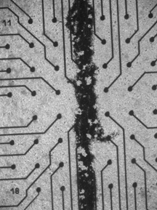
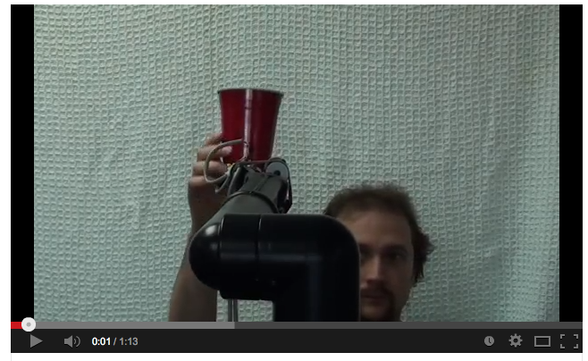
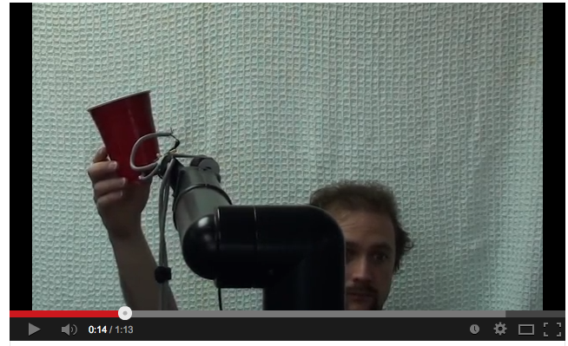
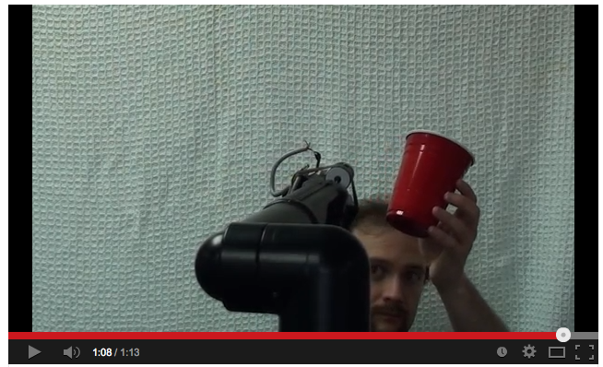
Live Tracking
Network
Segmented into
Left and Right
Video of Tracking
Video of Network Activity
COMBO:
Tracking to the left
Tracking to the right
 |  |  | Seconds
Total time |  |  | 70
Cup out of view from 32 to 44 sec |  |  | 12
total available tracking time |  |  | 58
total seconds NOT moving or holding
in "correct" direction (from 52-56sec) |  |  | 4
Percent time tracking |  |  | 89.7%

