Slide 1
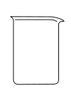
P1
Vernalization
1. Water
4. Lid
2. Seeds
3. Filter paper layers and bridge
To cold room: 4°C from 5 to 20 days (depending on the weed species)

Slide 2
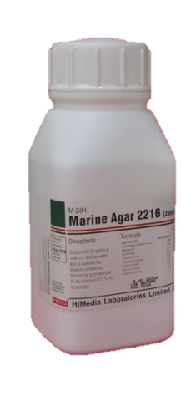
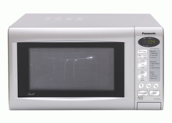
P2
- Agar preparation:
KNO₃
+
AGAR
+
- Germination:
3
2
1
To germination cabinet: 25/15 °C, 12 h photoperiod for 6 days

Slide 3
P3
-Seedling transplanting:
LOL_SS
14-01
pinoxad
1x
1
R1-1
0073959
LOL_SS
14-01
pinoxad
1x
1
R1-1
0073959
To greenhouse: to reach 2-3 leaf stage

Slide 4

P4
-Herbicide treatment:
1x
LOL_SS
14-01
pinoxad
1x
1
R1-1
0073959
LOL_SS
14-01
pinoxad
1x
1
R2-1
0073959
3x
LOL_SS
14-01
pinoxad
3x
1
R1-2
0073960
LOL_SS
14-01
pinoxad
3x
1
R1-2
0073960

Slide 5

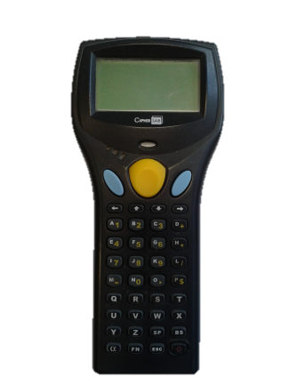


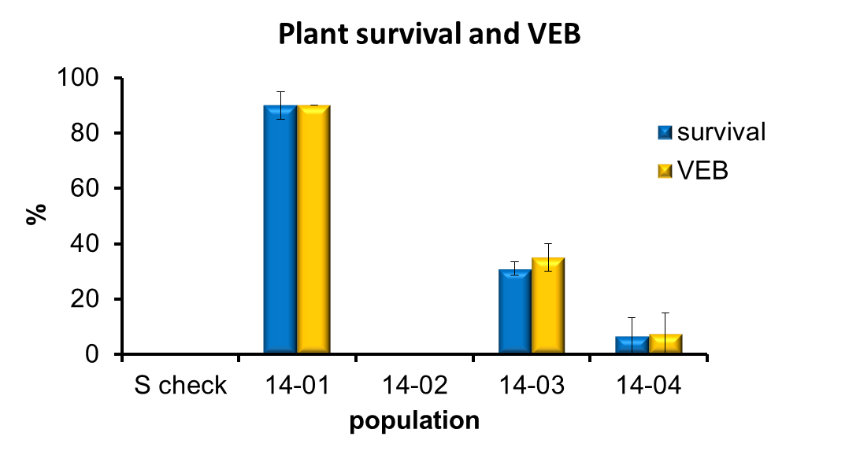
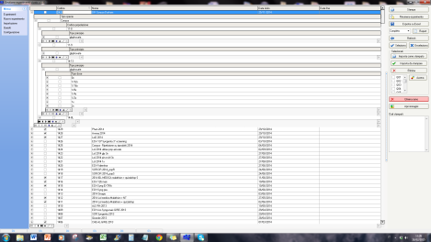
P5
-Data collection:
LOL_SS
14-01
pinoxad
1x
1
R1-1
0073959

