Slide 1
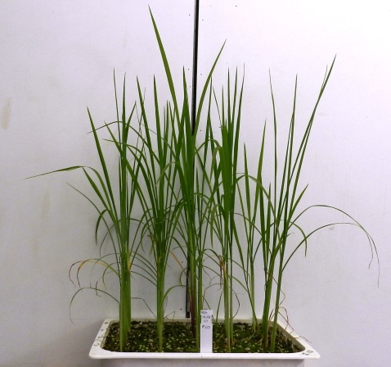
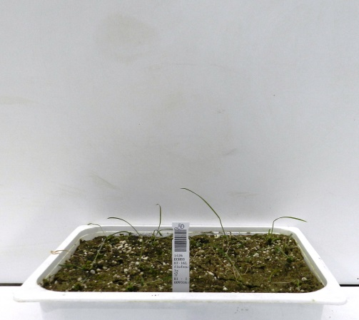
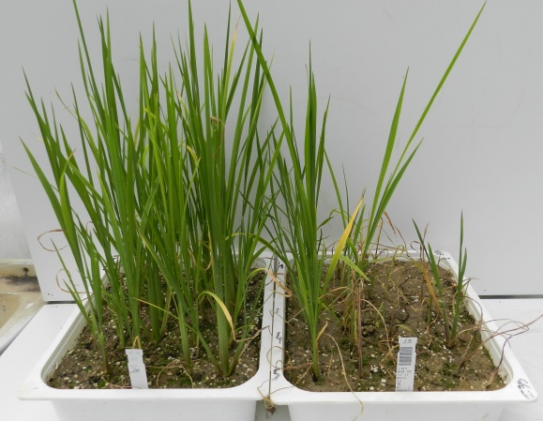
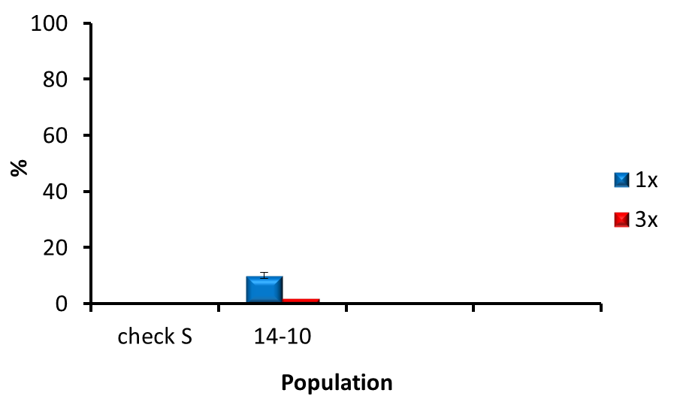
Pop. 14-10
SR
Check S
Before
After
NT
1x
Plants of Echinochloa spp. treated with penoxsulam
PLANT SURVIVAL
SR

Slide 2
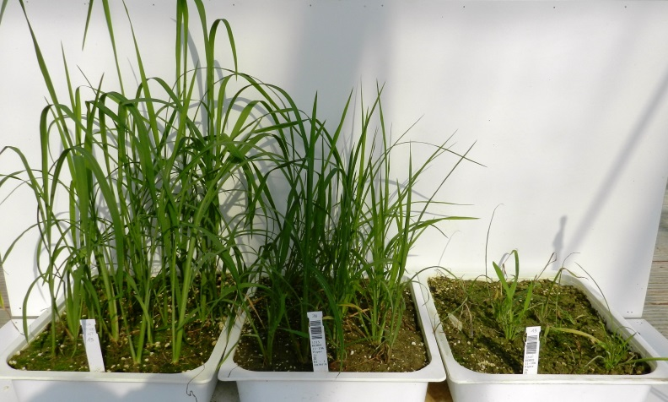
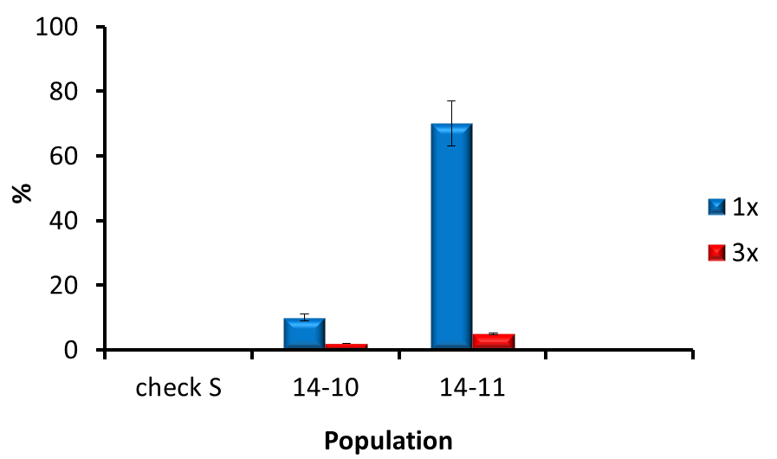
Pop. 14-10
SR
Check S
Before
After
NT
1x
Pop. 14-11
R
Echinochloa spp. plants treated with penoxsulam
PLANT SURVIVAL
R
NT
1x
3x
SR

Slide 3
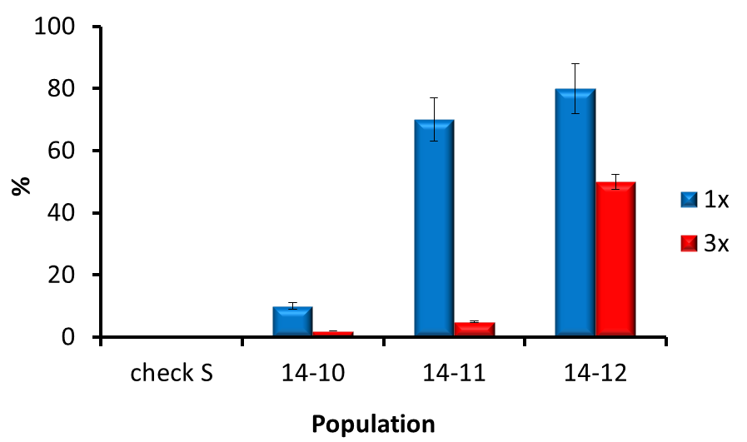
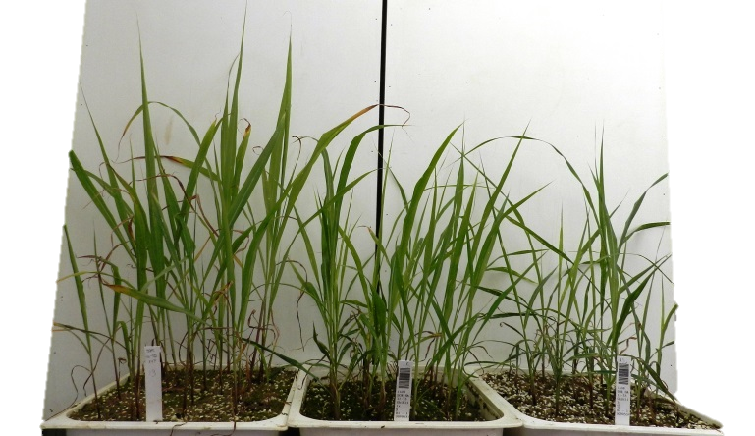
Pop. 14-10
SR
Check S
Before
After
NT
1x
Pop. 14-11
R
Echinochloa spp. plants treated with penoxsulam
PLANT SURVIVAL
RR
R
NT
1x
3x
SR
Pop. 14-12
RR
NT
1x
3x

Slide 4
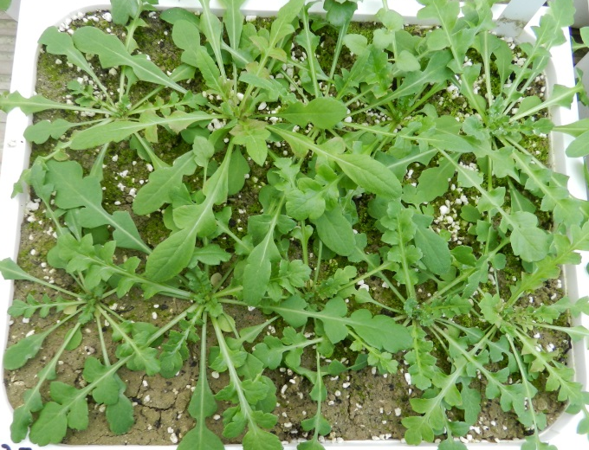
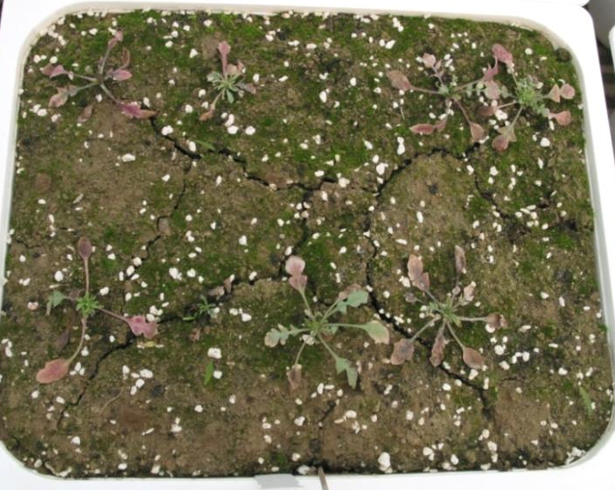
Plants of Papaver rhoeas treated with tribenuron-methyl
VISUALLY ESTIMATED BIOMASS
NT
VEB = 10
No plant survived
VEB = 0

Slide 5
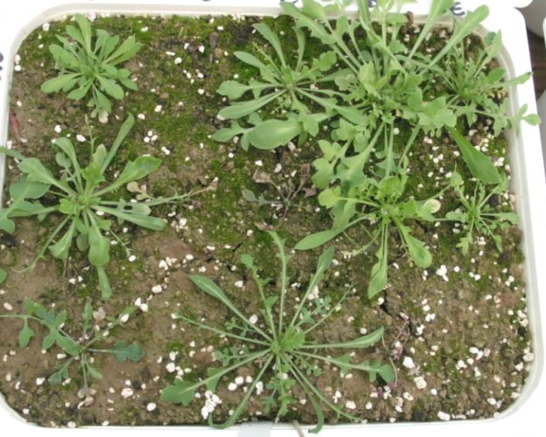
Plants of Papaver rhoeas treated with tribenuron-methyl
VISUALLY ESTIMATED BIOMASS
NT
VEB = 10
No plant survived
VEB = 0
Plants affected by tribenuron-methyl
VEB = 5

Slide 6
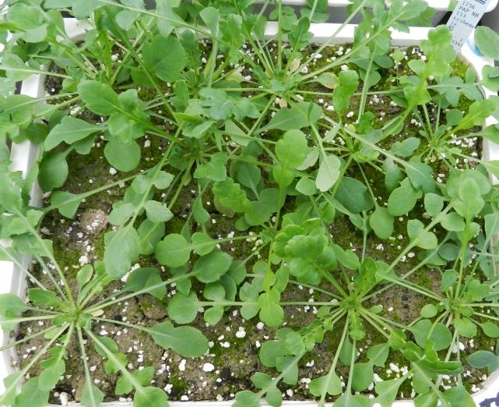
Plants of Papaver rhoeas treated with tribenuron-methyl
VISUALLY ESTIMATED BIOMASS
NT
VEB = 10
No plant survived
VEB = 0
Plants affected by tribenuron-methyl
VEB = 5
No plants affected by tribenuron-methyl
VEB = 10

