Slide 1
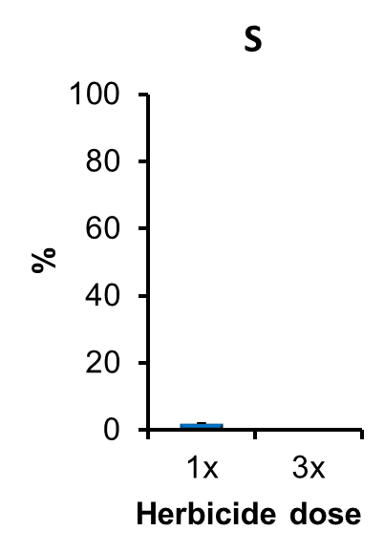
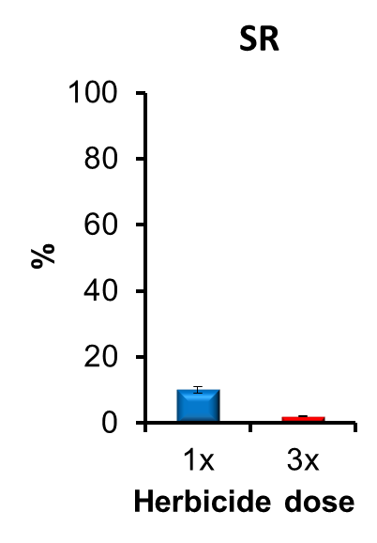
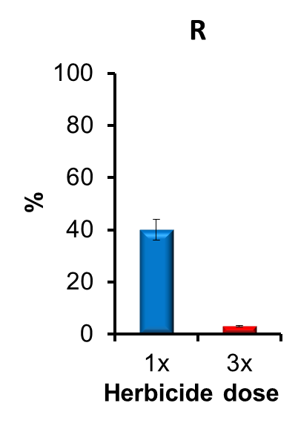
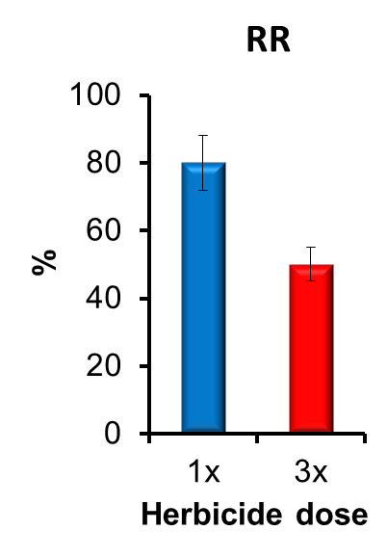
S
SR
Plant Survival (%)
Category | Herbicide dose
 | 1x | 3x
S | < 5 | -
SR | 5-20 | -
R | > 20 | -
RR | > 20 | > 10
R
RR

