Slide 1
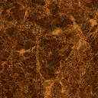
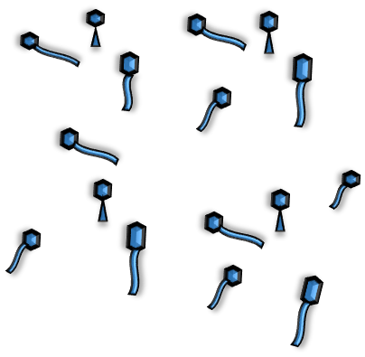
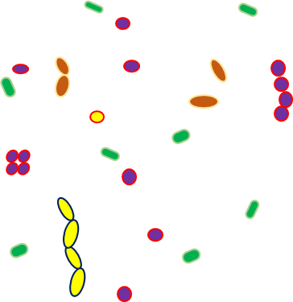
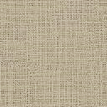
Collect 1-2 kg soil
Soil extract
c
P1
0.22 μm filter
Soil extract
LB + Soil extract
c
c
c

Slide 2
P2
P3

Slide 3

P4
P5
3
2
4
1

