Slide 1


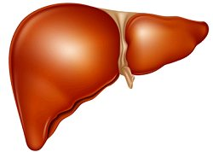

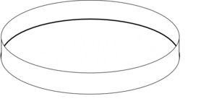
Anaesthetise mouse
Isolate and flush blood from liver and
perfuse with fixative in situ
Remove hardened, fixed liver and cut
into small cubes with a sharp scalpel

Slide 2
Secondary fixation is carried out using
Osmium tetroxide and then tissue is dehydrated
in an ethanol gradient, followed by hexamethyldisilazane
Liver pieces are mounted on metal stubs for Scanning
Electron Microscopy, coated using a Sputter Coater and imaged on the
microscope
Images are then ready to be analysed in Image J.

