Slide 1
Vision Training

Slide 2
Functional peripheral vision
Notes:
Functional Peripheral Vision is the concept where visual information from peripheral visual fields is able to be perceived and processed by the visual system. Improving the processing of visual in formation from the periphery is often encouraged by coaches by advising “use your peripheral vision” but without a method to improve that performance. This is a component of the training we are instructing here.

Slide 3
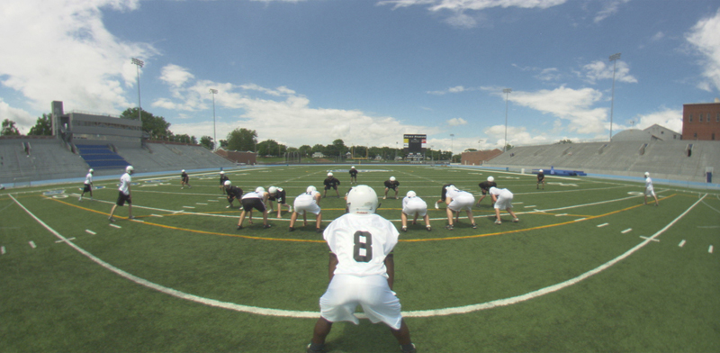
Notes:
This picture represents a sensory image on a football field.

Slide 4
Notes:
This image represents how improved peripheral vision provides more information to the brain.

Slide 5
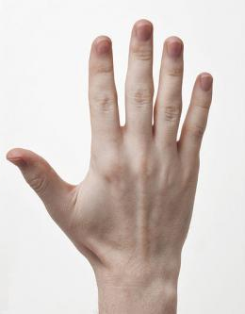
Reaction time (Animation sequence – middle white light turns red then hand swipes over top of it)
Notes:
In this figure we see a representation of how a person keeps their hand to the right and waits for a button to light up. One of the lights to the left will light up and the person is to hit the light as quickly as possible.

Slide 6
Notes:
In this image the button is lit up.

Slide 7
Notes:
As soon as the light is lit the person hits the button.

Slide 8
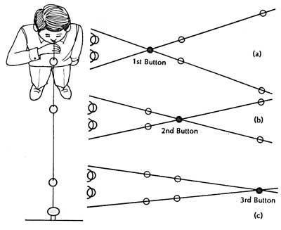
Focus training
Notes:
In this image a subject is lined up in front of the Brock string. He is looking at each ball in turn back and forth to train the eyes to converge and accommodate on objects.

Slide 9
Notes:
When performing the Brock string task the point of view of the subject, on the left, is focusing on the first bead and sees one bead. However when the person is not suppressing their visual systems they see two strings that cross at the bead.

Slide 10
Notes:
As the subject changes the bead they are looking at they see one bead and the strings cross at that point.

Slide 11
Notes:
As the subject moves on to the final bead the string appears to cross at that final bead.

Slide 12
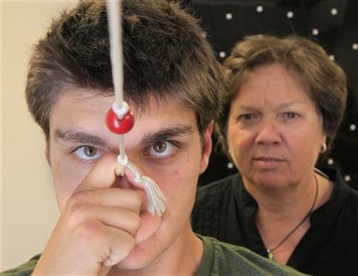
Notes:
In this picture a subject is looking at the first bead.

Slide 13
Saccadic Eye Movement training

Slide 14
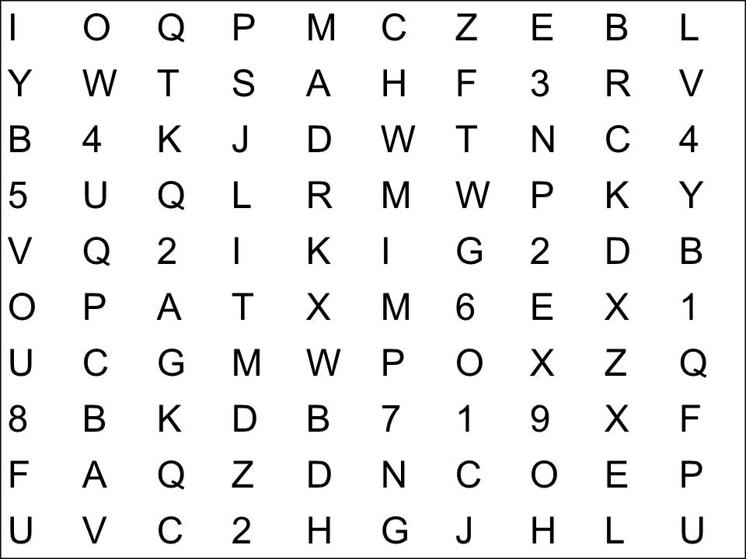
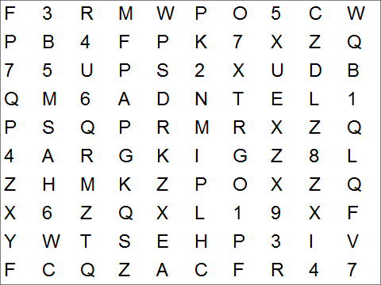
Notes:
To do saccadic eye movement training a pair of alphanumeric grids as represented above are placed about xxx feet apart and the subject stands about xxx feet from the grids. The subject reads back and forth the alphanumeric.

Slide 15
Notes:
Keeping the head still the eyes track left and right (or up and down) reading the alphanumeric.

Slide 16
Notes:
The subject is advised to read left and right as well as going DOWN the coluns.

Slide 19

perception
Notes:
Depth perception is a complicated process involving convergence of the eyes, size estimation and paralaxis. The eye convergence component of depth perception, including stereopsis, is improved with ocular motor training such as saccades and brock string.

Slide 20
