Slide 1
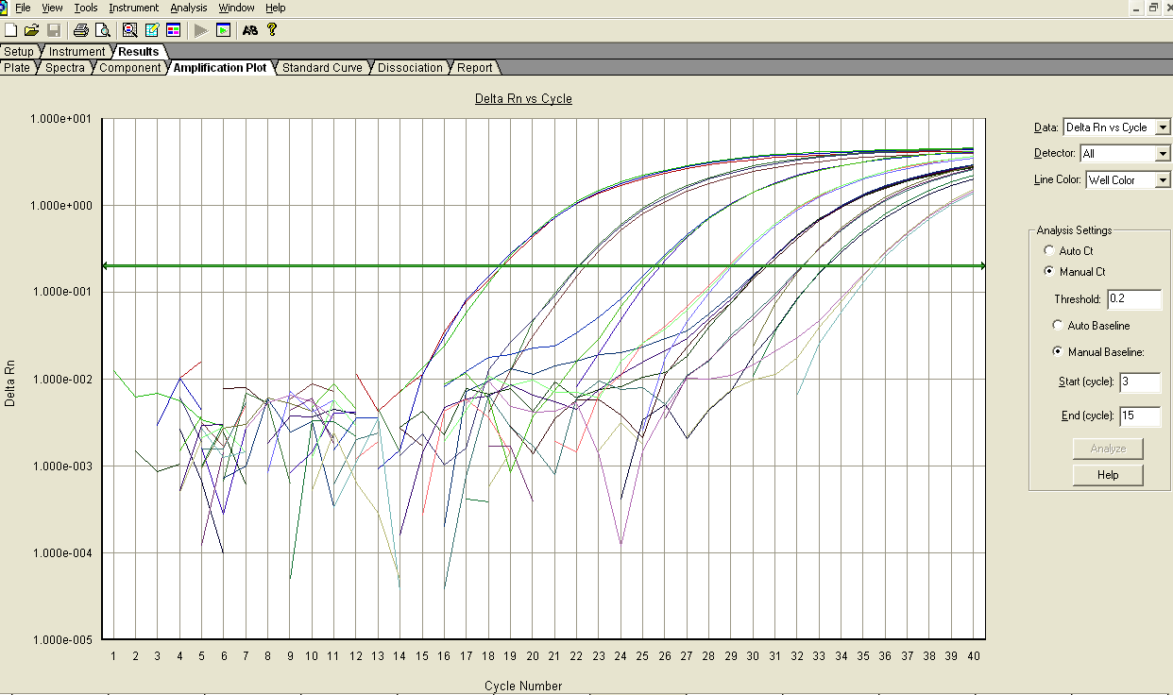
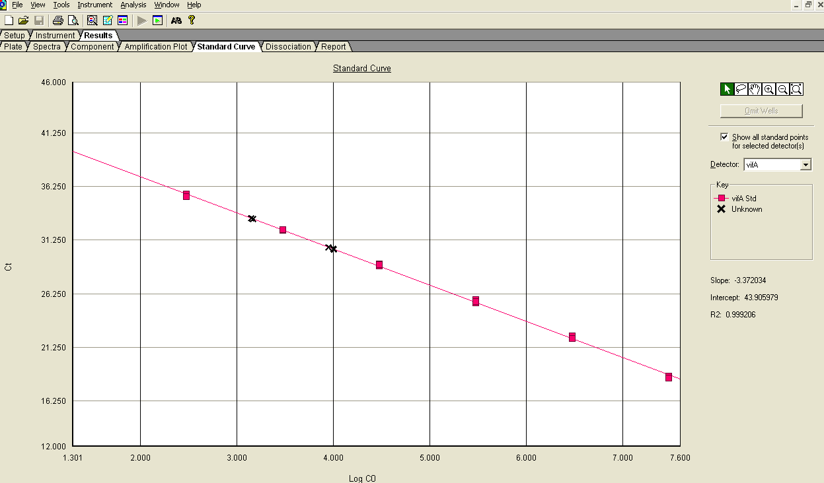
Ct | Quantity
18.5634 | 3.00E+06
18.5326 | 3.00E+06
18.3835 | 3.00E+06
22.3182 | 3.00E+05
22.0515 | 3.00E+05
22.0942 | 3.00E+05
25.4196 | 3.00E+04
25.7253 | 3.00E+04
25.5332 | 3.00E+04
29.0401 | 3.00E+03
28.8359 | 3.00E+03
28.9395 | 3.00E+03
32.1749 | 3.00E+02
32.2038 | 3.00E+02
32.204 | 3.00E+02
35.5478 | 3.00E+01
35.3197 | 3.00E+01
35.3259 | 3.00E+01
30.5804 | 8.95E+02
30.4112 | 1.00E+03
33.2805 | 1.42E+02
30.3912 | 1.02E+03
30.4024 | 1.01E+03
33.2136 | 1.48E+02
3,000,000
3,000
30
30,000
300,000
300
Threshold
sample
standard
30
300
3,000
30,000
sample
300,000
3,000,000
sample

